Slide 1
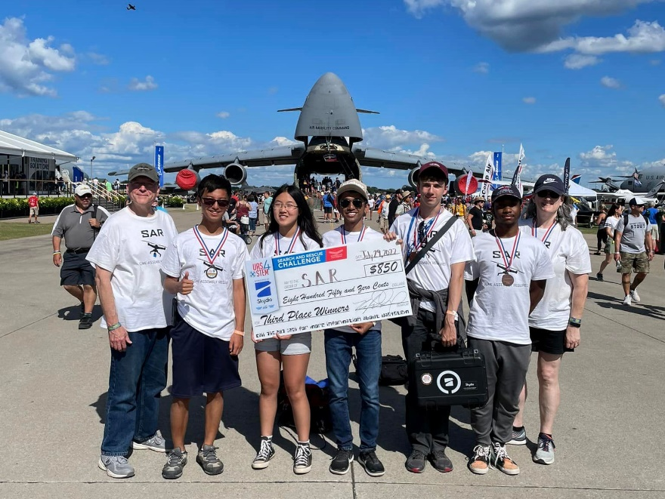
Engineering Exploring Program
Explorer Post 1010
Rockville Maryland
Bob Ekman, Advisor
September 2023

Slide 2
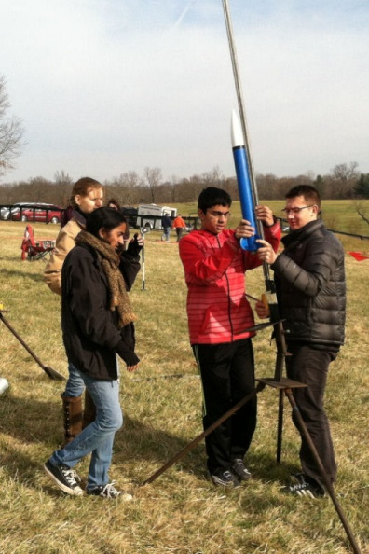
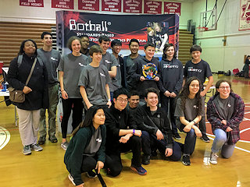
Who We Are
Enthusiastic students from local high schools, interested in engineering
Sponsored by the Rockville Science Center
Organized under national
Exploring Program,
Learning for Life,
Boy Scouts of America Affiliate

Slide 3
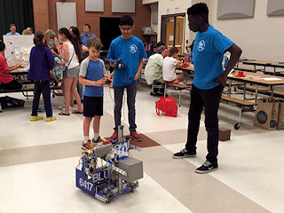
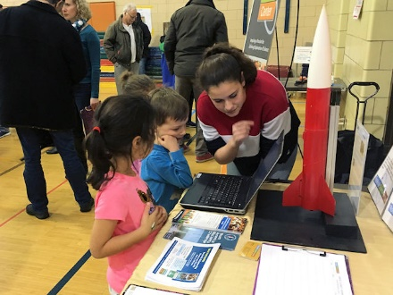
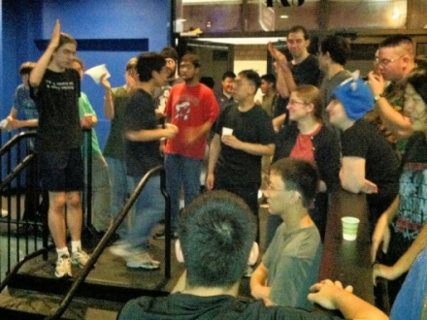
What We Do (Help Discover Your Future)
Compete in international robotics,
rocketry and drone programs
Everyone on a team
Teen leadership responsibilities
Local field trips and presentations
Community service opportunities
Adult support
And we have a lot of fun!

Slide 4
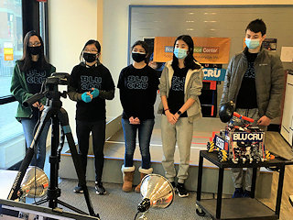
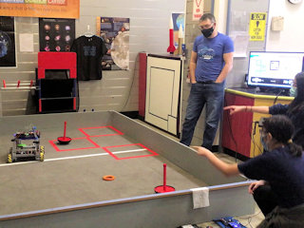
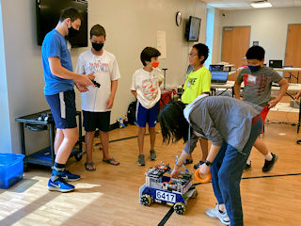
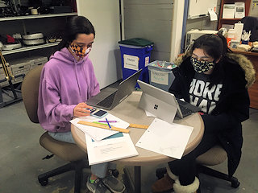
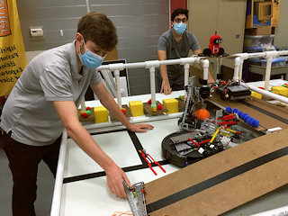
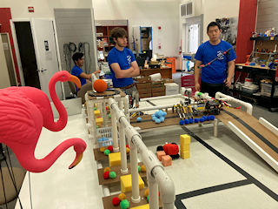
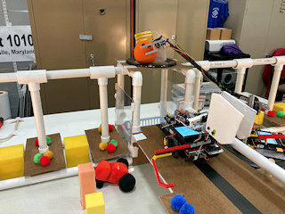
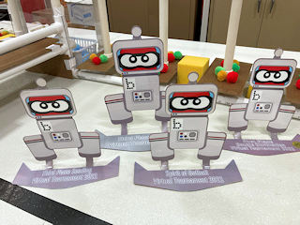
We Kick Bots!
FIRST Tech Challenge (Blu Cru)
  Eleven years participation
  Awards in local, regional, world events
  New challenge for 2023/24
Botball Educational Robotics
  Twenty-Two years participation
  Compete in DC region tournaments, participate in global conference
  Regional and global awards over many years

Slide 5
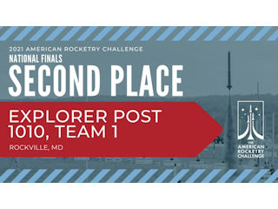
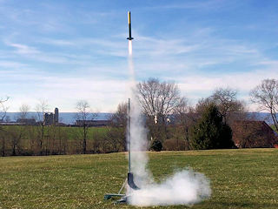
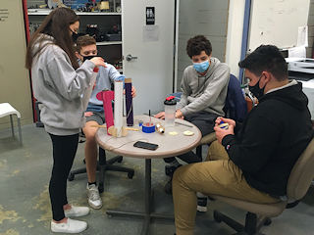
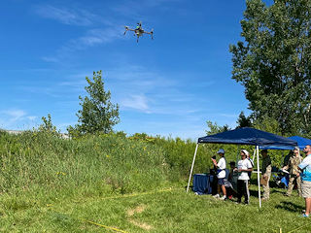
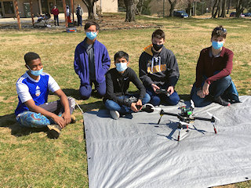
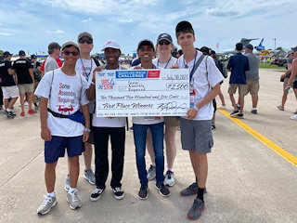
We Fly Them High!
The American Rocketry Challenge
  Design/build model rockets to meet a specific
  altitude, duration, design, and recovery
  NASA Student Launch Inititive
  Launch in MD and VA
  19th Place Nationally in 2023
Uncrewed Aircraft Systems (UAS4STEM)
  Build and fly a quadcopter to complete a detailed mission
  Regional leader
  2nd Place Nationally
  in 2023

Slide 6

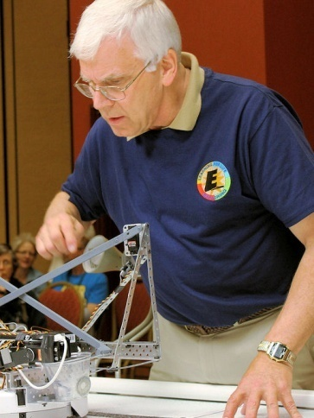
Operations
Membership 2022
  40 high school girls and boys
  From many different schools
  90% graduate to science/engineering
  higher education degree programs
Meetings
  Weekday, 7pm – 9pm
  Varied in-person work sessions
  Saturday/Sunday launches, competitions
  Annual picnic, teamwork events
  Exhibits, school visits, SSL opportunities
  Local tours, summer overnight trips

Slide 7

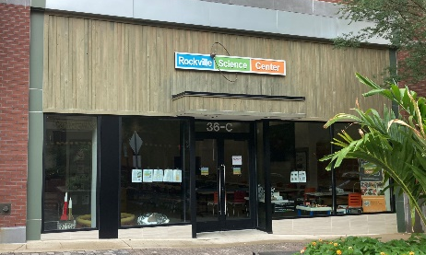
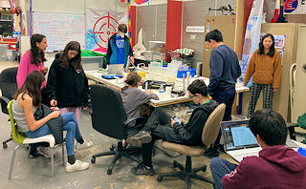
Rockville Science Center Sponsorship
Explorer Post 1010 in 26th year
  Seventeen years at Lockheed Martin
  Five years at Johns Hopkins
Rockville Science Center Support
  Volunteers, mentors, resources, outreach
  Storefront at Rockville Town Square
Rockville Makerspace
  Facility use, safe and secure location
Funding
  Dues ($300 annual)
  Grants, contributions
  Fund raising

Slide 8


Exploring (Learning for Life)
National organization
  Strives to be the foremost co-educational youth program for character and career development
  http://www.learning-for-life.org/
Exploring is work site career program
  Provides high school teens with environment, resources, and relationships they need to learn and grow
  Aviation, Business, Communications, Engineering, Fire Service, Health, Law Enforcement, Law & Government, Science
  20 Posts in DC area council, 600 students

Slide 9
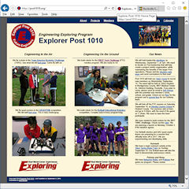
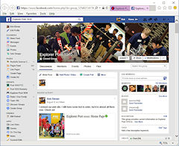
Contact
Advisor: Bob Ekman
  Rockville Science Center
  RSC Storefront/Makerspace
  36C and 33F Maryland Ave, Rockville, MD 20850
  301-512-1278 (mobile)
  info@post1010.org
  bob.ekman@att.net
Web Page: www.post1010.org
Facebook: Explorer Post 1010
Google Calendar: http://www.post1010.org/calendar.html

