Slide 1
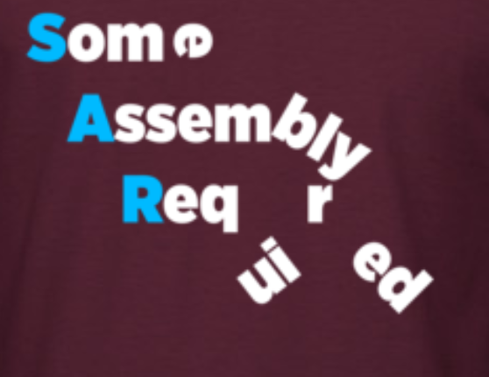
Team XXX
Some Assembly Required
Explorer Post 1010
Flight Readiness Review Briefing
Notes:
Visesh - introduce team (not individuals)

Slide 2
Team XXX
Some Assembly Required
Explorer Post 1010
Flight Readiness Review Briefing
Notes:
Visesh - introduce team (not individuals)

Slide 3
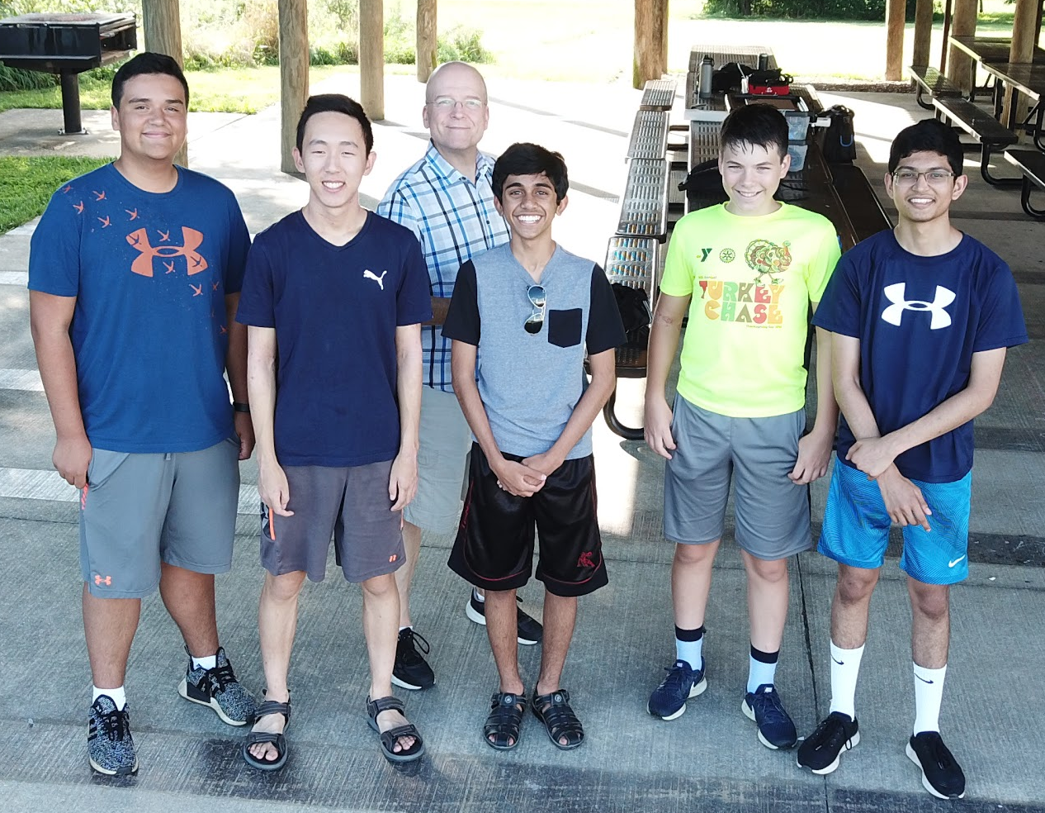
Introductions and Flight Mission Roles
Visesh | Primary Pilot in Command
Nick | Mission Planner Specialist / Alternate Pilot
Gunvir | Scoring Captain
Lucas | Aircraft Specialist / Safety Specialist
Timothy | Strategic Technician
Notes:
4.4.6.2.1: Team member introductions including flight mission roles and experience (10%)
Speaker notes : we communicate with each other to make sure
We present our own roles, what experience
Everyone participates here
Nick: Hi, I’m Nick Azarm, and I’m the Mission Planner Specialist. I am new to drones, but I’ve already flown a Phantom II, I have practiced using Mission Planner, and participated in the team meetings where we worked on Quadzilla and practiced flying missions.

Slide 4
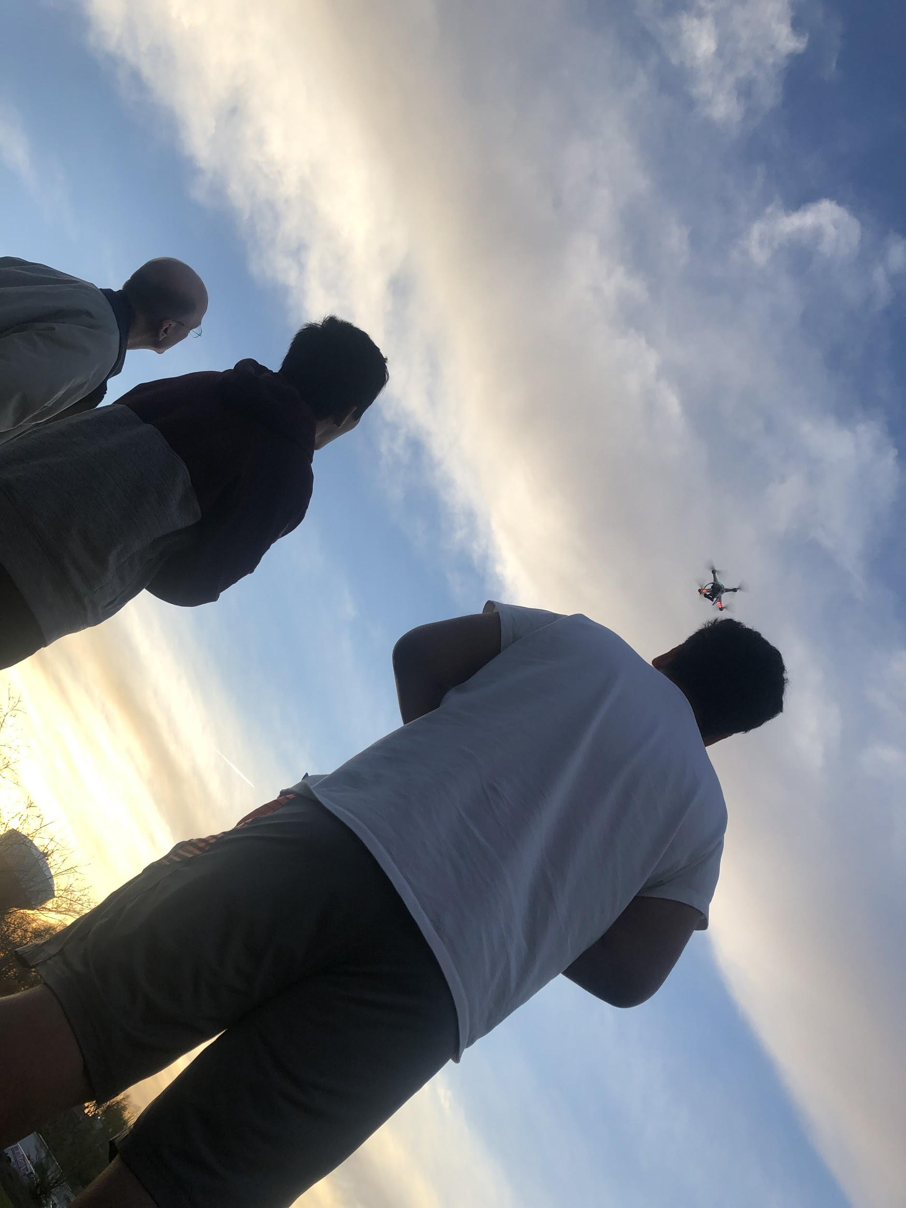
Introductions and Flight Mission Roles
Visesh | Primary Pilot in Command
Nick | Mission Planner Specialist /Alternate Pilot
Gunvir | Scoring Captain
Lucas | Aircraft Specialist /Safety Specialist
Timothy | Strategic Technician
Notes:
4.4.6.2.1: Team member introductions including flight mission roles and experience (10%)
Speaker notes : we communicate with each other to make sure
We present our own roles, what experience
Everyone participates here
Nick: Hi, I’m Nick Azarm, and I’m the Mission Planner Specialist. I am new to drones, but I’ve already flown a Phantom II, I have practiced using Mission Planner, and participated in the team meetings where we worked on Quadzilla and practiced flying missions.

Slide 5
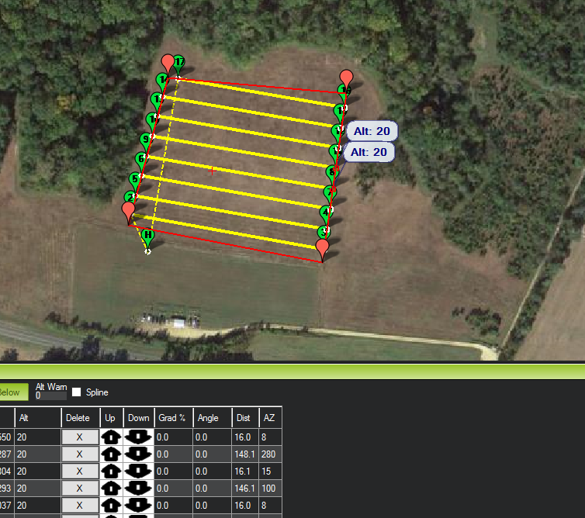
System Overview - Flight Method Strategy and Tasks
Fly autonomous objectives
Manually search for scoring items
Autonomously fly to scoring items
  Record coordinates
  Drop balloons
  Land
Autonomous takeoff and landing
Notes:
4.4.6.2.2 A brief system overview relating to flight tasks planned, expected performance, and any risk evaluation (10%)

Slide 6
System Overview - Flight Method Strategy
We considered two methods of flying and scoring points:
Fly autonomously, then manually search for scoring items (targets, debris, etc.)
Fly autonomously for found scoring items (while carrying balloons), locate accurate coordinates and drop balloons, then land to perform autonomous takeoff and landing
Notes:
4.4.6.2.2 A brief system overview relating to flight tasks planned, expected performance, and any risk evaluation (10%)

Slide 7
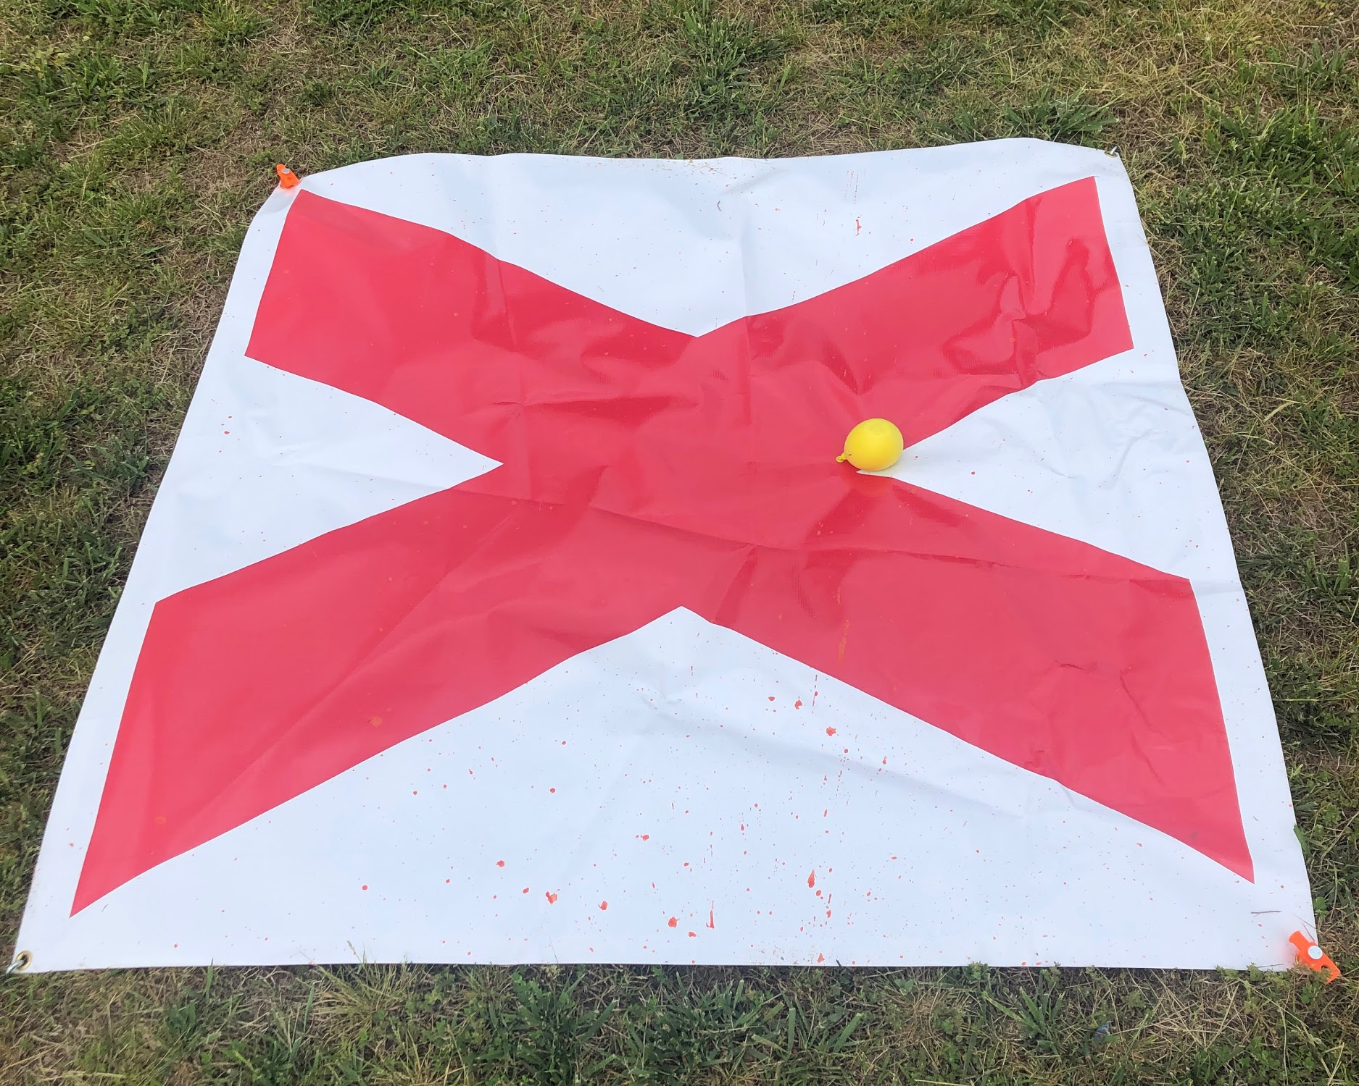
System Overview - Expected Performance
3 packages (balloons) on-target
All 16 waypoints captured
At least 6 of 8 SAR targets located and classified
Mission completed within
25-28 minutes flight time
Autonomous takeoff and landing
Notes:
4.4.6.2.2 A brief system overview relating to flight tasks planned, expected performance, and any risk evaluation (10%)
Visesh- don’t say word for word what’s on the slides
Describe flight tasks in a more fluid and descriptive way

Slide 8
Flight Tasks
Expected Performance
System Overview - Expected Performance
Execute autonomous tasks first, mapping any targets seen on the way
Use map to guide our pilot to the approximate locations of the targets to obtain precise GPS coordinates
Use coordinates to drop balloons on designated targets using autonomous mission
All 5 SAR targets located and classified
All 10 waypoints captured
Mission completed within 25-28 minutes flight time
Autonomous takeoff and landing
At least one package (balloon) delivered successfully
Notes:
4.4.6.2.2 A brief system overview relating to flight tasks planned, expected performance, and any risk evaluation (10%)
Visesh- don’t say word for word what’s on the slides
Describe flight tasks in a more fluid and descriptive way

Slide 9
System Overview - Risk Evaluation
Decision | Risk | Reward
Autonomous search | GPS malfunctions, unable to pause/resume mission to write down coordinates | Consistent/reliable searching for scoring objects
Manual search | Loss of orientation, inconsistent altitude, drift while recording coordinates | Able to recover from GPS issues, potentially faster speed
Notes:
4.4.6.2.2 A brief system overview relating to flight tasks planned, expected performance, and any risk evaluation (10%)
Visesh
Communication procedures this a requirement
Emphasize how mission planner plays key role in the the communication of our team. The specialist relays to scoring specialist, and the specialist relays to pilot.

Slide 10
System Overview - Flight Method Risk Evaluation
Decision | Risk | Reward
Autonomous search pattern | GPS malfunctions, unable to pause/resume mission to write down coordinates | Consistent/reliable searching for scoring objects
Manual searching | Loss of orientation, inconsistent altitude, drift while recording coordinates | Able to recover from GPS issues, potentially faster speed
We decided to employ a hybrid approach: manually following a search pattern using loiter mode provides the benefits of both strategies - consistent search pattern with the ability to make manual adjustments as needed. This works by the Mission Planner specialist giving the Pilot heading directions to move the right stick, and when something is found, the Monitor Observer guides the pilot.
Notes:
4.4.6.2.2 A brief system overview relating to flight tasks planned, expected performance, and any risk evaluation (10%)
Visesh
Communication procedures this a requirement
Emphasize how mission planner plays key role in the the communication of our team. The specialist relays to scoring specialist, and the specialist relays to pilot.

Slide 11
System Overview - Mission Planner Usage
Monitor aircraft telemetry data
Program autonomous missions
Control Balloon Mechanism Servo
Safety dashboard (arm/disarm,
GPS status, flight mode)
Use flight log
  Diagnose Problems
  Assess aircraft performance
Notes:
4.4.6.2.2 A brief system overview relating to flight tasks planned, expected performance, and any risk evaluation (10%)
Nick ----go into more details about flight log analysis
Communication procedures
Emphasize how mission planner plays key role in the the communication of our team. The specialist relays to scoring specialist, and the specialist relays to pilot.

Slide 12
System Overview - Mission Planner Usage
Get telemetry data from the aircraft
Use the flight log to understand aircraft performance
  Diagnose Problems
  Compare Data
Program autonomous missions
Monitor relevant aircraft telemetry data
Use Mission Planner to Control Servo on Balloon
Mechanism (Camera Shutter approach)
Check for safety (arm/disarm, GPS lock,
GPS satellite count, flight mode check)
Notes:
4.4.6.2.2 A brief system overview relating to flight tasks planned, expected performance, and any risk evaluation (10%)
Nick ----go into more details about flight log analysis
Communication procedures
Emphasize how mission planner plays key role in the the communication of our team. The specialist relays to scoring specialist, and the specialist relays to pilot.
Nick’s notes:
Hi, my name is Nick and I am the Mission P{lanner Specialist. I am fairly new to drones, but I’ve already flown a Phantom 2, I have practiced in Mission Planner and participated in team meetings where we worked on Quadzilla and practiced flying missions.
Now we are going to transition to a System Overview starting with the Mission Planner. The purpose of the mission planner is to...

Slide 13
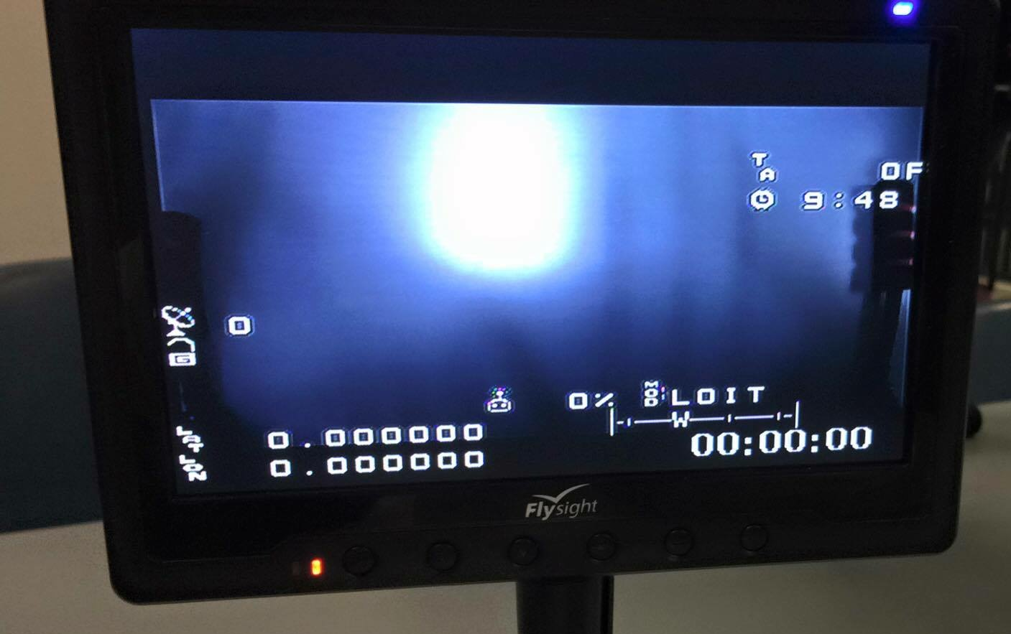
System Overview - Monitor Usage
Team decisions made based on:
Latitude/Longitude
Altitude
Battery Voltage
GPS Lock
GPS Satellite Count
Flight Mode
Notes:
4.4.6.2.2 A brief system overview relating to flight tasks planned, expected performance, and any risk evaluation (10%)
Not Nick?

Slide 14
System Overview - Monitor Usage
With our monitor we track the following:
Latitude/Longitude
Altitude
Battery Voltage
GPS Lock
GPS Count
Flight Mode
Most of our decisions pertaining to safety and scoring are made by our whole team using this information.
Notes:
4.4.6.2.2 A brief system overview relating to flight tasks planned, expected performance, and any risk evaluation (10%)
Not Nick?

Slide 15
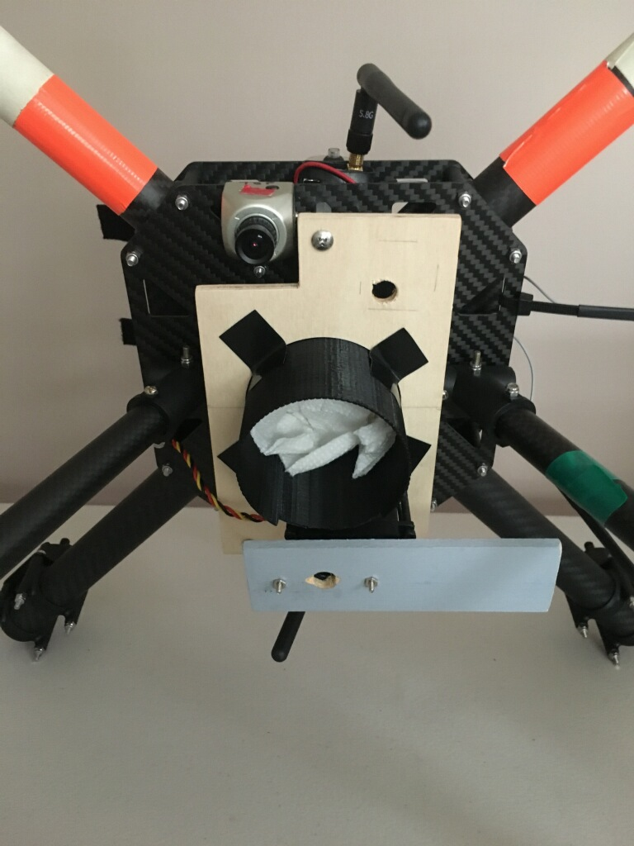
System Safety - Design Strategies
Single balloon drop system
Wood plate attached with 3 nylon standoffs
3D-printed cylinder to hold balloon
Balloon secured by wood plate on servo
“Camera Shutter” feature activates servo to release balloon
Notes:
4.4.6.2.3 System Safety with identified design and operational strategies (10%) - Lucas
Remember to mention that we initially had two balloon drop system

Slide 16
System Safety - Design Strategies
Our final design is a single balloon drop system
We used 3 nylon standoffs to firmly attach a wood plate to the aircraft
A 3D-printed cylinder holds the balloon in place
A single wood plate is on the servo, to secure the balloons until ready to be released
Activating the “Camera Shutter” feature toggles the servo releasing the balloon and recording the location of the drop in mission planner !
Notes:
4.4.6.2.3 System Safety with identified design and operational strategies (10%) - Lucas
Remember to mention that we initially had two balloon drop system

Slide 17

System Safety - Operational Strategies
ALL flights conducted:
With supervising adult
In visual line of sight
BELOW 400 feet and within FAA regulations
NO flights conducted:
Without performing pre-flight inspection
In bad weather or bad visibility
Over people or buildings
Notes:
4.4.6.2.3 System Safety with identified design and operational strategies (10%)
Lucas

Slide 18
System Safety - Operational Strategies
All flights conducted with supervising adult
All flights conducted in visual line of sight
All flights conducted BELOW 400 feet and
within FAA regulations
NO flights conducted without performing pre-flight inspection
NO flights conducted in bad weather or bad visibility
NO flights conducted over people or buildings
Notes:
4.4.6.2.3 System Safety with identified design and operational strategies (10%)
Lucas

Slide 19
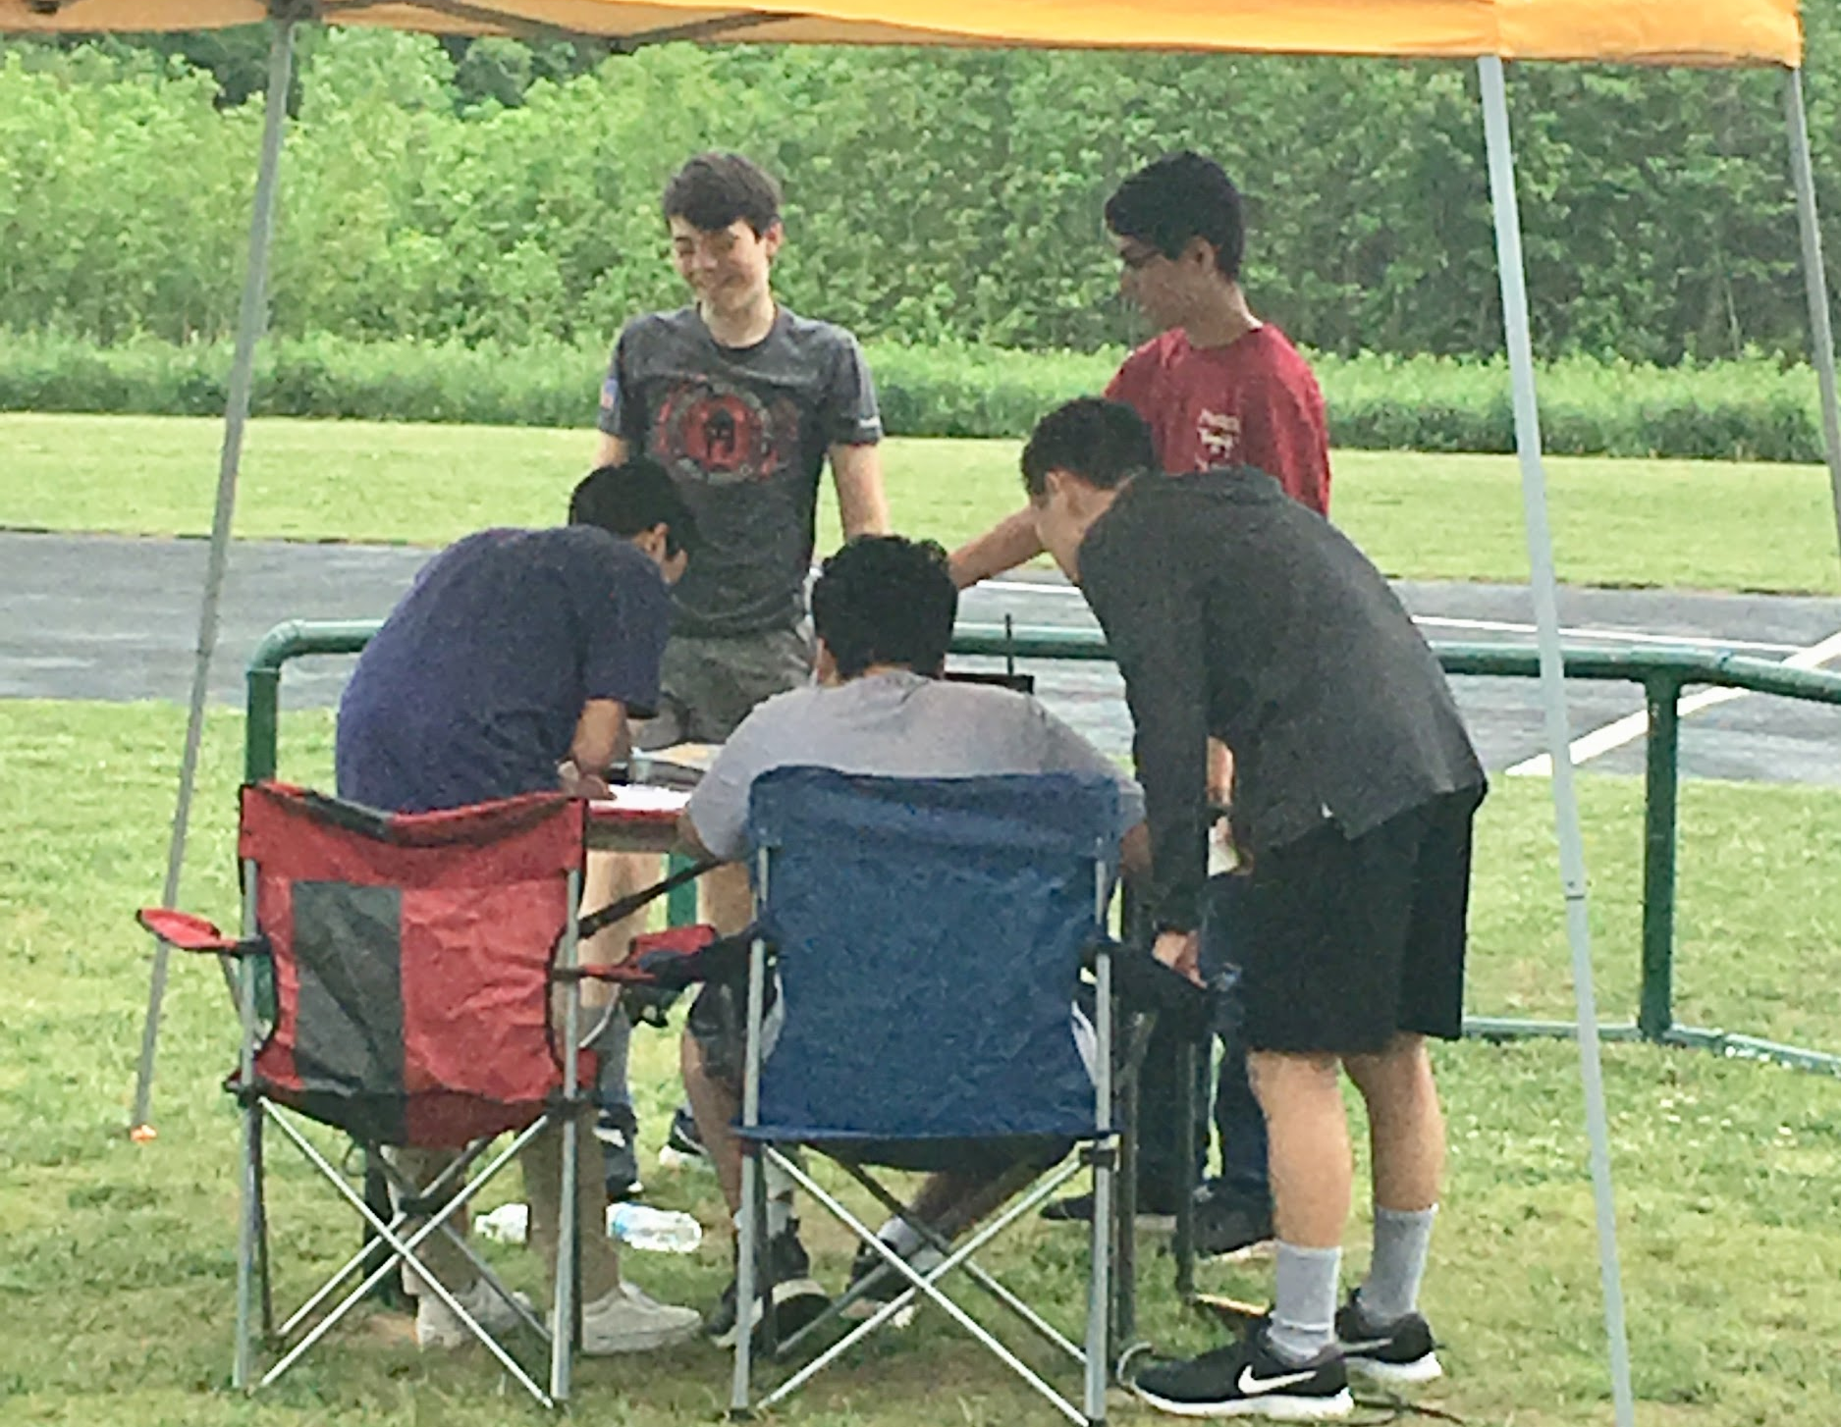
System Safety - Maintenance and Checklists
We use checklists to enforce safety
  Pre-flight
  Post-flight
We regularly inspect all aircraft parts
Repairs are made with consent from all team members
Notes:
4.4.6.2.3 System Safety with identified design and operational strategies (10%)
Lucas

Slide 20
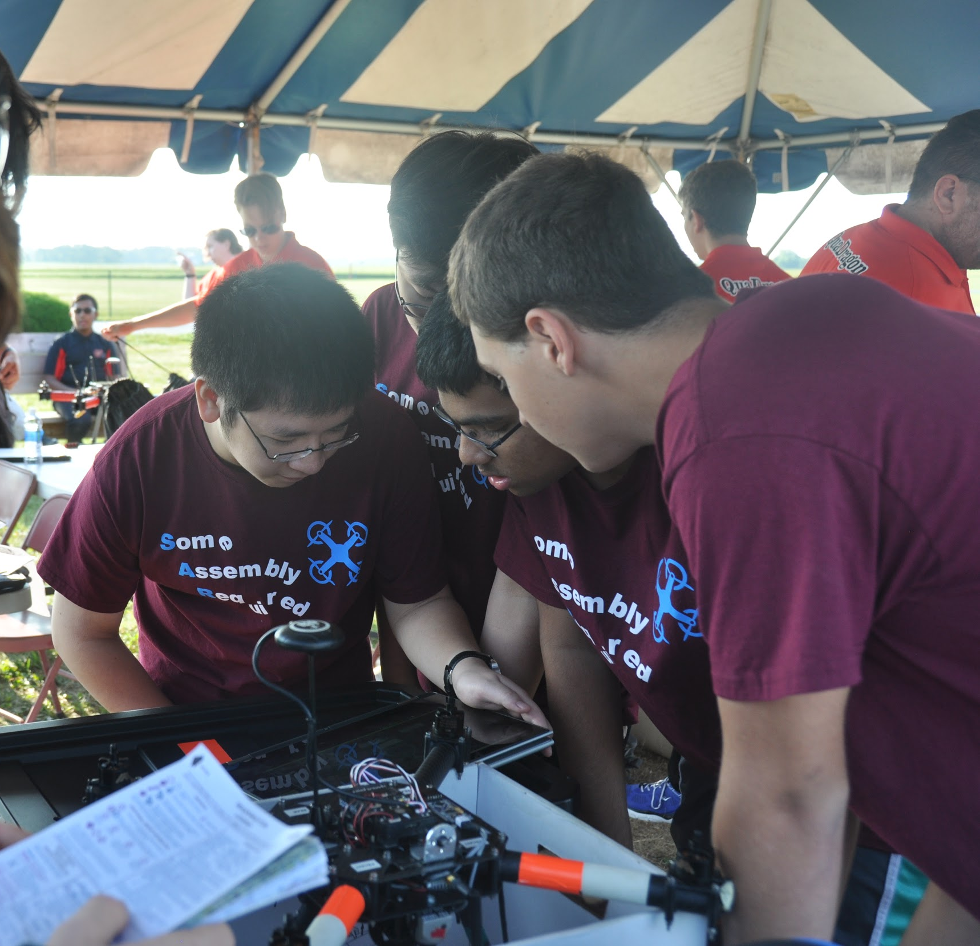
System Safety - Maintenance and Checklists
To enforce safety our team uses a series of checklists: pre- and post-flight.
Checklists ensure a safer, more successful flight.
All parts of our aircraft are regularly inspected.
All repairs are made with consent of all the members.
Notes:
4.4.6.2.3 System Safety with identified design and operational strategies (10%)
Lucas

Slide 21
Developmental Test - Ground and Mission Performance
Ground tests after aircraft modifications
Flight tests in open field at King Farm Park
Consistently performed well
  Finding scoring items (autonomous map method followed by manual search)
  Dropping balloons on target
  Completing autonomous objectives
Initial issue with landing upright
Notes:
4.4.6.2.4 Developmental Test Results including: test plan schedule (through ground testing to flight testing to mission performance testing), results of testing, and any corrective action taken to improve the effectiveness on mission (30%)]- Gunvir
Test plan schedule- include details like
WE Practiced two times a week leading up to the schedule, and focused on simulating a competition flight experience

Slide 22
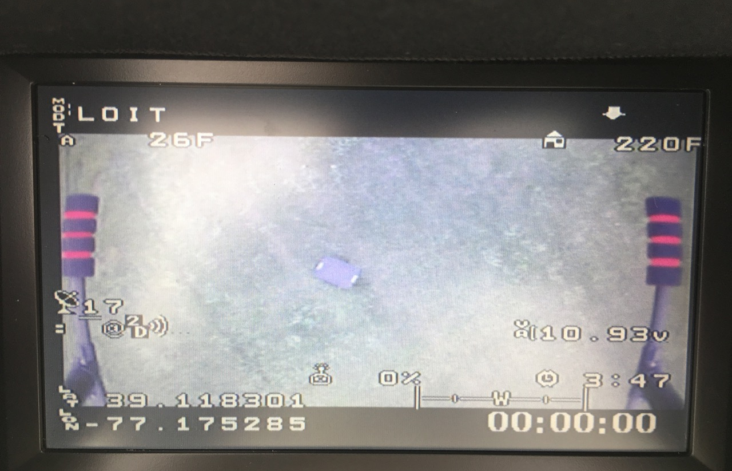
Developmental Test - Ground and Mission Performance
All of our tests were conducted at King Farm Park in an open field
Manual flight tests using our “hybrid” strategy and autonomous flight went well
We were consistently able to search for and locate search objectives and were also able to autonomously take off and land
We practiced using our “Map” method to locate the general locations of targets in autonomous mode prior to the search mode
Notes:
4.4.6.2.4 Developmental Test Results including: test plan schedule (through ground testing to flight testing to mission performance testing), results of testing, and any corrective action taken to improve the effectiveness on mission (30%)]- Gunvir
Test plan schedule- include details like
WE Practiced two times a week leading up to the schedule, and focused on simulating a competition flight experience

Slide 23
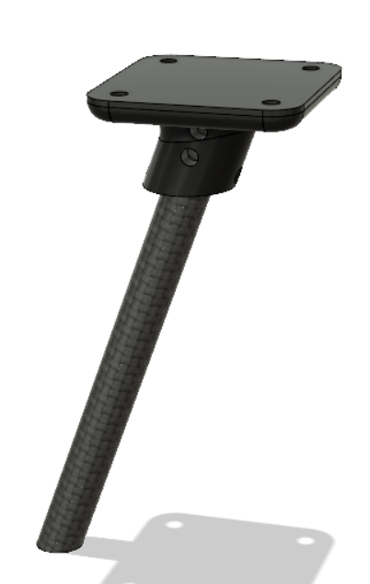
Developmental Test - System Enhancement (New Landing Gear)
Redesigned landing gear to achieve greater stability
  Cut down carbon fiber rods from stock
  landing gear
  Used 4 custom 3D-printed pieces to attach legs to aircraft
Performance
  100% upright landings!
Notes:
4.4.6.2.4 Developmental Test Results including: test plan schedule (through ground testing to flight testing to mission performance testing), results of testing, and any corrective action taken to improve the effectiveness on mission (30%)]- Gunvir

Slide 24
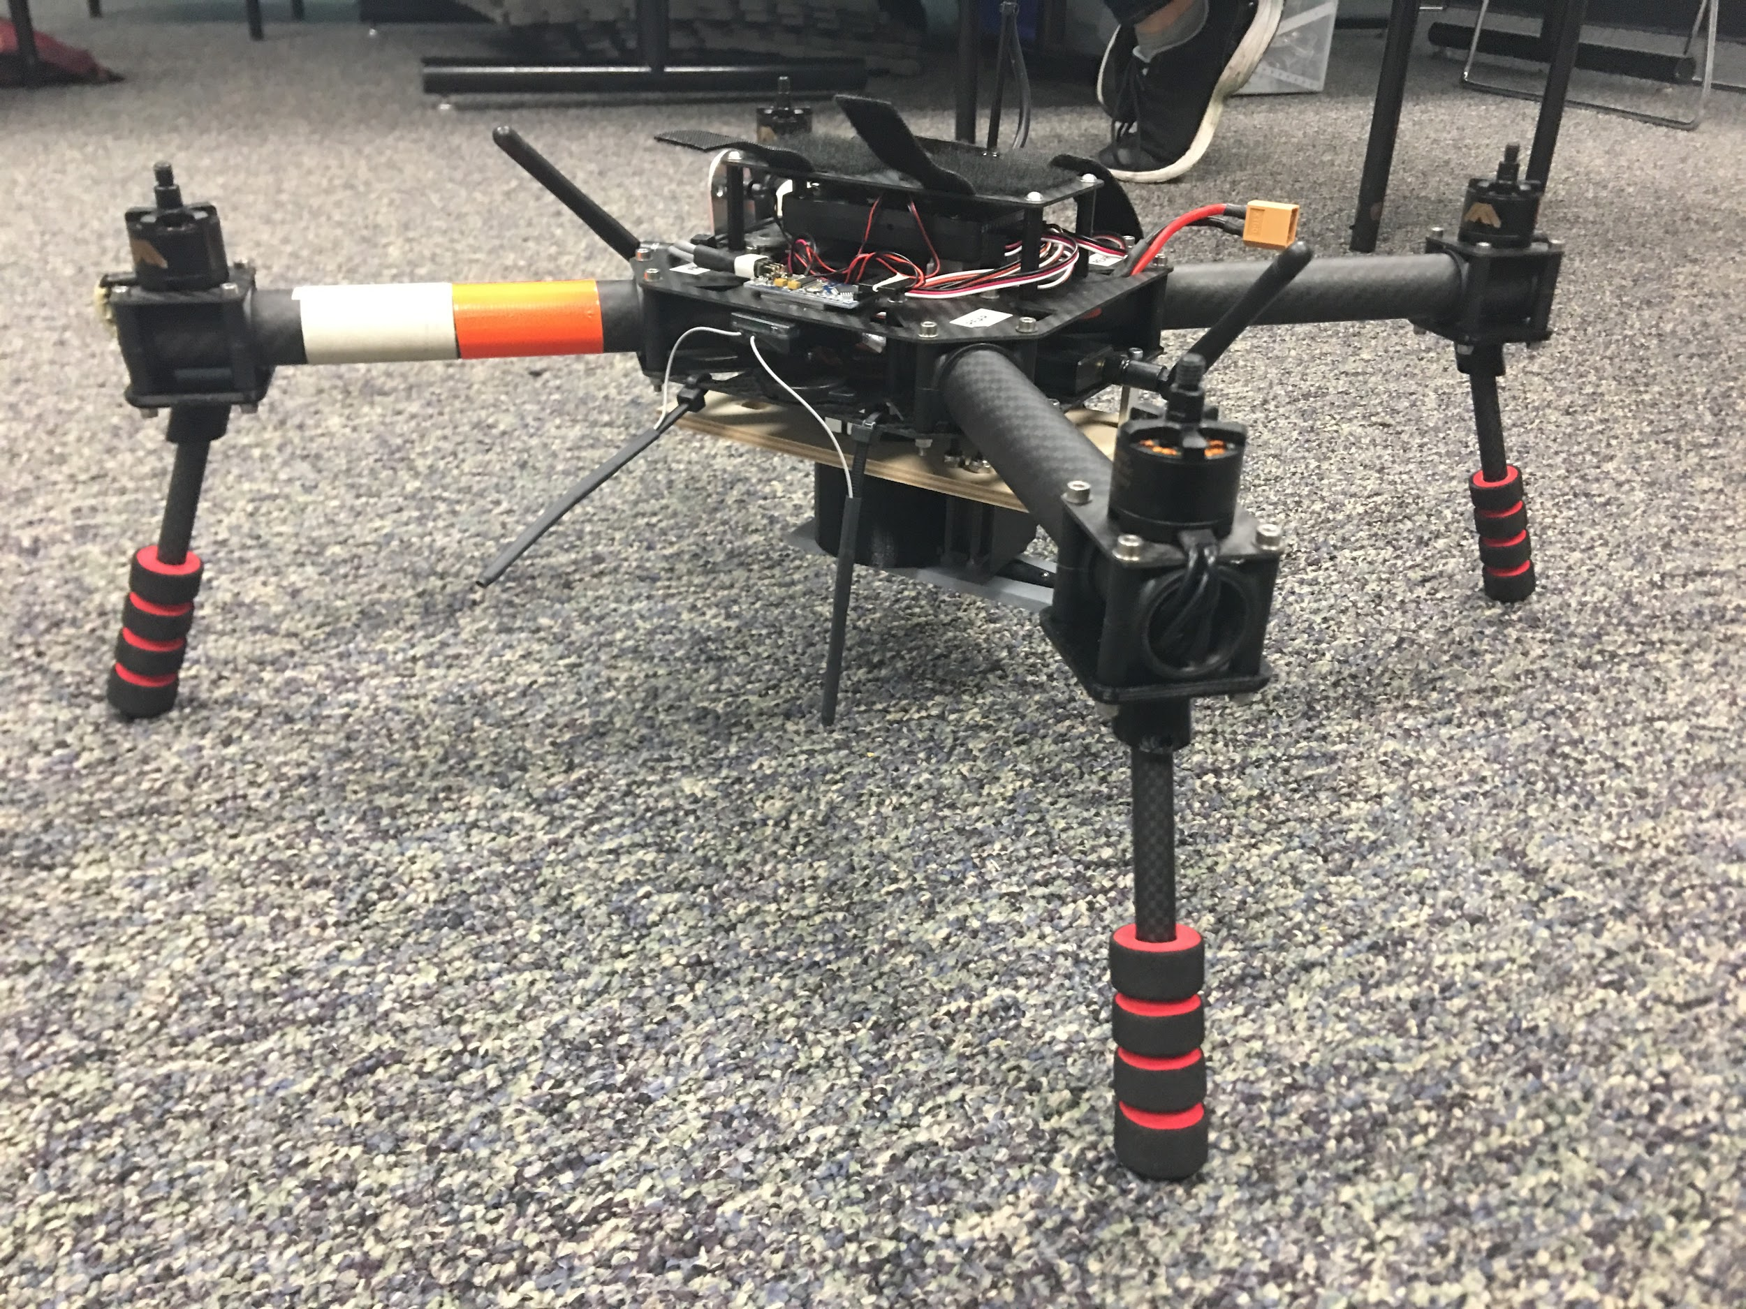
System Enhancement - New Landing Gear
The landing gear uses the same carbon fiber rods from the stock landing gear, but we cut them to achieve greater stability.
The interface between the legs and the aircraft are 4 custom 3D-printed pieces
Our new landing gear ensures that we land upright 100% of the time!
Notes:
4.4.6.2.4 Developmental Test Results including: test plan schedule (through ground testing to flight testing to mission performance testing), results of testing, and any corrective action taken to improve the effectiveness on mission (30%)]
Nick’s notes:
We custom-3d-printed a mount at an angle for the carbon fiber rods to go in. THis nesures that we land upright 100% of the time.

Slide 25
Other Corrective Actions to Improve Mission Effectiveness
Issue:
Double balloon drop system increased amp draw and decreased battery life
Motor Mounts Misaligned to Frame
Standing waves formed in balloons
Corrective action taken:
Switched to single balloon drop system
New motor arm design
Shortened Balloon Holder
Notes:
4.4.6.2.4 Developmental Test Results including: test plan schedule (through ground testing to flight testing to mission performance testing), results of testing, and any corrective action taken to improve the effectiveness on mission (30%)
Gunvir
e initially tested a double balloon drop system, but encountered issues with weight, and current draw which affected our battery life.
Only able to carry one balloon at a time
We also had problems with large amount of vibration, making the quad uncontrollable
Issues with decreased flight time per period
Issues With Standing Wave Formation in Water Balloons
Makes Quad unstable
Visesh----> verbally address solutions and what we did accomplish
These were the problems and this is how we fixed it slide
Results of testing
Corrective action

Slide 26
Corrective Actions Taken to Improve Effectiveness of Mission
Worked Well:
Single & Balloon Drop System
  Increased Flight Time and Improved Reliability
New motor arm design keeping motor mounts aligned
Shortened Balloon Holder
  provides more balloon compression and less room for balloon movement
In tests able to locate, identify, and drop balloons over targets autonomously
Didn’t Work:
Initial Double Balloon Drop System
  Increased Amp Draw and Decreased Battery Life
Motor Mounts Misaligned to Frame
  Increased Vibrations/Caused Failsafe
Standing Wave Formation in Balloons
  Made Quad Unmanageable in the Air
Notes:
4.4.6.2.4 Developmental Test Results including: test plan schedule (through ground testing to flight testing to mission performance testing), results of testing, and any corrective action taken to improve the effectiveness on mission (30%)
Gunvir
e initially tested a double balloon drop system, but encountered issues with weight, and current draw which affected our battery life.
Only able to carry one balloon at a time
We also had problems with large amount of vibration, making the quad uncontrollable
Issues with decreased flight time per period
Issues With Standing Wave Formation in Water Balloons
Makes Quad unstable
Visesh----> verbally address solutions and what we did accomplish
These were the problems and this is how we fixed it slide
Results of testing
Corrective action

Slide 27
Evidence of Mission Accomplishments
>20 successful flights
Accurately identified target objects
Balloons landed <10 ft from targets
Safety protocols effectively prevented unsafe deviations from planned mission (autonomous mode)
Problems solved through effective team communication
Notes:
4.4.6.2.5 Evidence of Mission Accomplishments (10%)- Timothy

Slide 28
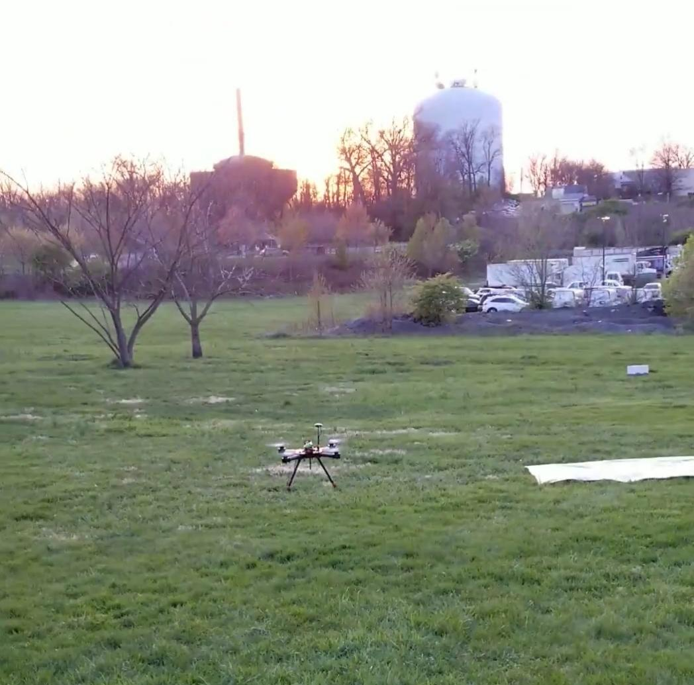
Evidence of Mission Accomplishments
More than 20 successful flights which included carrying balloons, autonomous missions, and use of hybrid method
Successful identification of target objects
Balloons landing less than 10 ft from desired targets
Safety protocols executed effectively to prevent unsafe deviations from the planned mission when in autonomous mode
Problems solved through effective team communication
Notes:
4.4.6.2.5 Evidence of Mission Accomplishments (10%)- Timothy

Slide 29
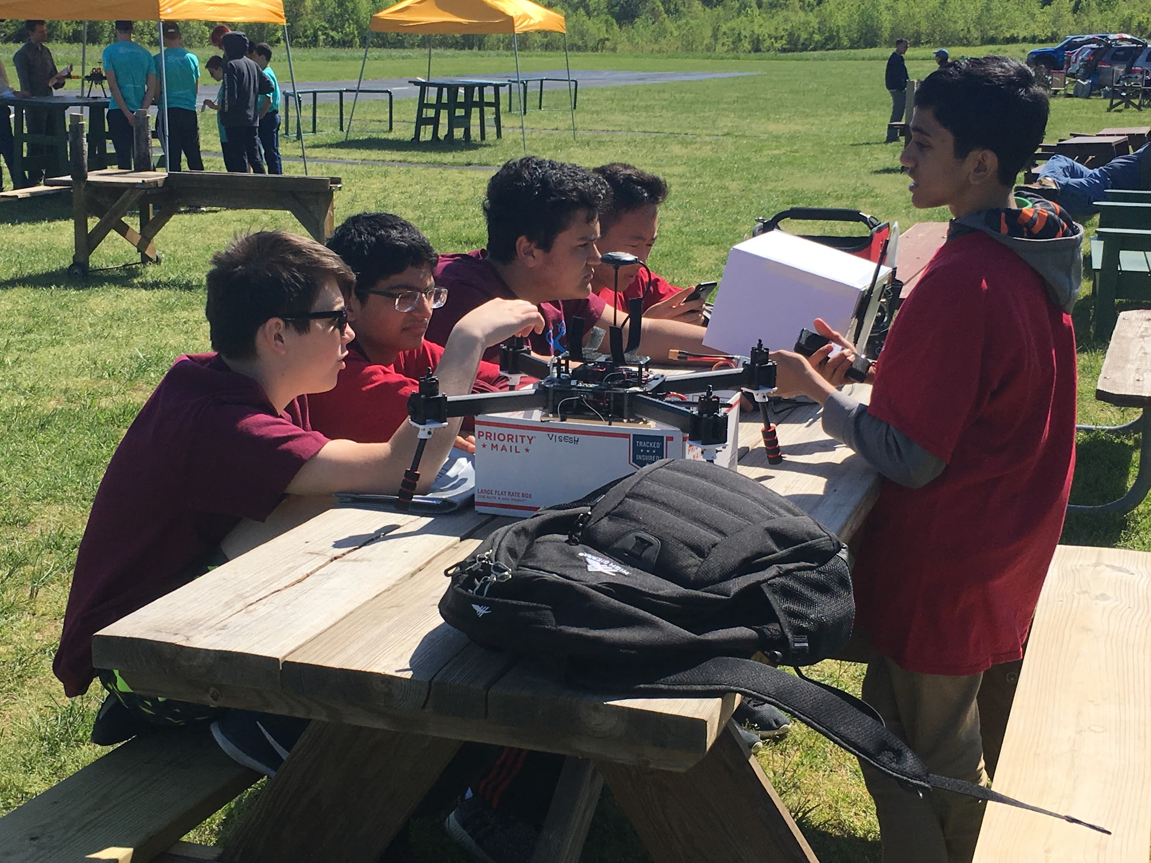
Pre-Mission Briefing - Personnel Resourcing & Communications
Visesh | Primary Pilot in Command
Nick | Mission Planner Specialist / Alternate Pilot
Gunvir | Scoring Captain
Lucas | Aircraft Specialist / Safety Specialist
Timothy | Strategic Technician
Notes:
4.4.6.2.6: Pre-Mission Briefing, including personnel resourcing for the flight, communication procedures... (20%) Timothy
Roles assigned based on skills and interests.
Communication important to be safe and effective.
Example of communication procedures (e.g., Nick calling out altitudes, etc.)
The process of searching for targets also an example, Timothy tells Nick which targets to direct visesh the pilot too, and sri shouts altitude and ragini tells visesh how to move once over the target

Slide 30
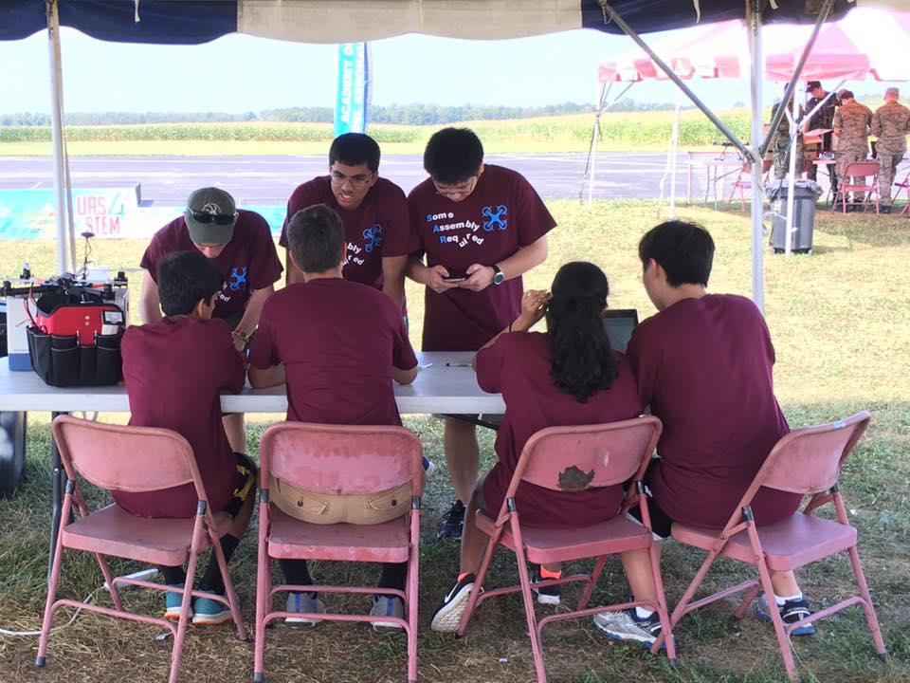
Pre-Mission Briefing - Personnel Resourcing & Communications
Visesh | Primary Pilot in Command
Nick | Mission Planner Specialist /Alternate Pilot
Gunvir | Scoring Captain
Lucas | Aircraft Specialist /Safety Specialist
Timothy | Strategic Technician
Notes:
4.4.6.2.6: Pre-Mission Briefing, including personnel resourcing for the flight, communication procedures... (20%) Timothy
Roles assigned based on skills and interests.
Communication important to be safe and effective.
Example of communication procedures (e.g., Nick calling out altitudes, etc.)
The process of searching for targets also an example, Timothy tells Nick which targets to direct visesh the pilot too, and sri shouts altitude and ragini tells visesh how to move once over the target

Slide 31
Pre-Mission Briefing - Go/No-Go Criteria and Fall Back Plans
Before Flight
Weather
Airspace Activity
Presence of people on field
Condition of Quad
During Flight
Aircraft stability / functionality
Wind Speed
Battery Condition
Airspace Activity
When one or more conditions is seen as a hazard we may:
Return to Land Immediately
Reschedule flight or travel to other fields
Make necessary plans to repair and inspect Quad thoroughly
Notes:
4.4.6.2.6: Pre-Mission Briefing, including… Go/No-Go criteria and fallback plans should a technical issue arise during flight mission (20%)
Lucas
Need to mention WHAT WE DO GIVEN THAT ONE OF THESE THINGS GOES WRONG IE FALL BACK PLANS

Slide 32
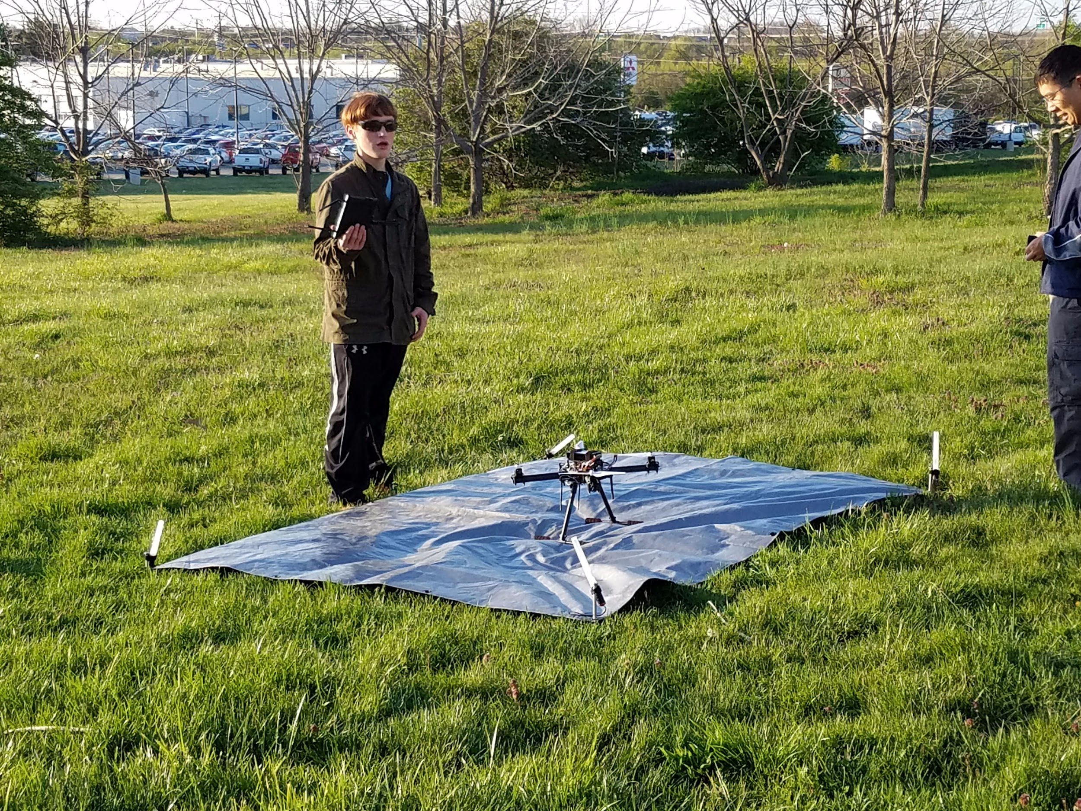
Pre-Mission Briefing - Go/No-Go Criteria and Fall Back Plans
We use checklists to ensure safety and make Go/No-Go decisions, using criteria such as
Before Flight
Weather
Airspace Activity
Whether there are people on the field
Condition of Quad
During Flight
Aircraft stability / functionality
Wind Speed
Battery Condition
Airspace Activity
When one or more conditions is seen as a hazard we may
Return to Land Immediately
Reschedule flight or travel to other fields
Make necessary plans to repair and inspect Quad thoroughly
Notes:
4.4.6.2.6: Pre-Mission Briefing, including… Go/No-Go criteria and fallback plans should a technical issue arise during flight mission (20%)
Lucas
Need to mention WHAT WE DO GIVEN THAT ONE OF THESE THINGS GOES WRONG IE FALL BACK PLANS

Slide 33
What we learned!
Compass calibrations (“Drone Dance”)
More ways to use mission planner
(control and drop servos)
Basic flight safety
Soldering and wire splicing skills
Handling GPS interference issues
How to apply physics to solve
problems (e.g., vibrations that caused rapid descent)
Notes:
Gunvir or Visesh

Slide 34
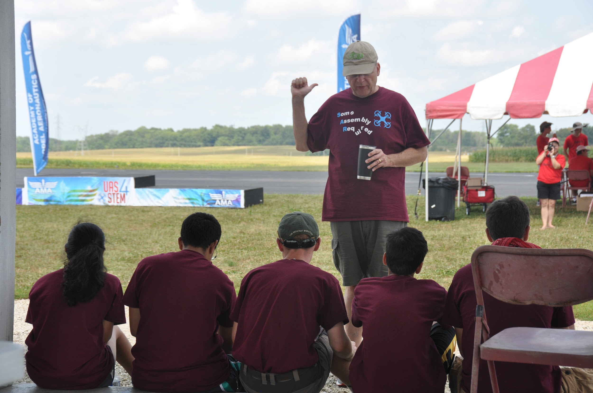
What we learned!
Compass Calibrations (“Drone Dance”)
Learned more ways to apply mission planner
  Control & Drop Servos
Basic Flight Safety
Built up soldering and wire splicing skills
Learned to handle GPS Interference Issues
We also learned how to apply physics to solve problems
  Minimize Vibrations that cause rapid descent
Notes:
Gunvir

Slide 35
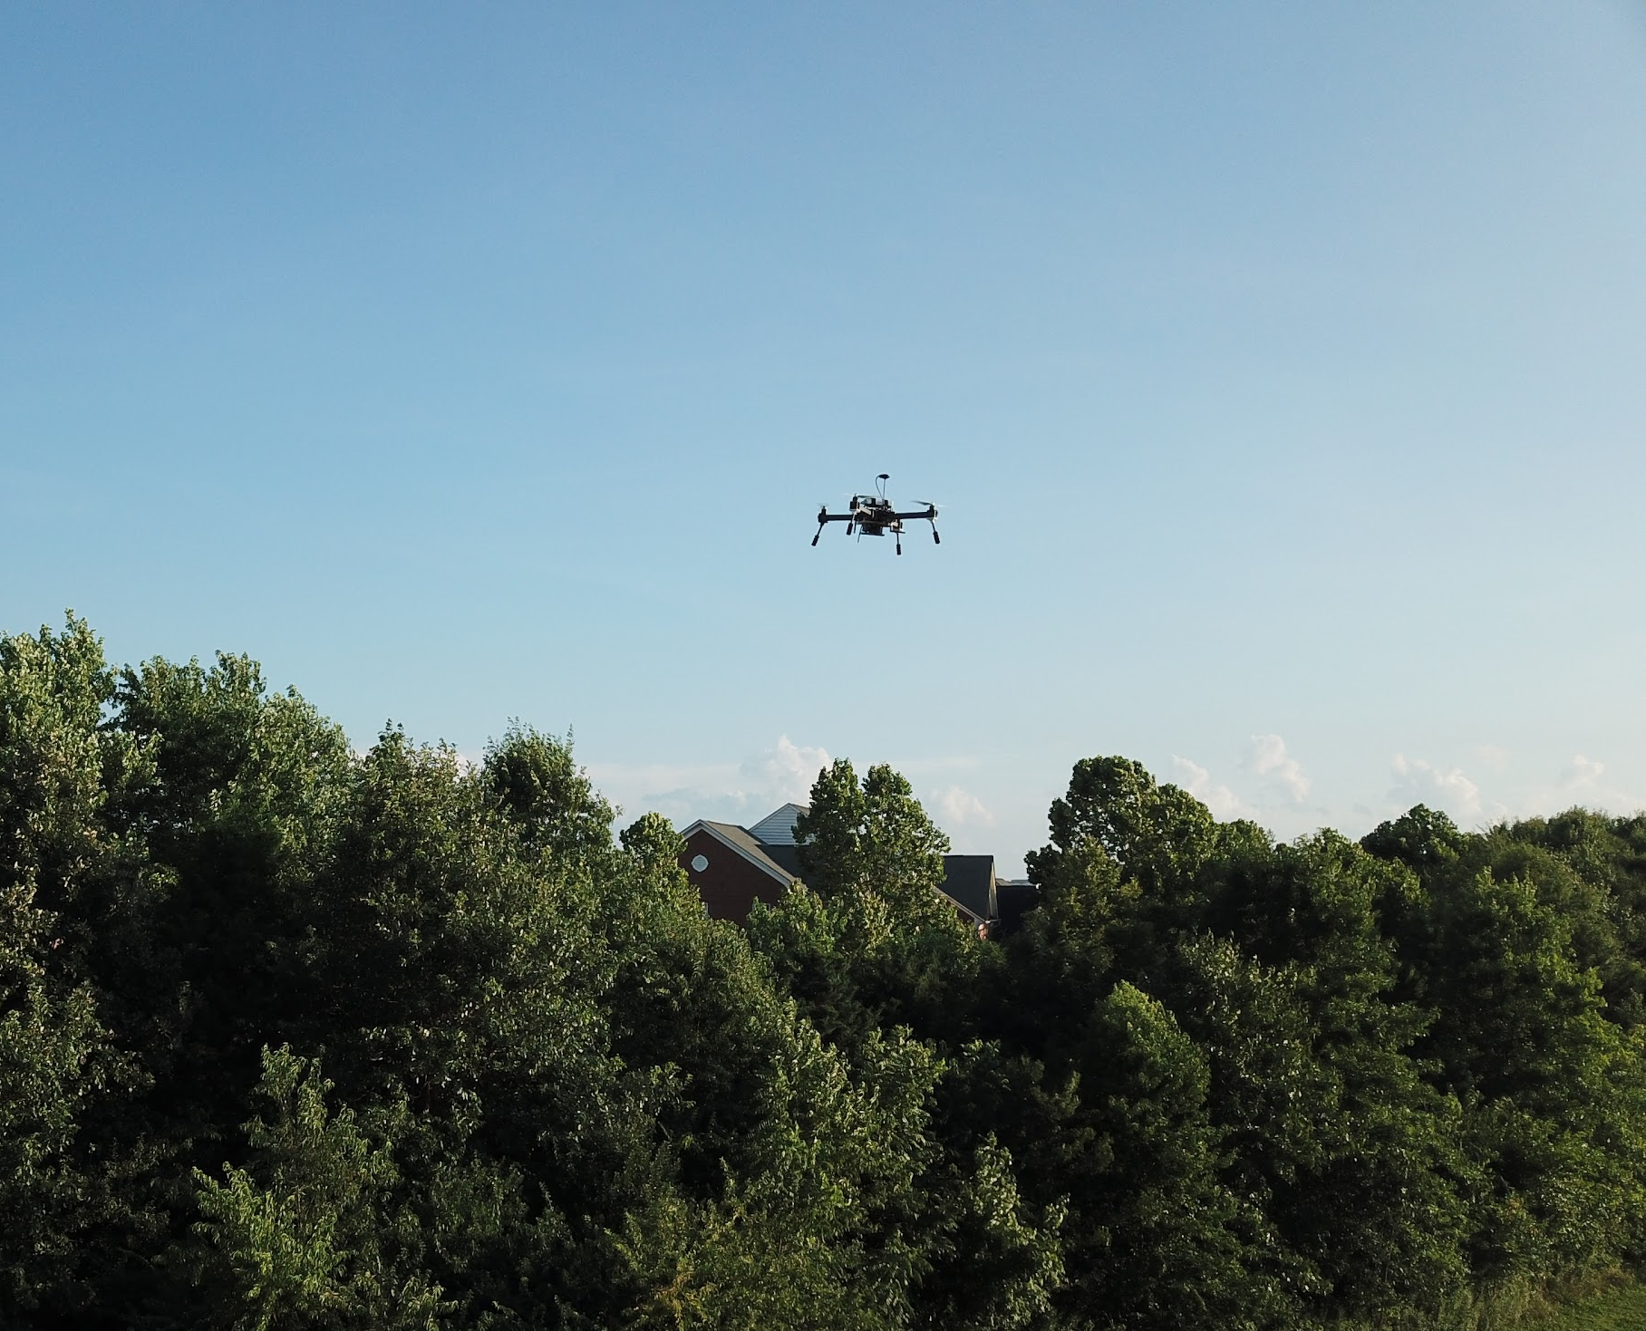
Future Steps for Improvement
Analyze quality of competition performance
More practice, practice, practice!
  Manual and autonomous flight
  Mission Planner
Ardupilot tuning and calibration
Techniques to improve GPS Accuracy
Maximize balloon drop accuracy
Increase understanding of the Pixhawk Parameters
Notes:
4.4.6.2.4 Developmental Test Results including: test plan schedule (through ground testing to flight testing to mission performance testing), results of testing, and any corrective action taken to improve the effectiveness on mission (30%)
Gunvir or Visesh

Slide 36
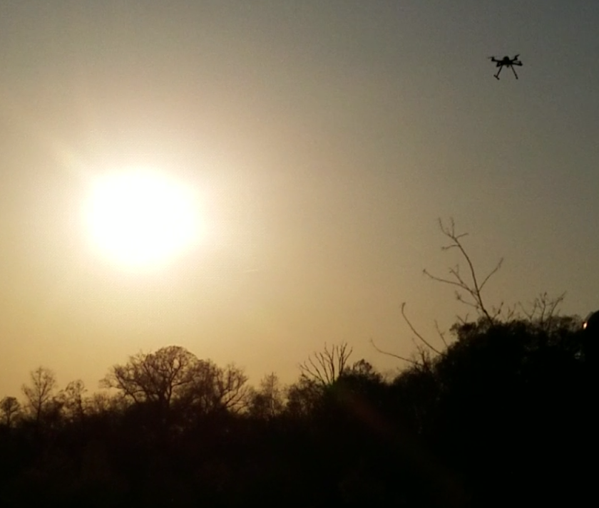
Future Steps for Improvement
Analyzing quality of competition performance
Practice, practice, practice!
  Manual and autonomous flight
  Mission Planner
Ardupilot tuning and calibration
Techniques to improve GPS Accuracy
Maximize Balloon Drop Accuracy
Increase understanding of the Pixhawk Parameters
Notes:
4.4.6.2.4 Developmental Test Results including: test plan schedule (through ground testing to flight testing to mission performance testing), results of testing, and any corrective action taken to improve the effectiveness on mission (30%)
Visesh

Slide 37
Thank you for your time!
Questions?
Notes:
4.4.6.2.7 Team member participation and communication skills (clarity, accuracy, logic, precision, relevance, depth, and suitability). (10%)
4.4.6.2.8 Judges will ask 5 questions directly from the UAS4STEM Ground School Course.
Each Question will be worth 1 point. Any team member may answer.

Slide 38
Thank you for your time!
Questions?
Notes:
4.4.6.2.7 Team member participation and communication skills (clarity, accuracy, logic, precision, relevance, depth, and suitability). (10%)
4.4.6.2.8 Judges will ask 5 questions directly from the UAS4STEM Ground School Course.
Each Question will be worth 1 point. Any team member may answer.

