Slide 1
Our Mission
The Blu Cru has always felt that a passion STEM holds the highest importance in the community. Reaching out into the community to instill a passion of STEM into its people, specifically through an involvement in robotics. We place a strong emphasis on community outreach. We have gained the support of the community, as well as the addition to join our team because of past outreach events. Outreach has always been a central part of our Mission.

Slide 2
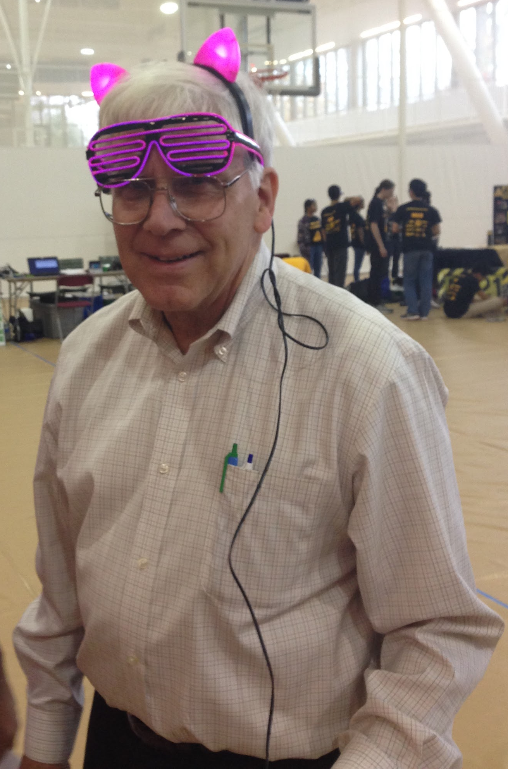
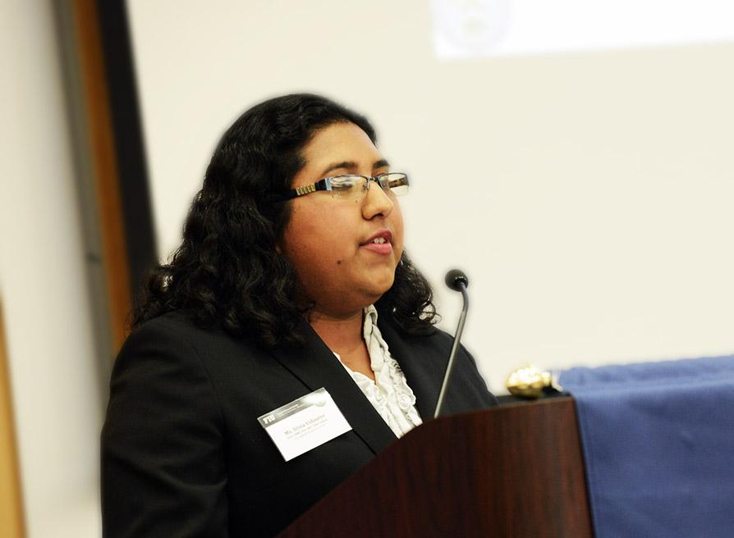
Meet the Mentors
Our Mentors Bob Ekman and Silvia Vidaurre are our team's greatest inspiration. They provide us with invaluable insight and ensured that year after year we are able fully embody FIRST in our competitions and succeed.

Slide 3
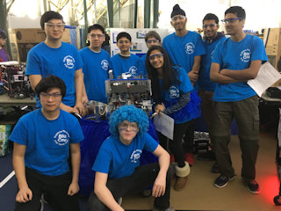
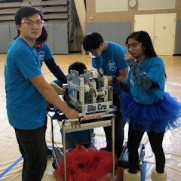
Meet the Cru
We are a Rockville, Maryland based team and a part of the Explorer Post 1010 Organization. This is the fifth season the Blu Cru has competed.
This season the Blu Cru has 13 members,five members more than last season’s team.Our members come from several different high schools in Montgomery County, Maryland

Slide 4




Thank You to Our Sponsors

Slide 5
Upcoming Outreach & Fundraising Events
FLL Tournaments in January 2017
FLL Workshops & Build Sessions
All Night Laser Tag at Shadowland on December 22nd, 2017

Slide 6
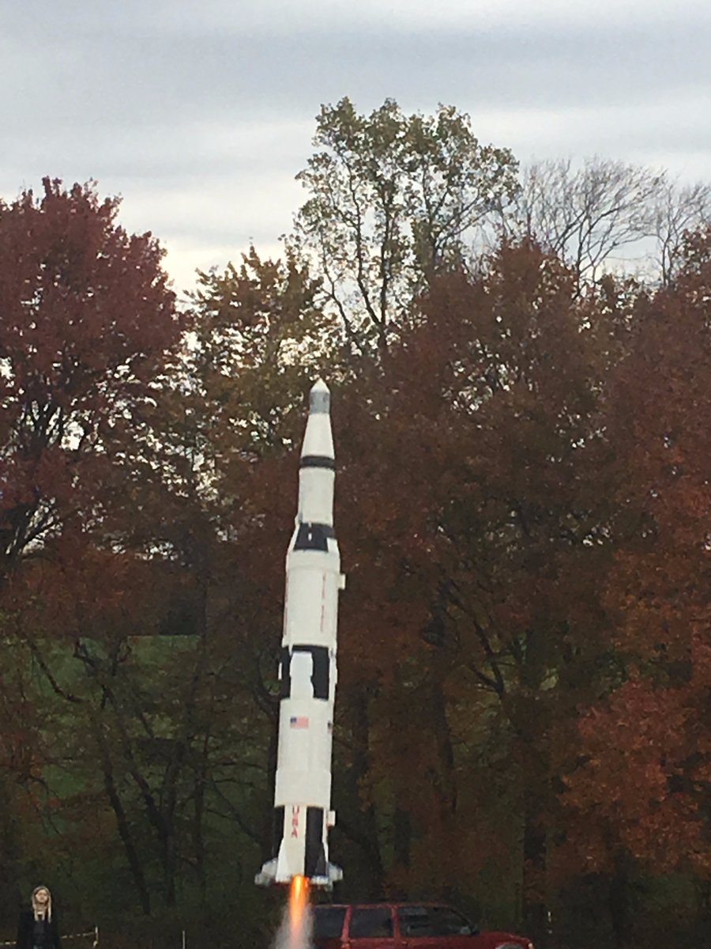
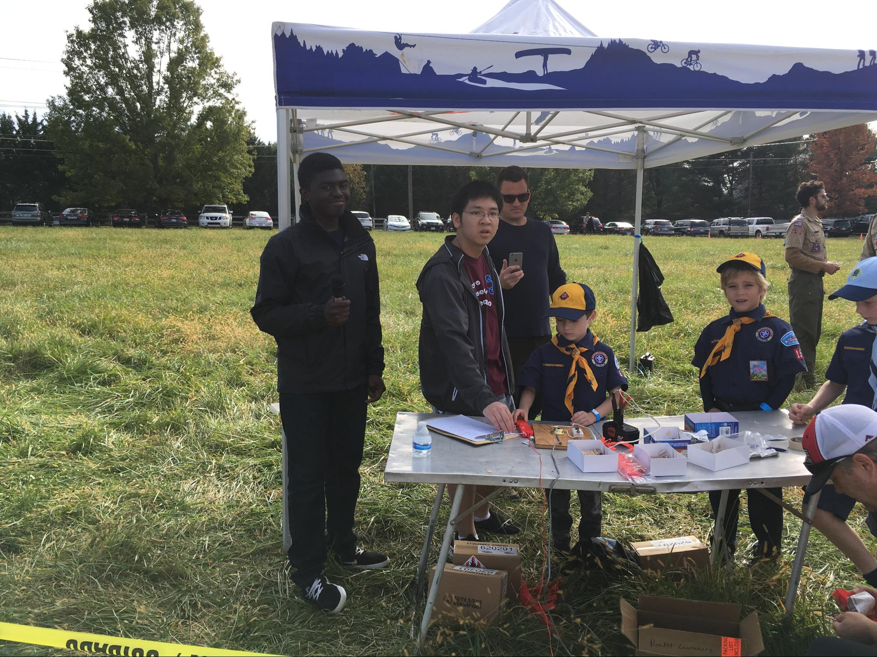
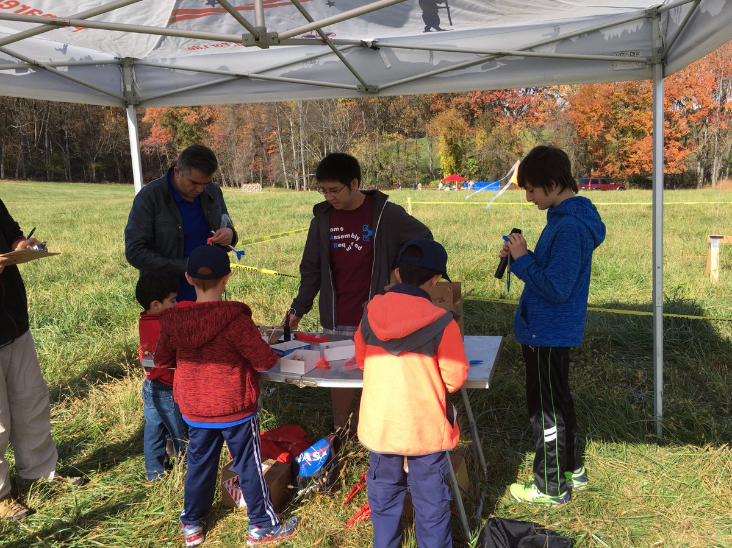
Cub Scouts Rocket Launch

Slide 7
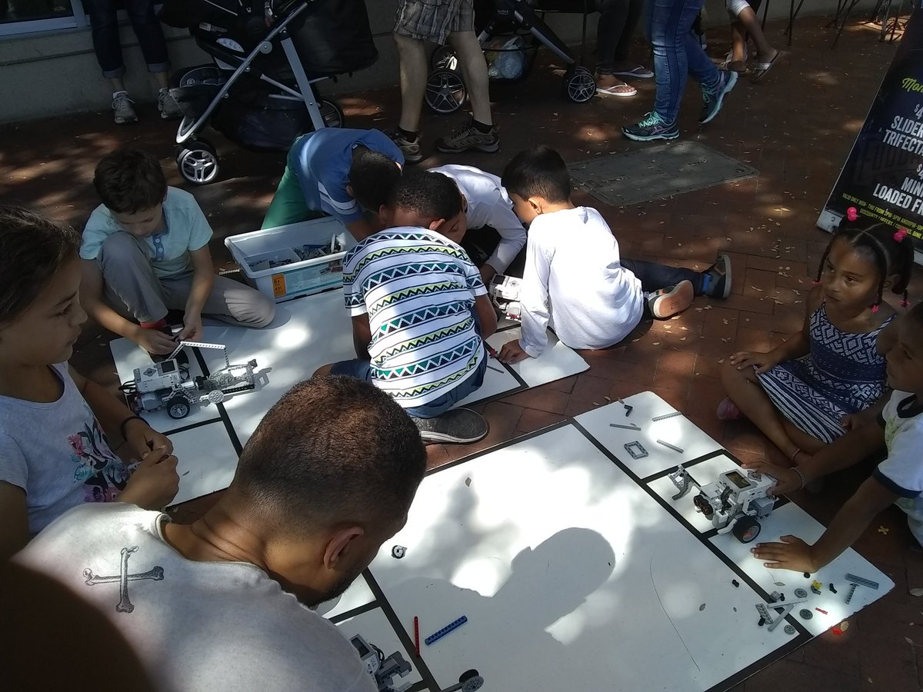
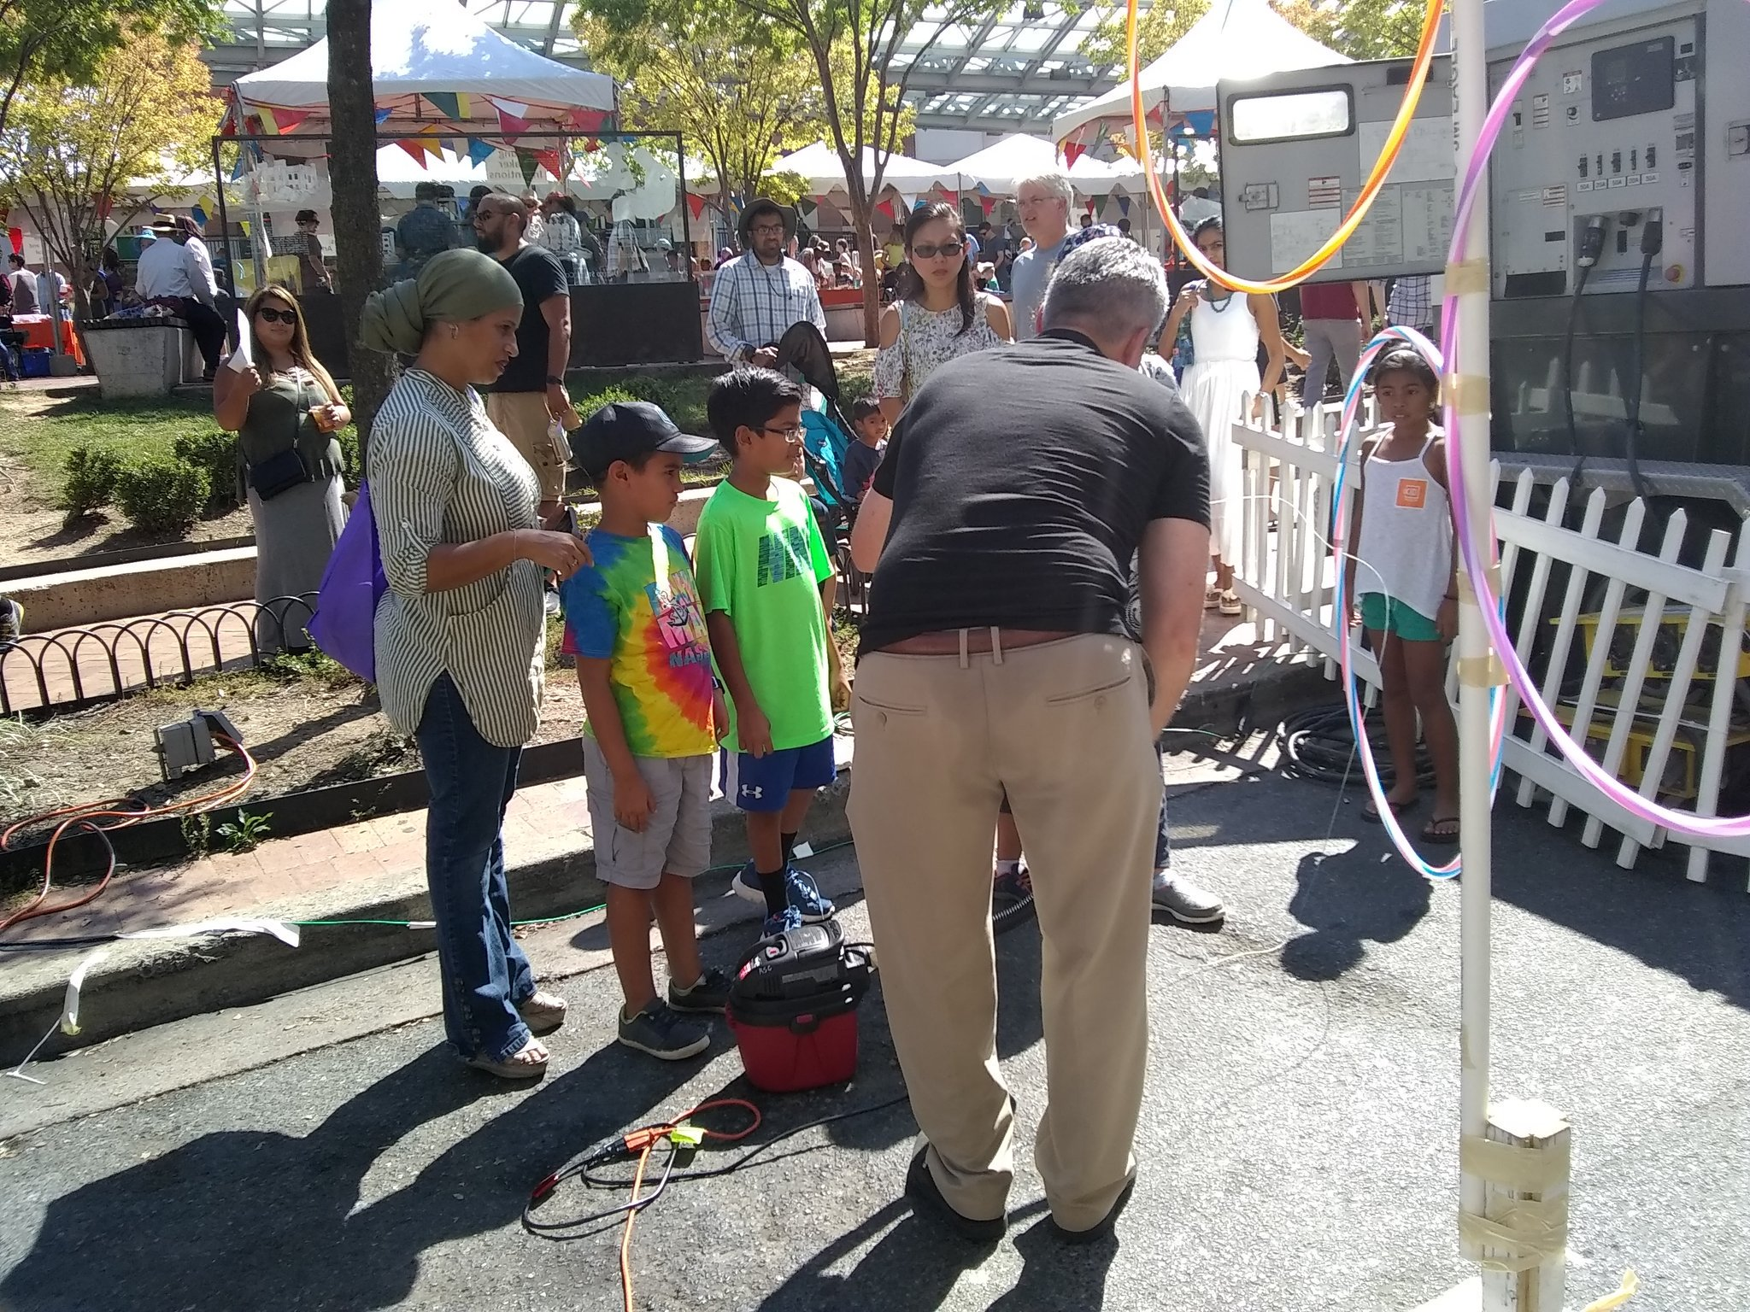
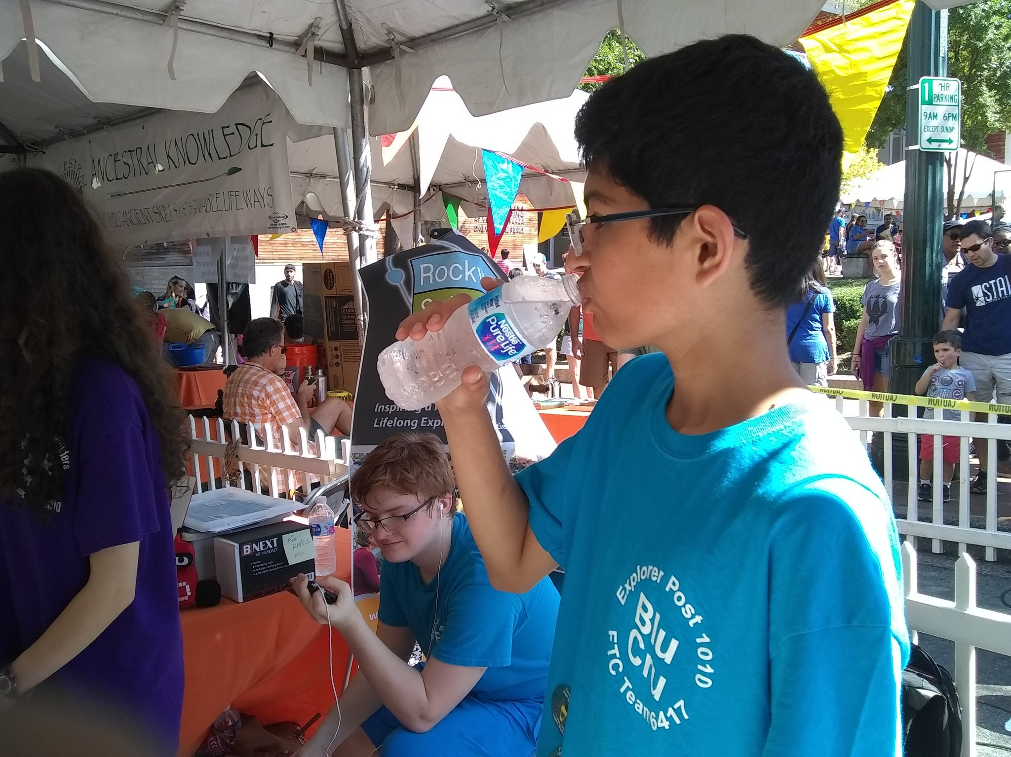
Kidfest

Slide 8
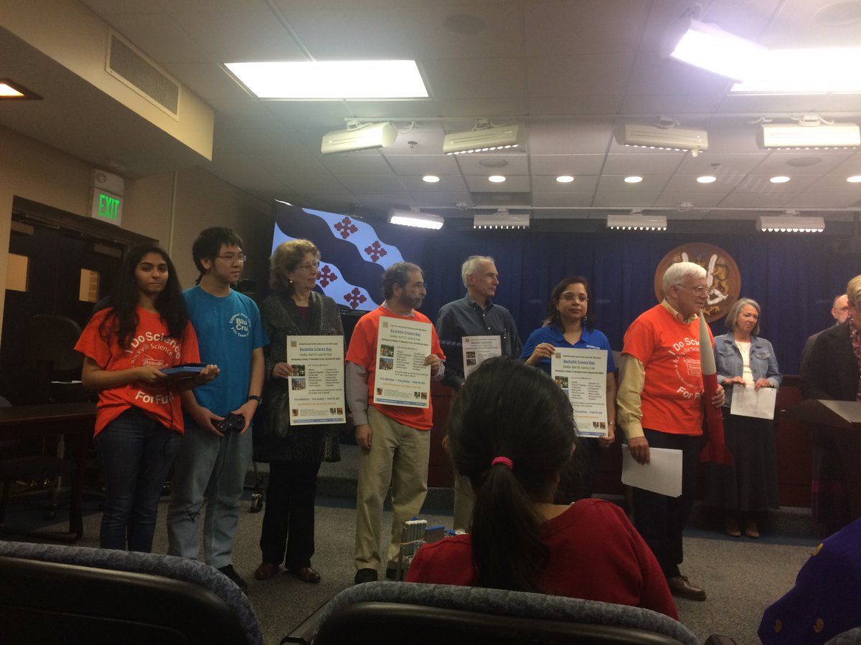
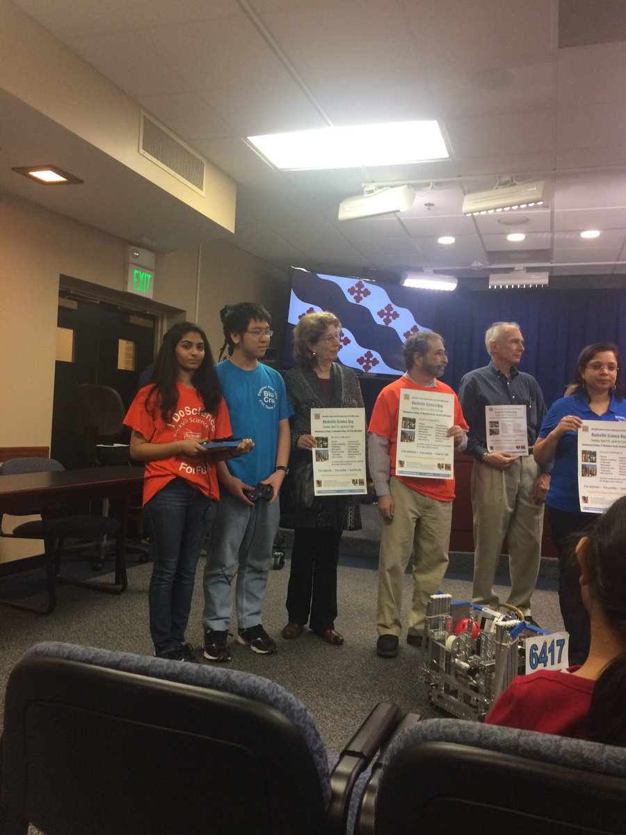
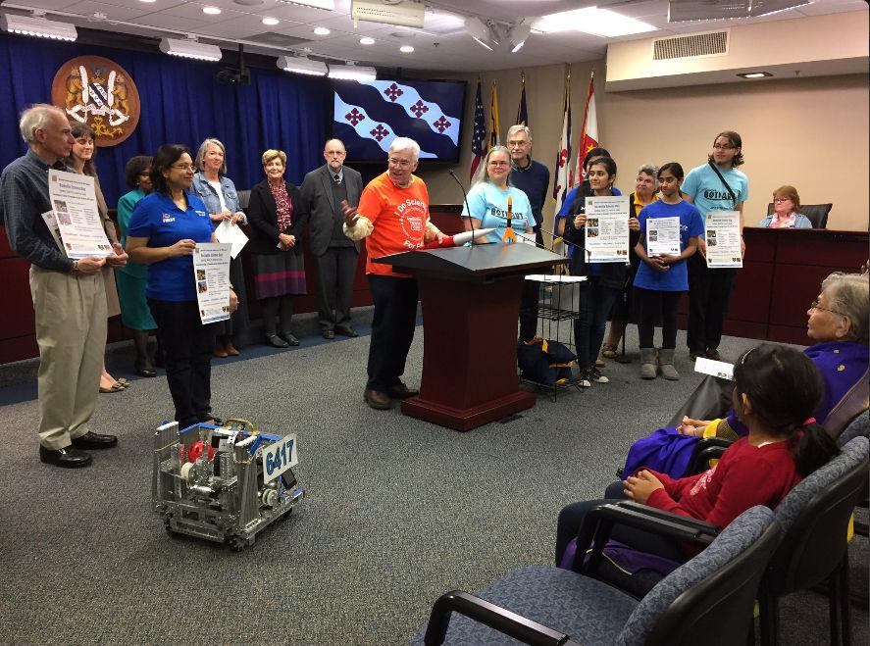
Rockville Science Day Proclamation at City Hall

Slide 9
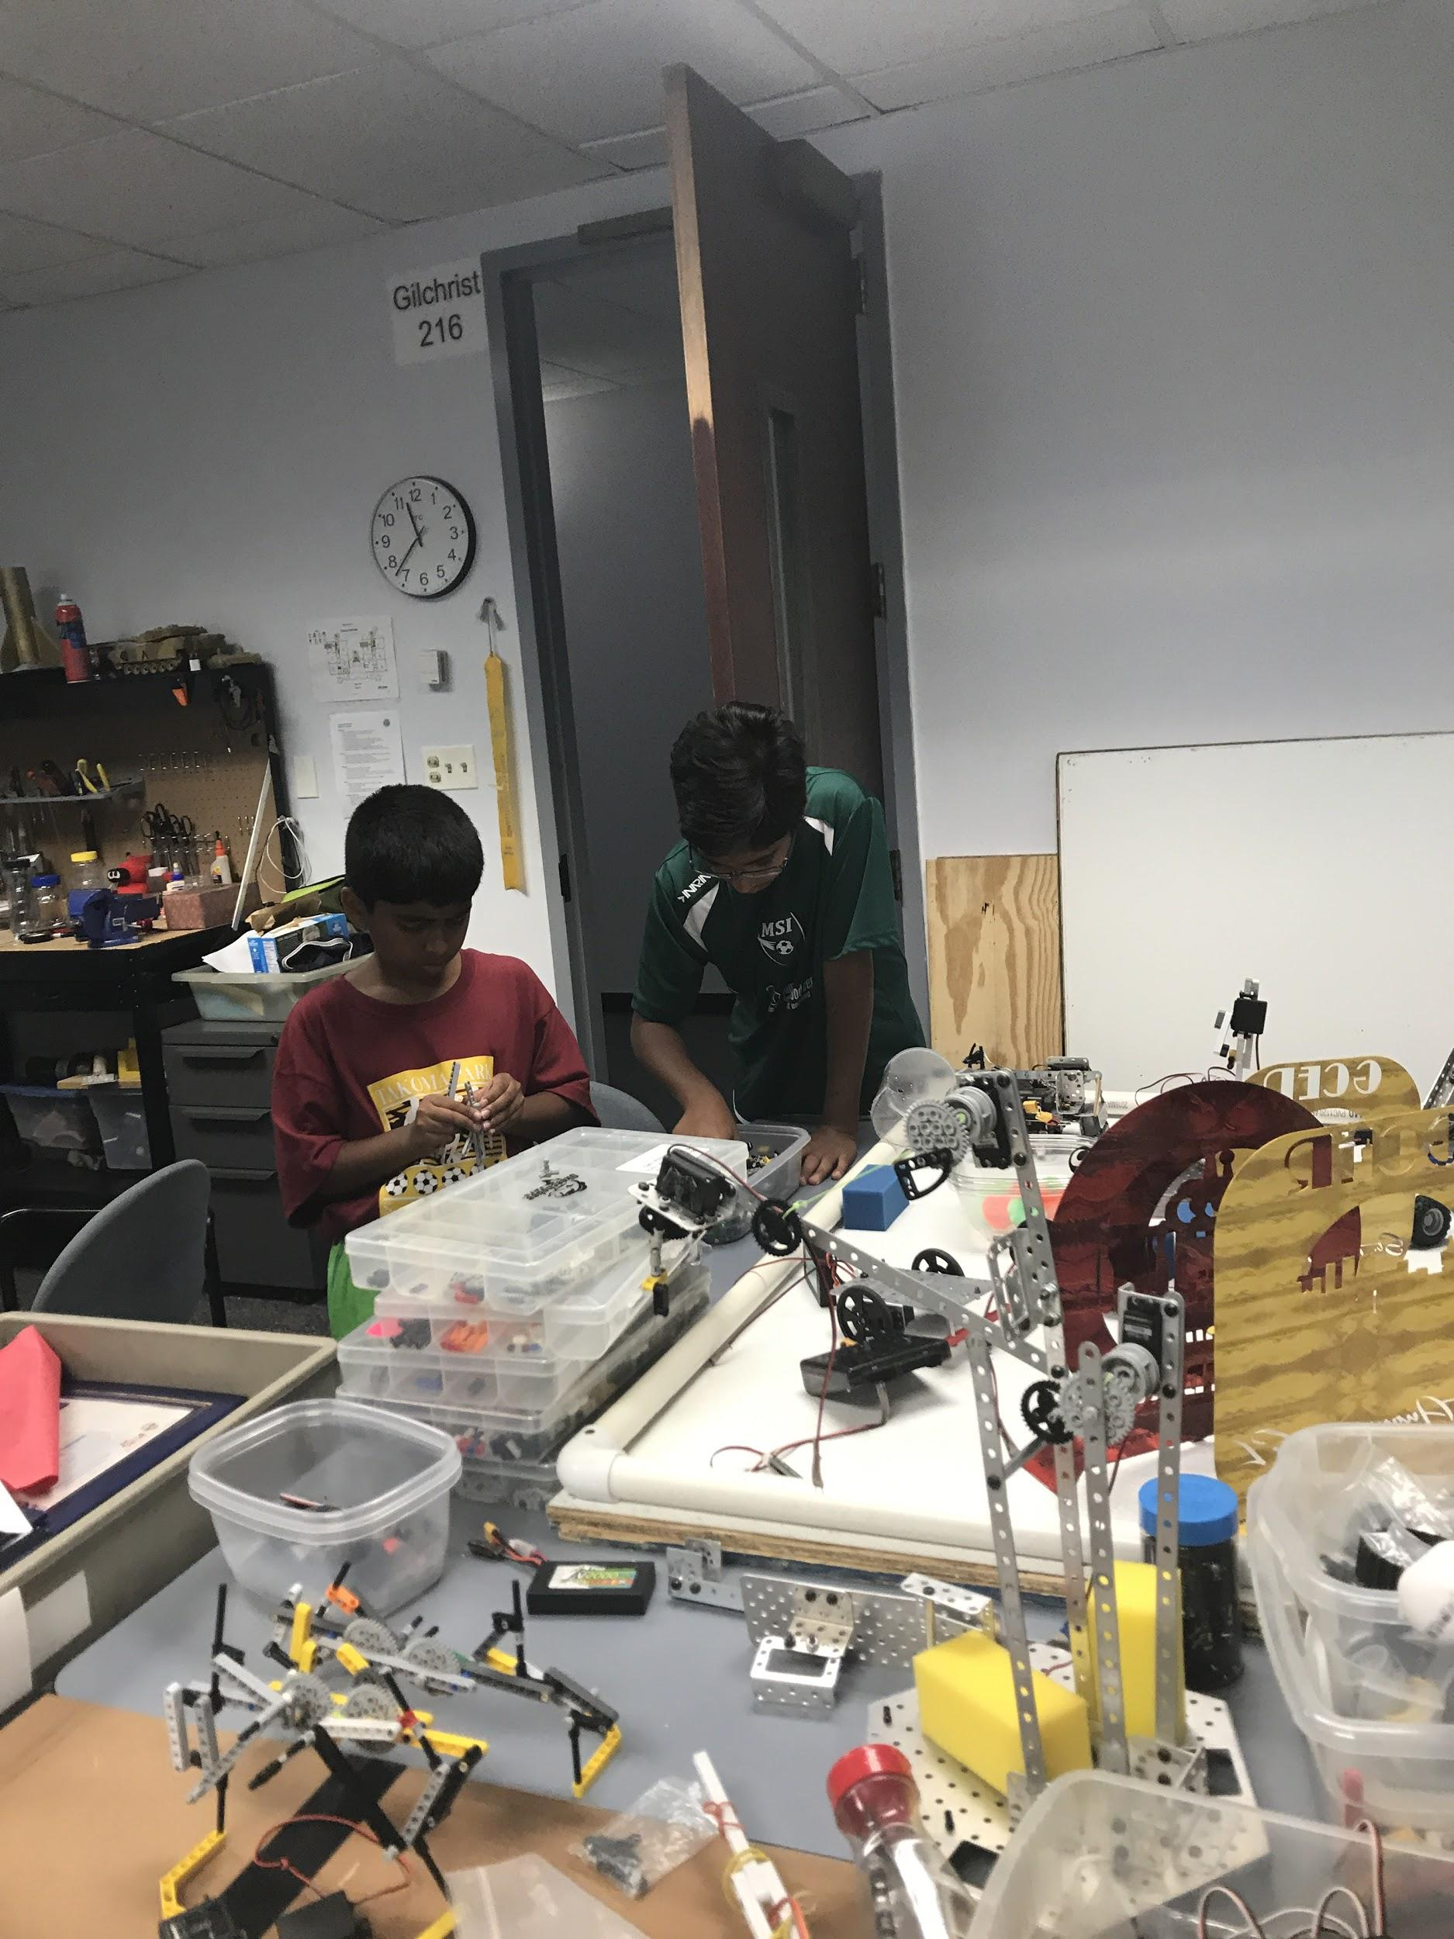
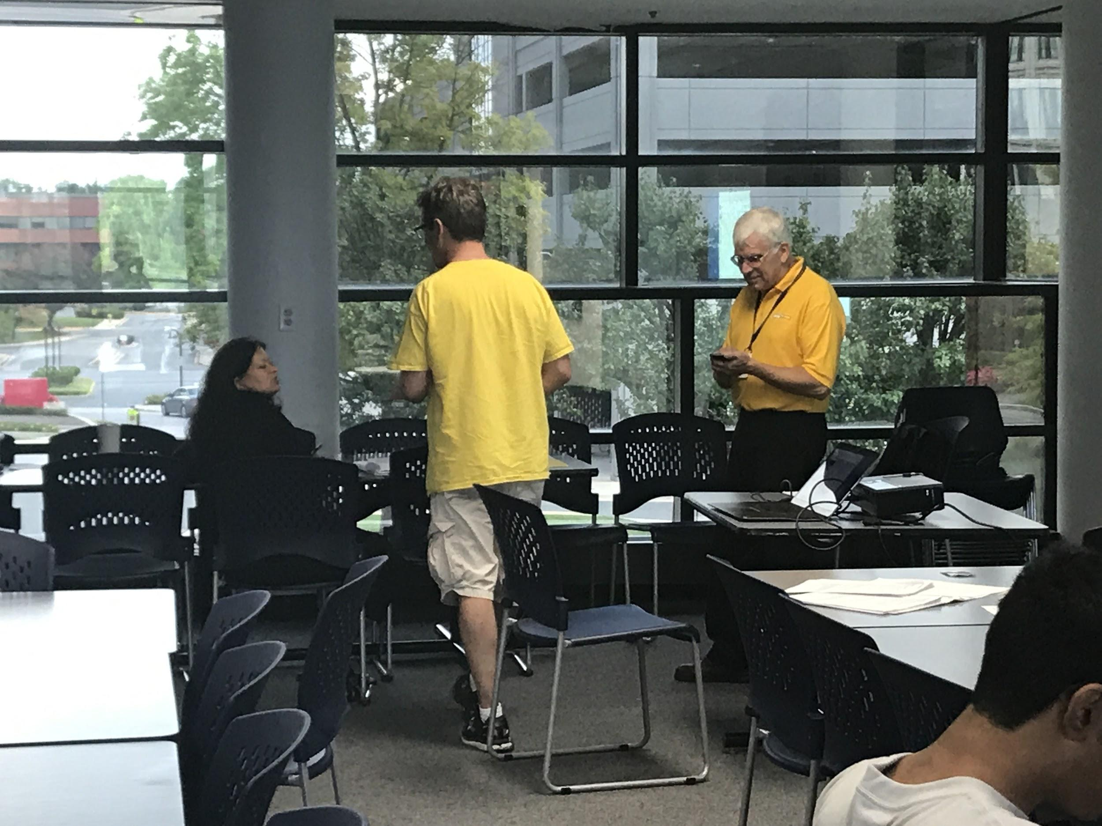
FLL Parent and Student Information Session

Slide 10
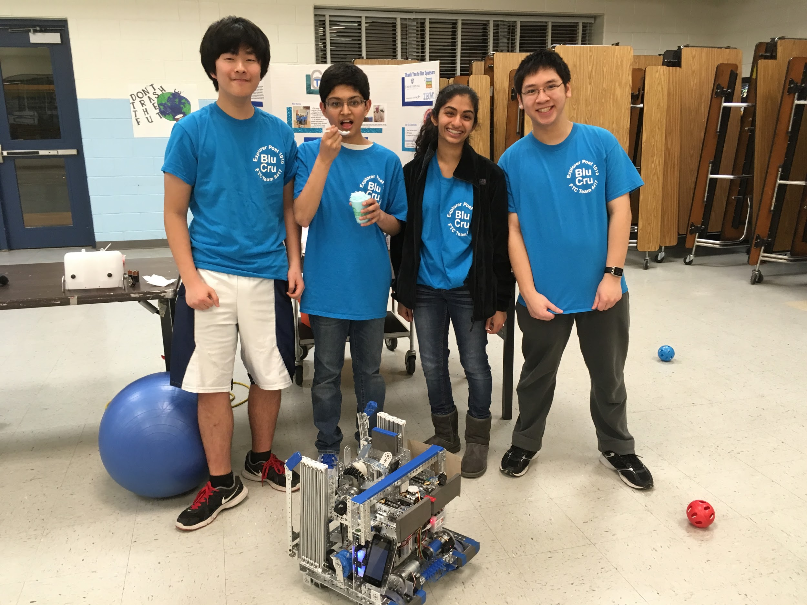
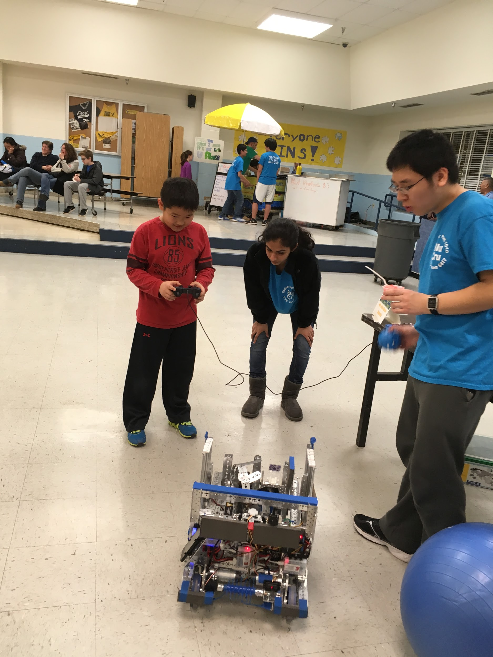
Robert Frost Stem Night

Slide 11
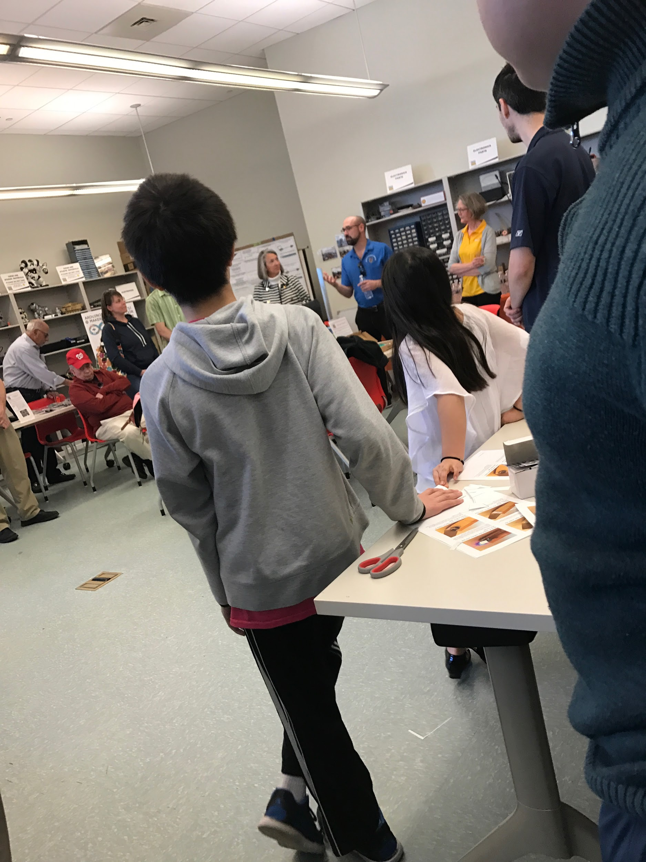
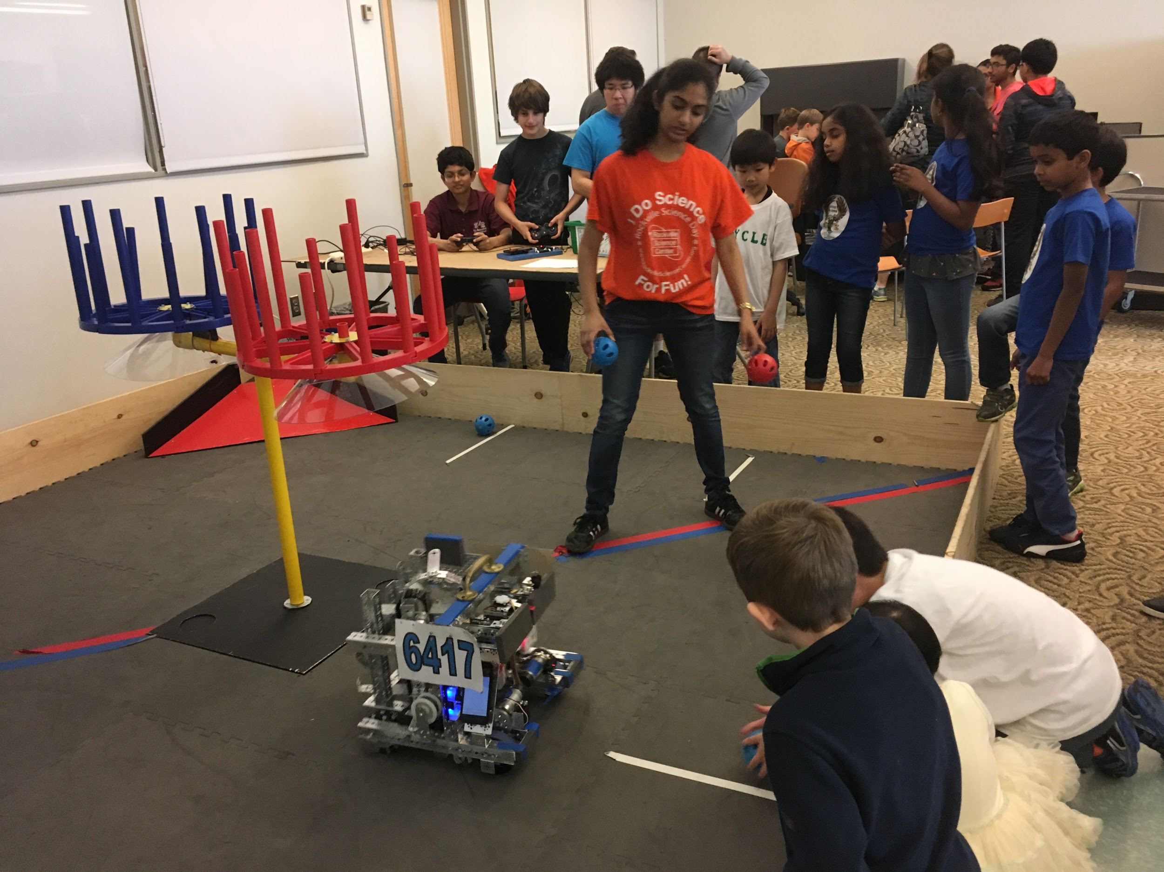
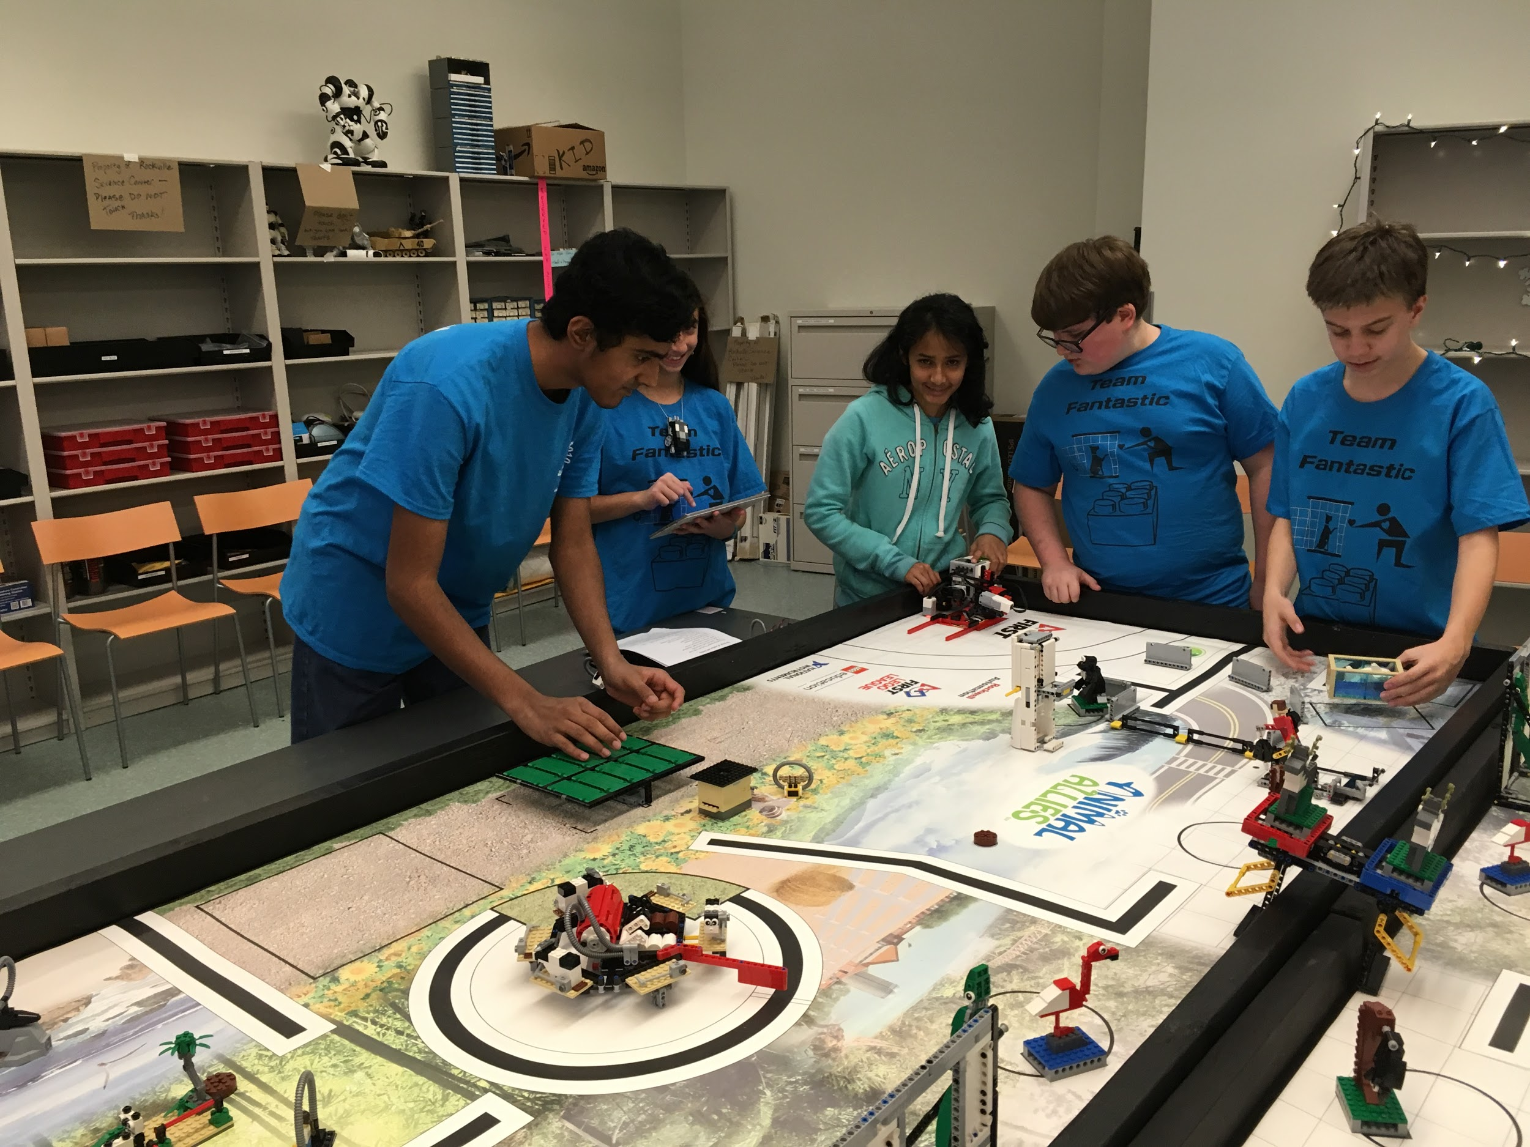
FLL Scrimmage Session Makerspace Opening in Rockville Library

Slide 12
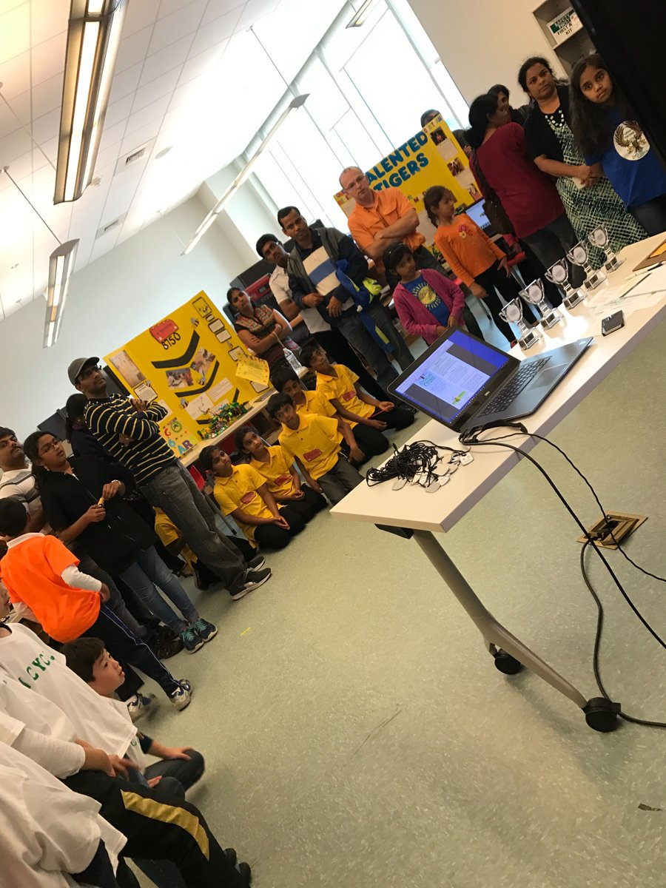
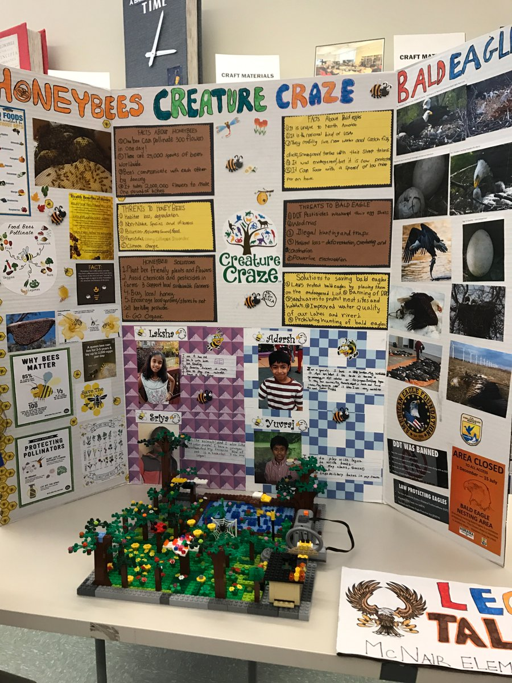
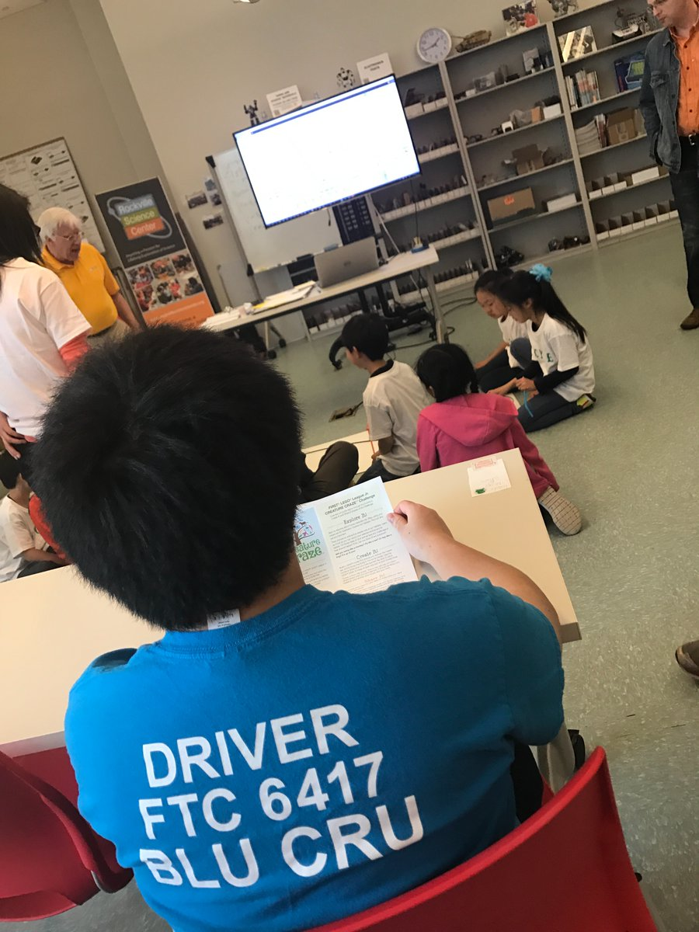
FLL Junior Expo

Slide 13
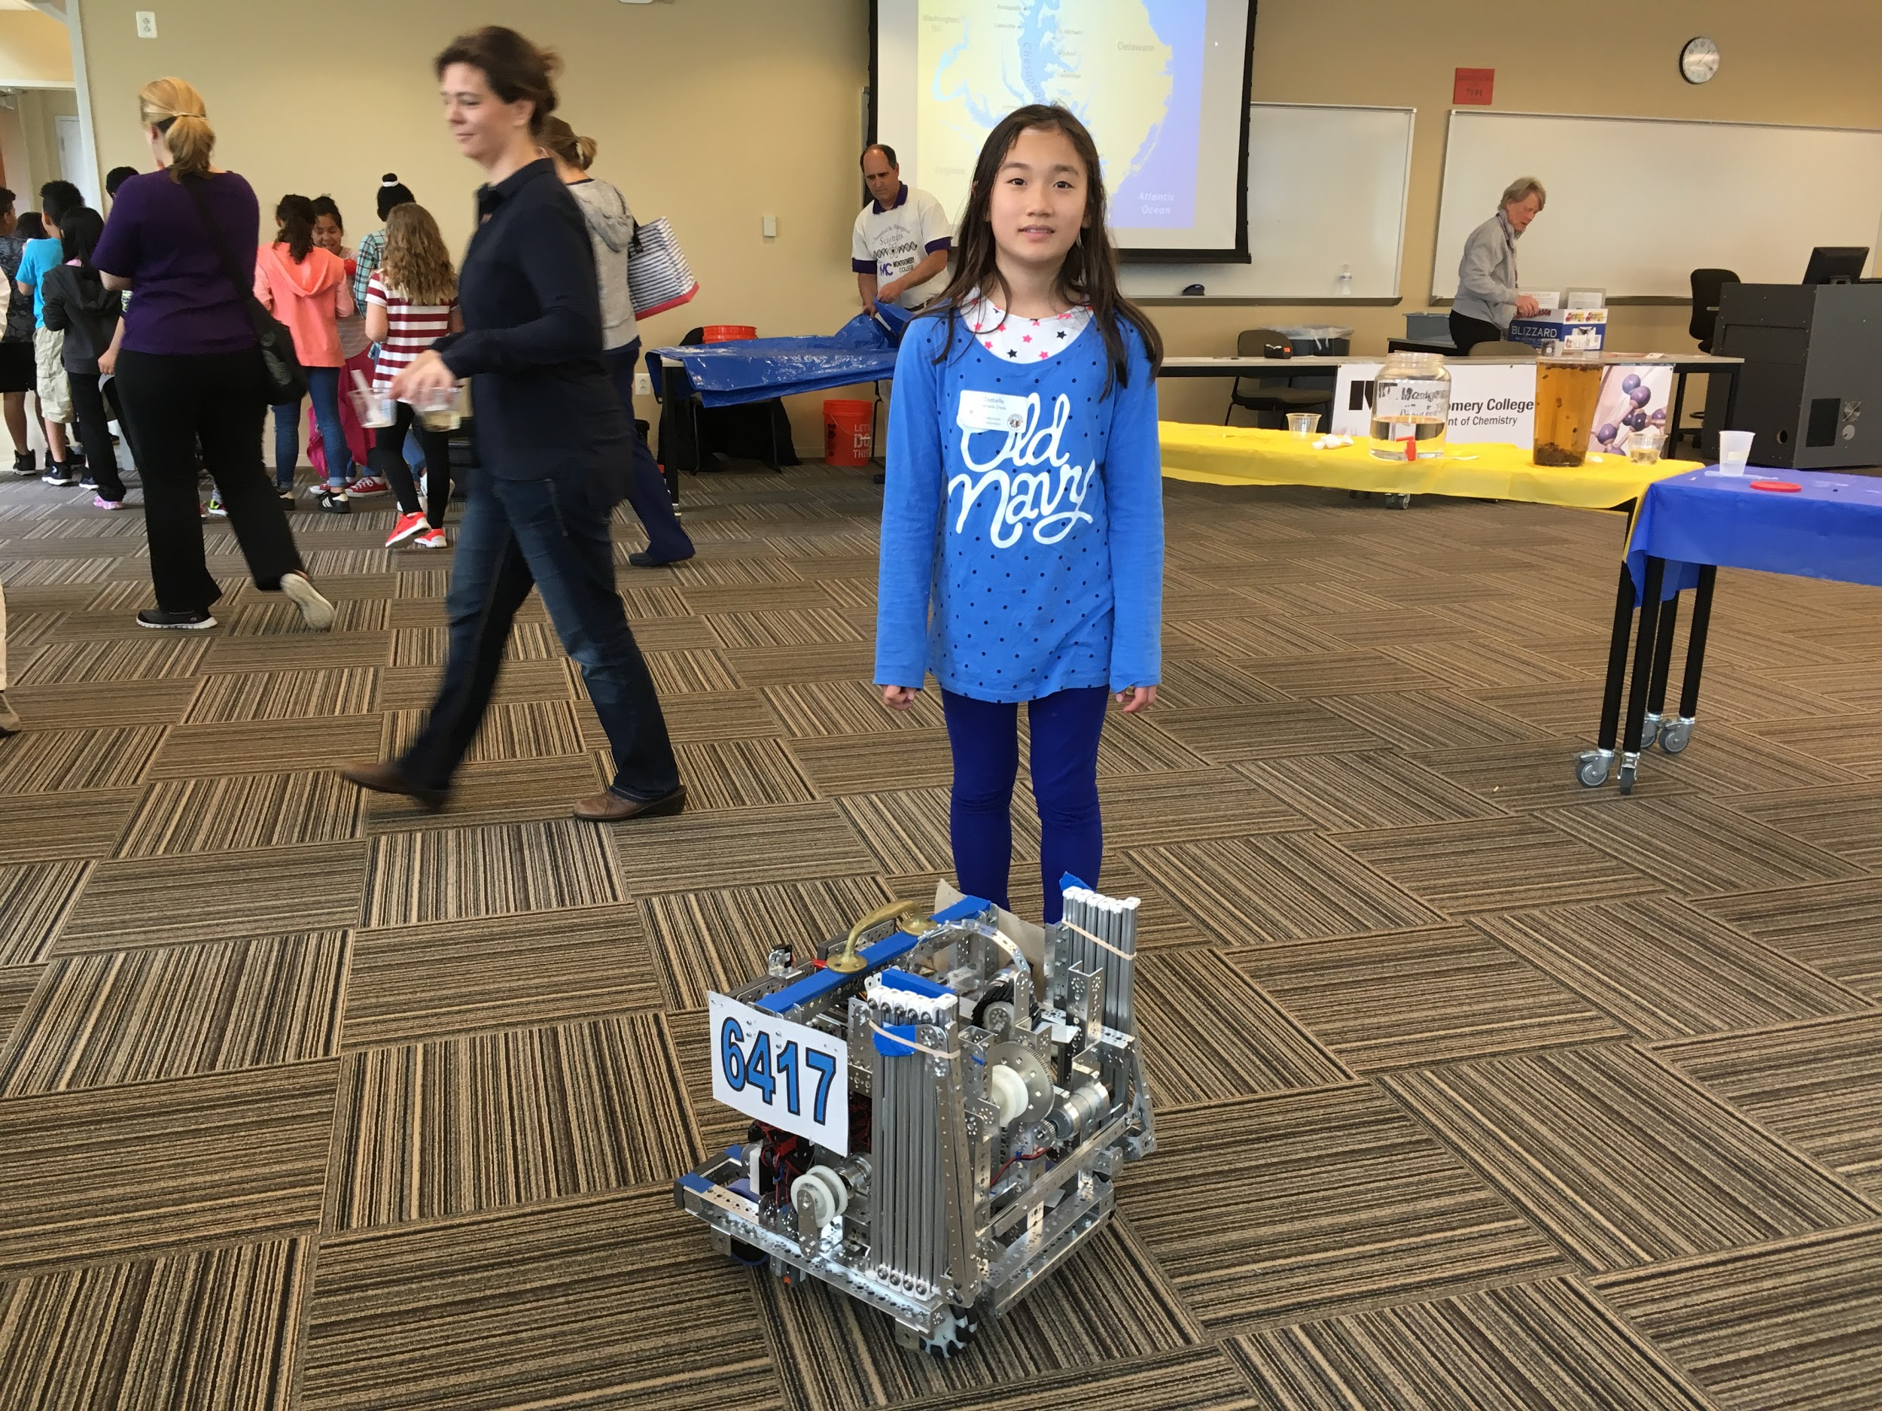
Johns Hopkins Science of Breadmaking Event

Slide 14
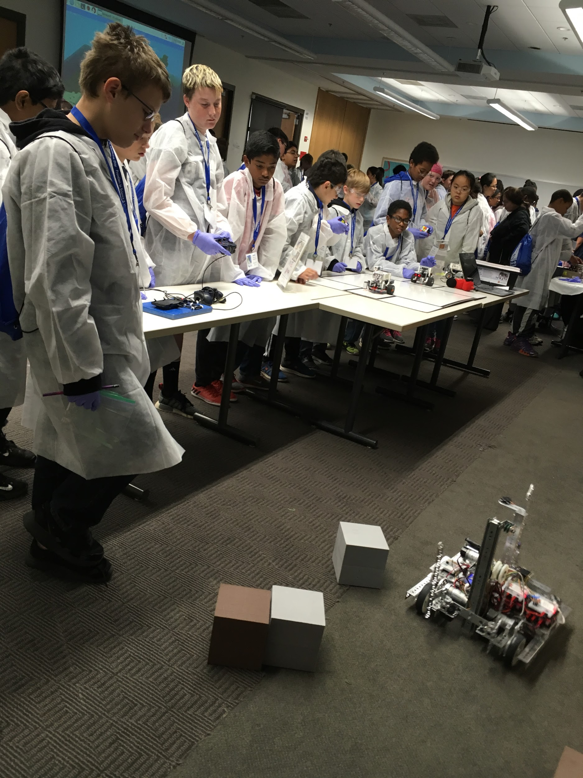
Johns Hopkins Final Frontiers

Slide 15
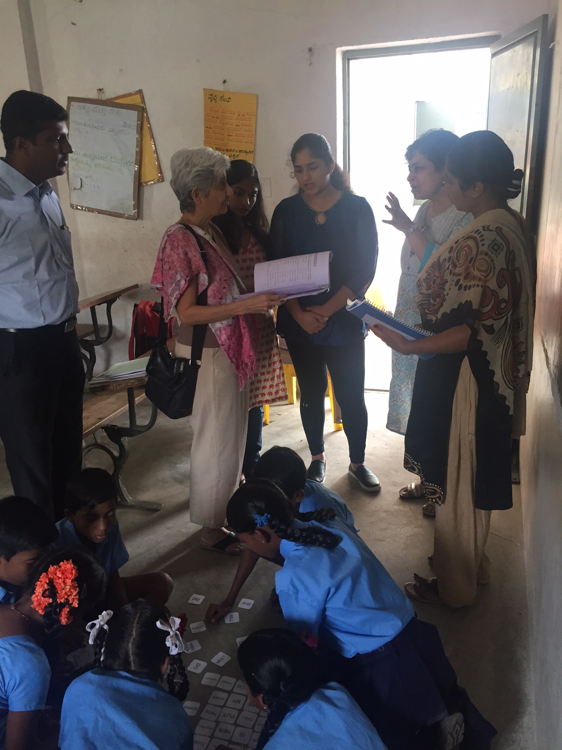
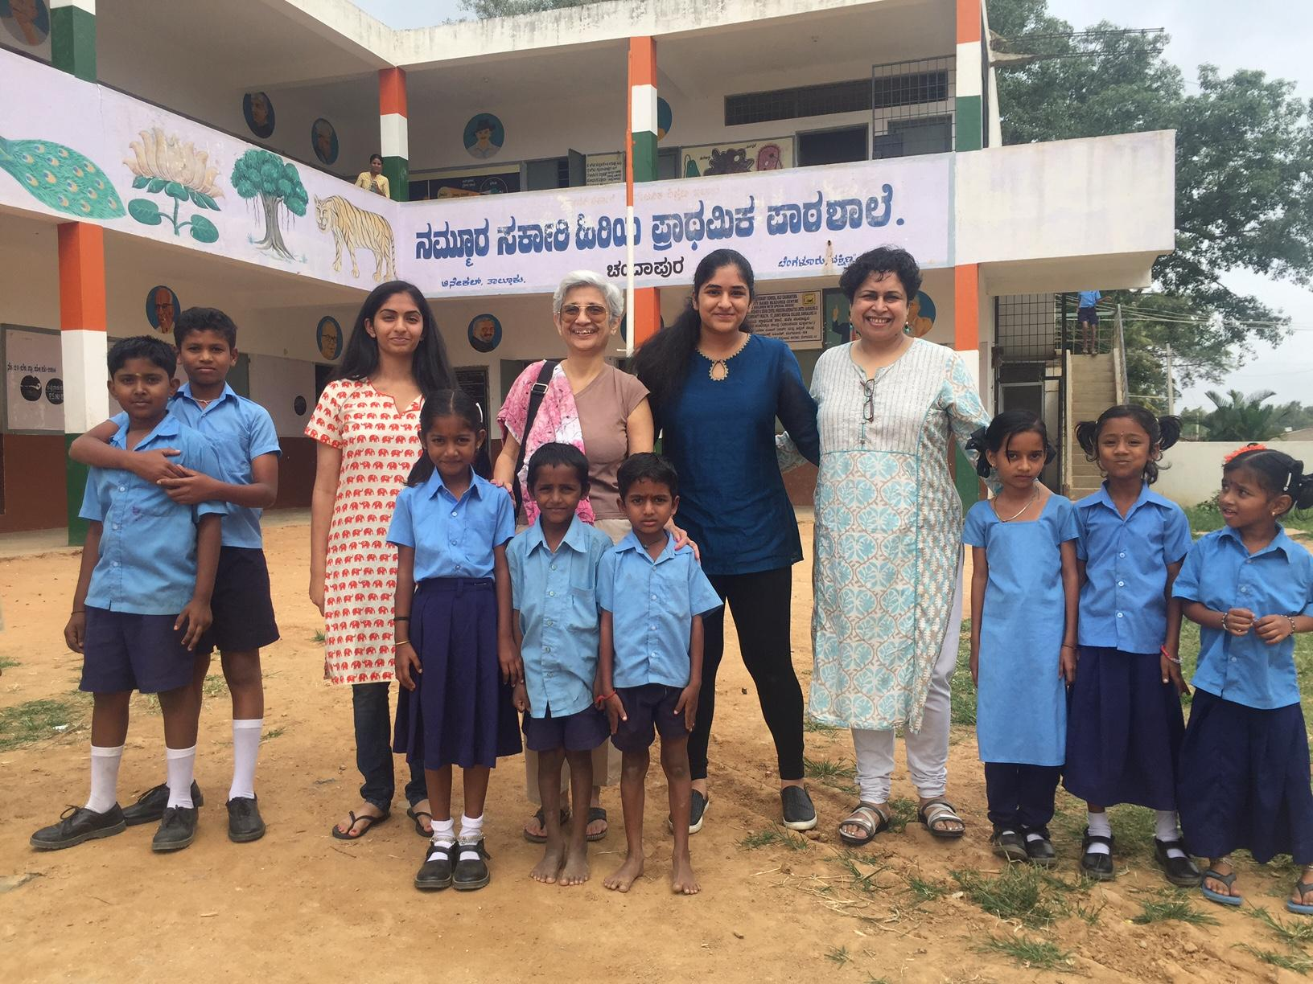
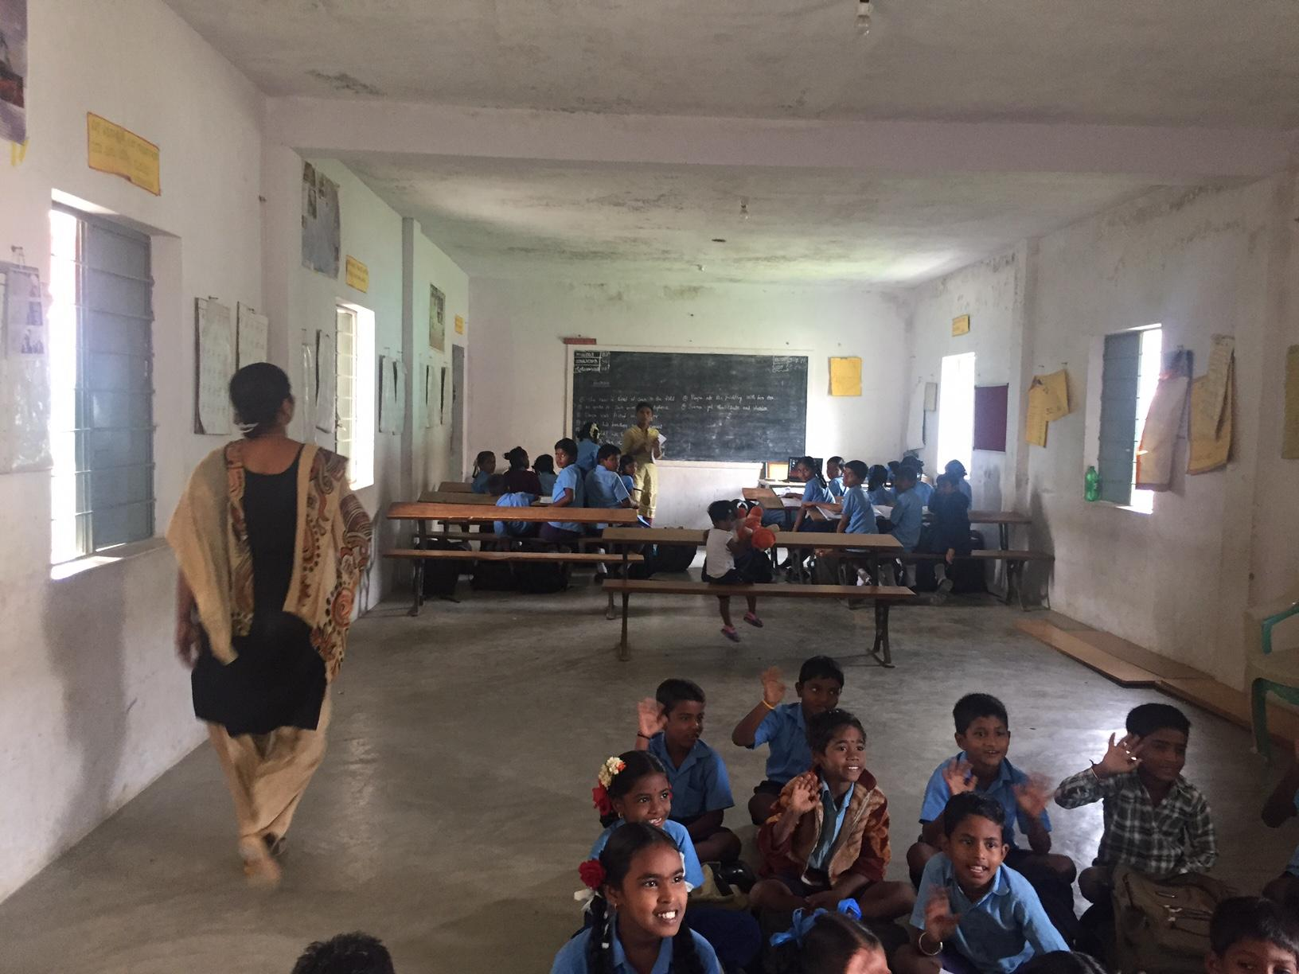
One Billion Literates Foundation Outreach in India

Slide 16
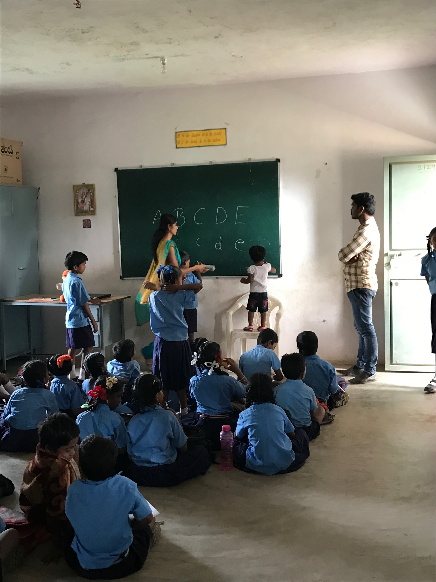
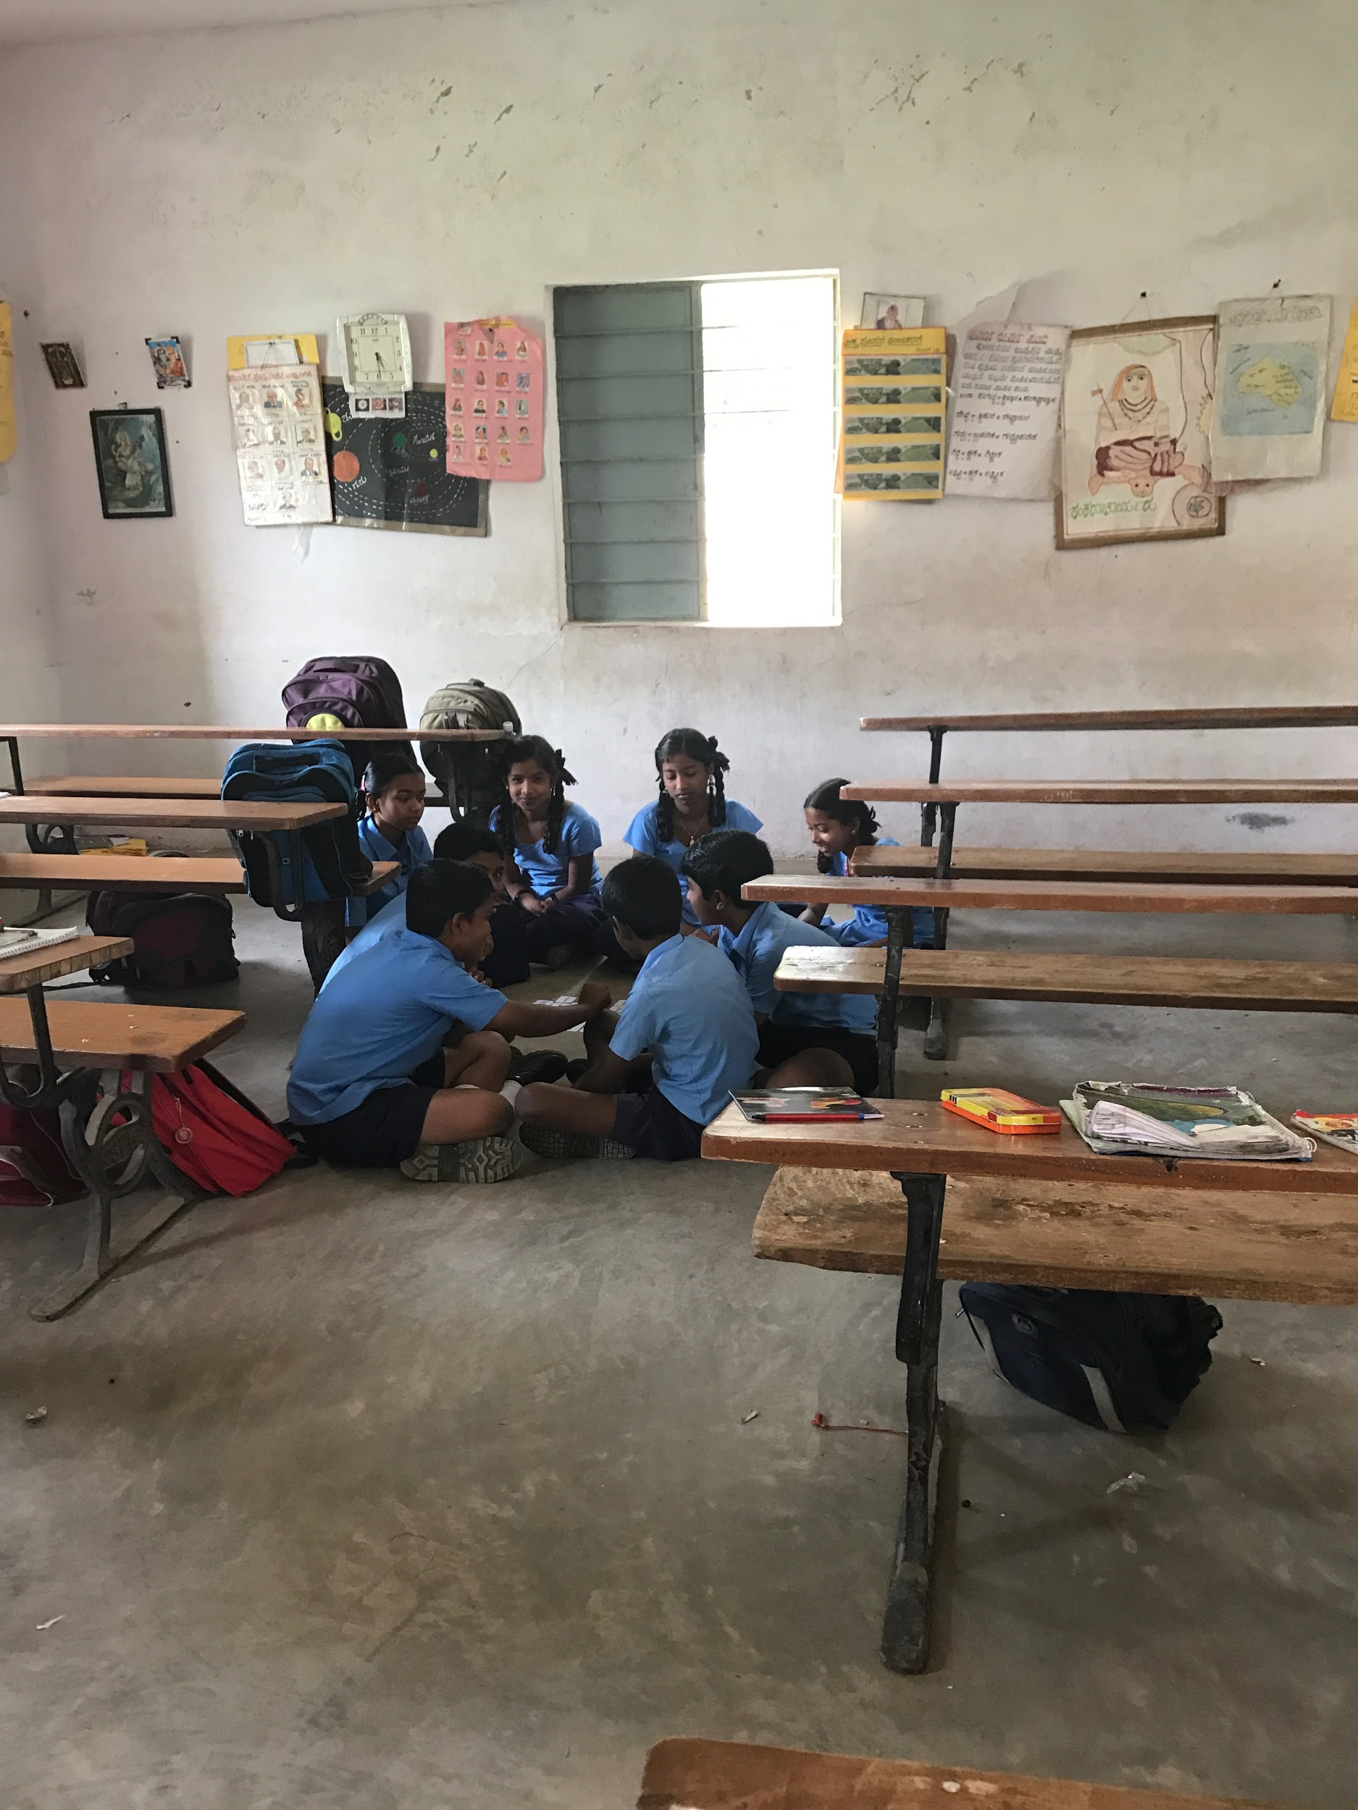
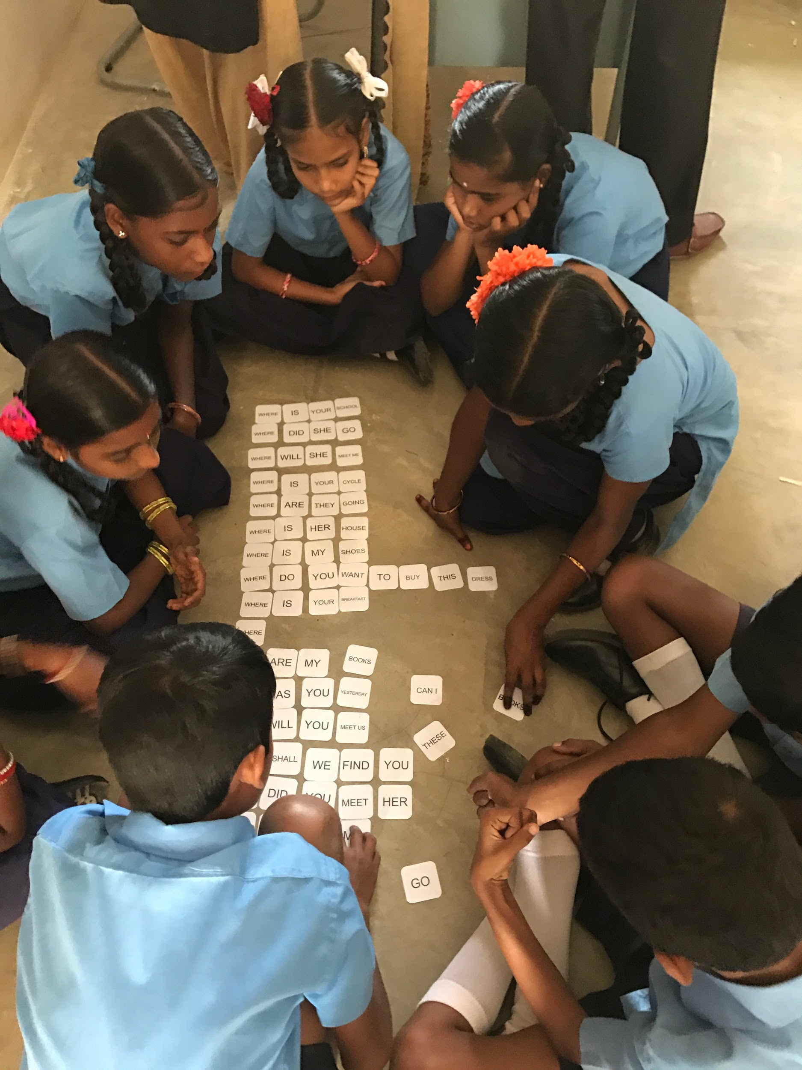

Slide 17
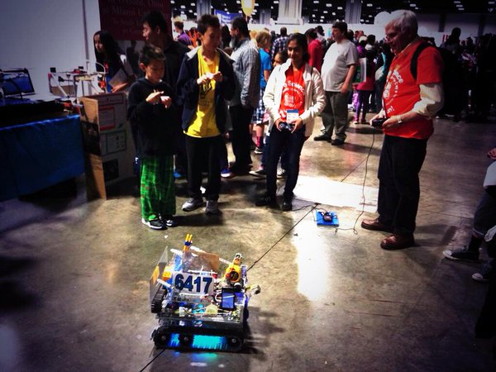
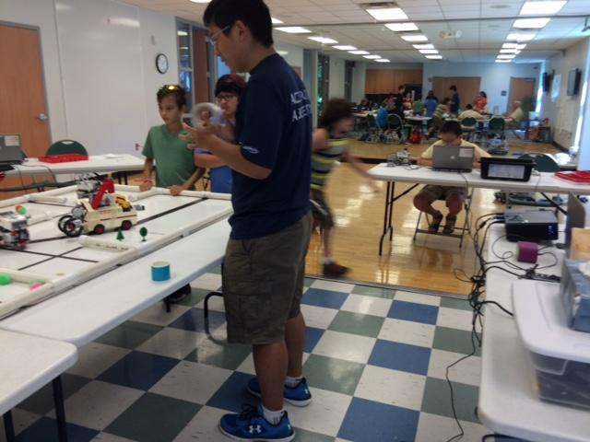
USA Science and Engineering Festival Robotics Camps

Slide 18
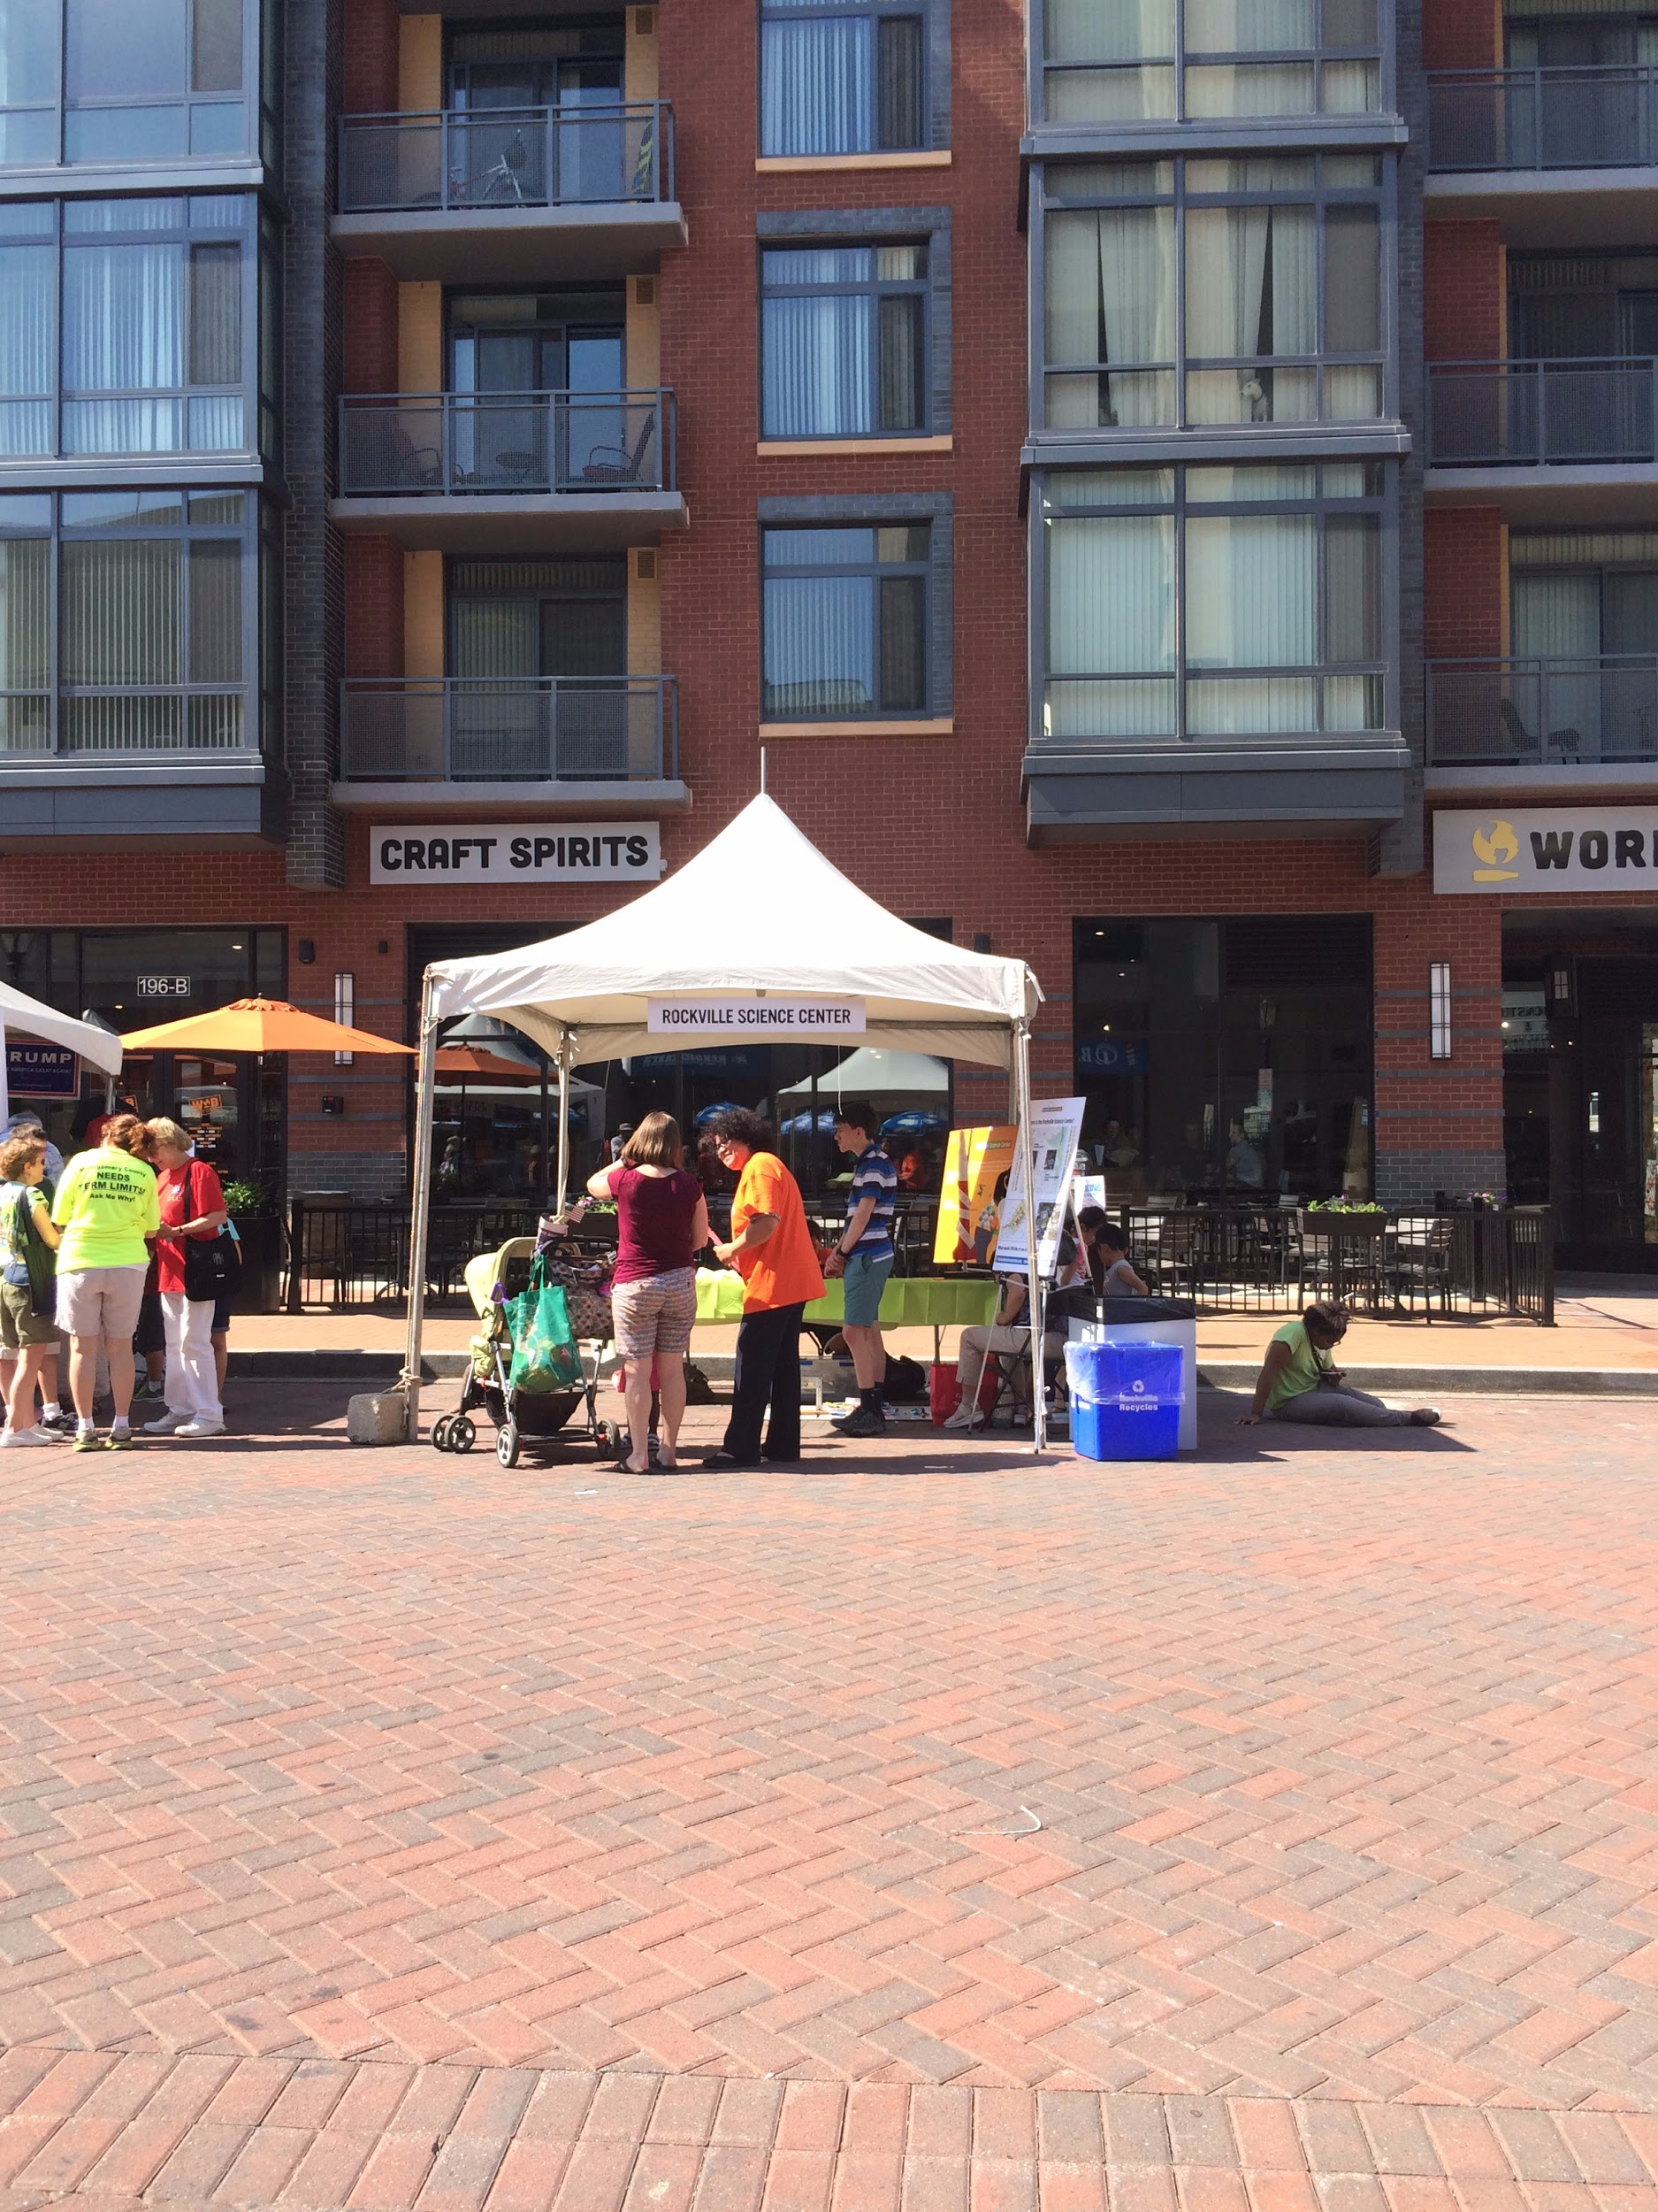
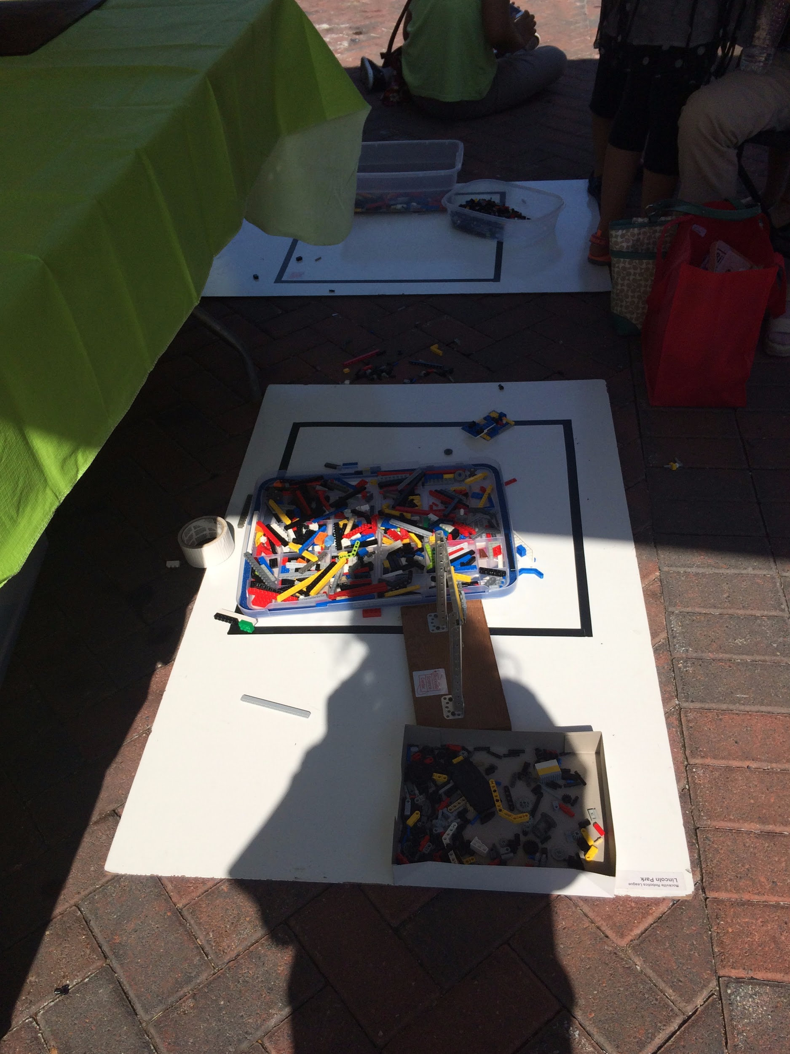
Hometown Holidays

Slide 19
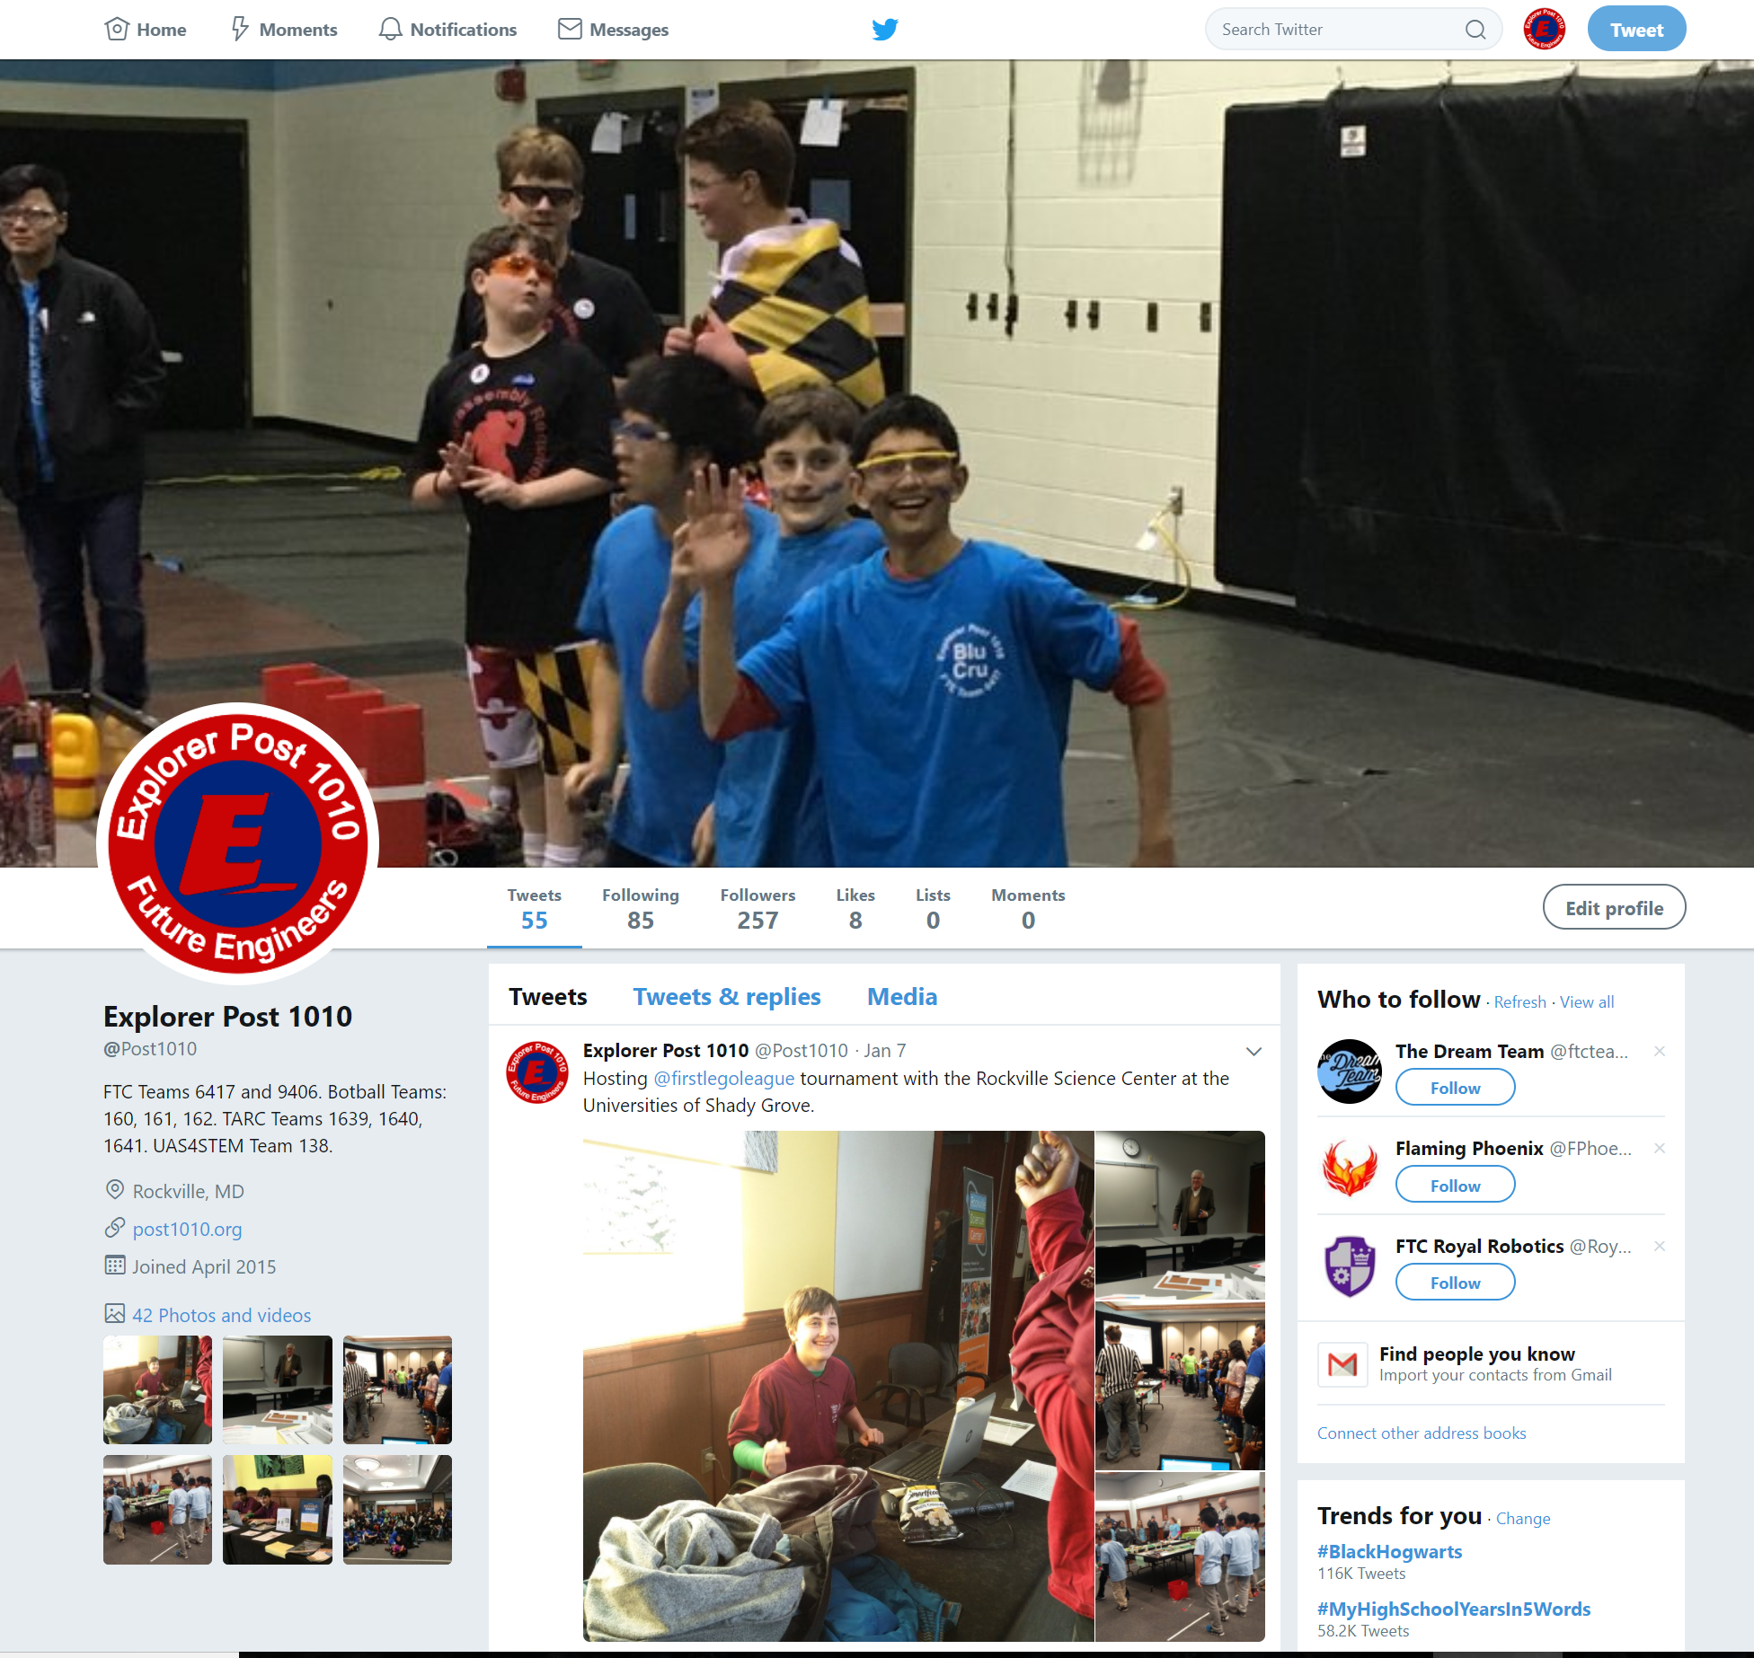
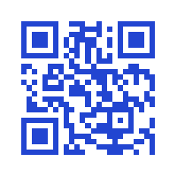
Find us on Social Media!!!
For More Updates Check Our Website- http://post1010.org
Twitter/Facebook -Explorer Post 1010 @post1010
Scan Our QR code

Slide 20


Slide 21


