Slide 1
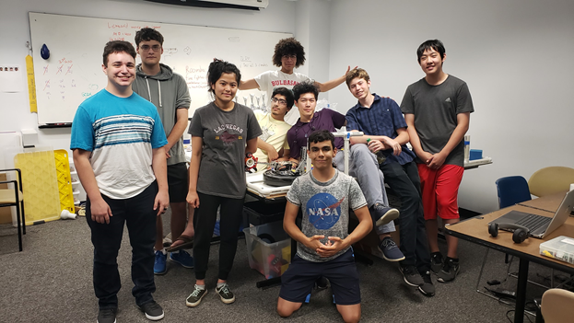
Explorer Post 1010
Team 0160

Slide 2
Team Knowledge

Slide 3
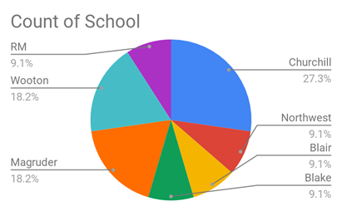
Structure and Organization
Demographics
Schools:
Gender Split:
Boys: 10 (91%) Girls: 1 (9%)
Grade Levels:
9th: 2 10th: 3 11th: 5 12th: 1

Slide 4
Structure and Organization
Meetings
Location: Johns Hopkins - Potomac MD (non-school based team)
During School:
Monday: 6-9 PM
Wednesday: 6-9 PM
Saturday: 10 AM-4 PM
During the Summer:
Monday: 3-7 PM
Wednesday: 3-7 PM
Friday: 3-7 PM

Slide 5
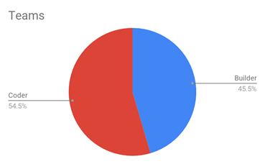
Structure and Organization
Team Roles
- Team Captain (elected) delegates work and strategizes
- Builders are assigned to build and improve robots
- Coders are assigned to a robot and focus on designing the robot path
--
For our 2 robots, coders and builders were evenly spread out

Slide 6
Learning Goals
Learn to write efficient and clean programs
Develop sturdy and simple designs that are easily implemented
Cultivate ability to work as a team
----
Over the building period, the goals were generally completed - we worked very well together and although our robots were not as “simple” as originally planned, they turned out well.

Slide 7
Division of Labor and Conflict
paired experienced members with new ones
individuals were taught in their area of interest
example of conflict: deciding on a strategy for the robots.
coders and builders tried to decide on a solution that would be easy for both to implement
pros and cons of each idea
everyone votes - in case of a tie, captain has final say

Slide 8
Project Iteration

Slide 9
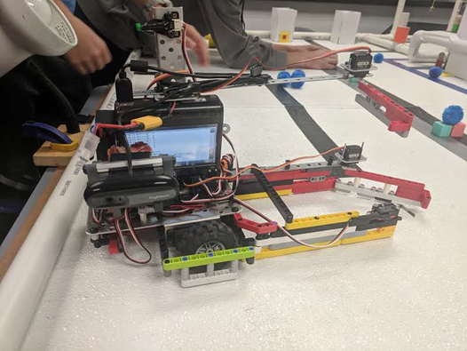
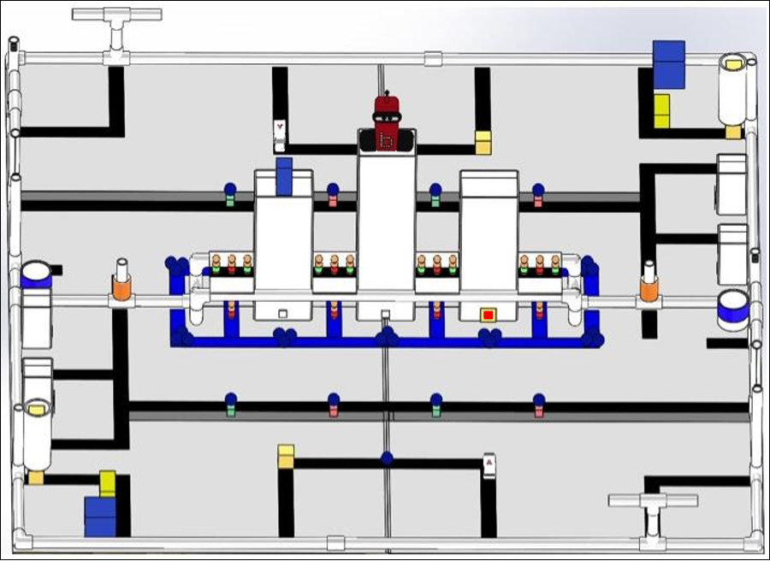
Initial Strategy
Get the pawns from the flood and bridges to the hospital
Design: a container with a mini-servo claw on the top and bottom, using camera to find people and burning buildings
Pseudocode:
- Take path shown using black lines (red)
- Use camera to detect red people and collect (blue)
- Go to medical center to release people (green)

Slide 10
Mid-Season Strategy
Get the pawns from the flood and bridges to the hospital (the same) + use center container to get green people to safe zone (more points)
Design changes: center container for green people
micro servos were unreliable, so we switched to using gear ratio and a long claw instead
Camera was unreliable, so we switched to a depth sensor to get to the people instead
Code development:
Most code for pathing was complete and consistent
code had to be changed to implement depth sensor
code had to be added to move to safe zone to drop more people

Slide 11
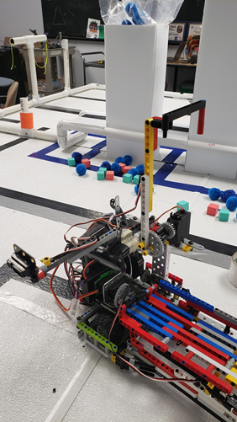
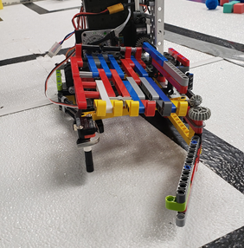
Mid-Season Strategy
Design changes: center container for green people (red)
micro servos were unreliable, so we switched to using gear ratio (blue) and a long claw (green) instead
Camera was unreliable, so we switched to a depth sensor (purple) to get to the people instead

Slide 12
Final Strategy
Get the pawns from the flood and bridges to the hospital
DO NOT use center container to get green people to safe zone - too difficult to consistently score more
Design changes: none
Programming status:
Code is consistent and uses many checks to ensure correct pathing

Slide 13
Example Code
// move forward into container
double t = seconds() + 1.5;
while(seconds() < t ){
if(digital(frontB)) { // if button hits wall
mav(leftMotor, -powerL);
mav(rightMotor, -powerL); // back up
msleep(600);
mav(leftMotor, -midPowerL); // turn
mav(rightMotor, 0);
msleep(200);
t +=1.4; // make up for time lost turning
} else {
mav(leftMotor, powerL);
mav(rightMotor, power); // move forward
msleep(10);
}
}

Slide 14
Risks
use of the camera
ineffective due to it having a hard time distinguishing the burning building from people, and also having technical problems.
mitigated by using depth sensor
possibility of claw hitting building
if the robot is inaccurate and hits the building, it can break
mitigated using a button to re-align robot

Slide 15
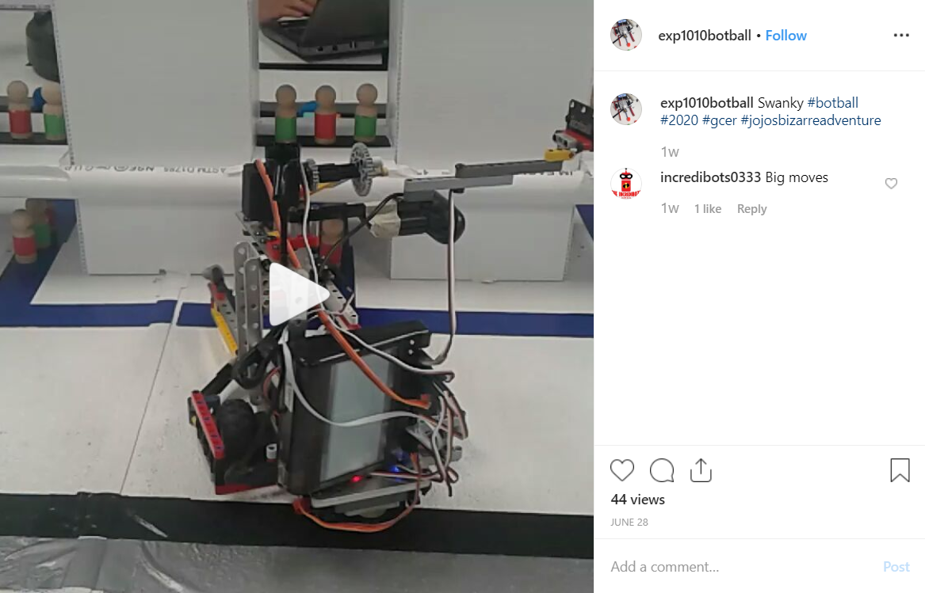
Social Media Impact
We have an Instagram account (@exp1010botball) where we put up test runs and videos of our robot
Our doors are open to anyone who wants to come in and look around
We volunteer at Rockville Science Center

