Slide 1
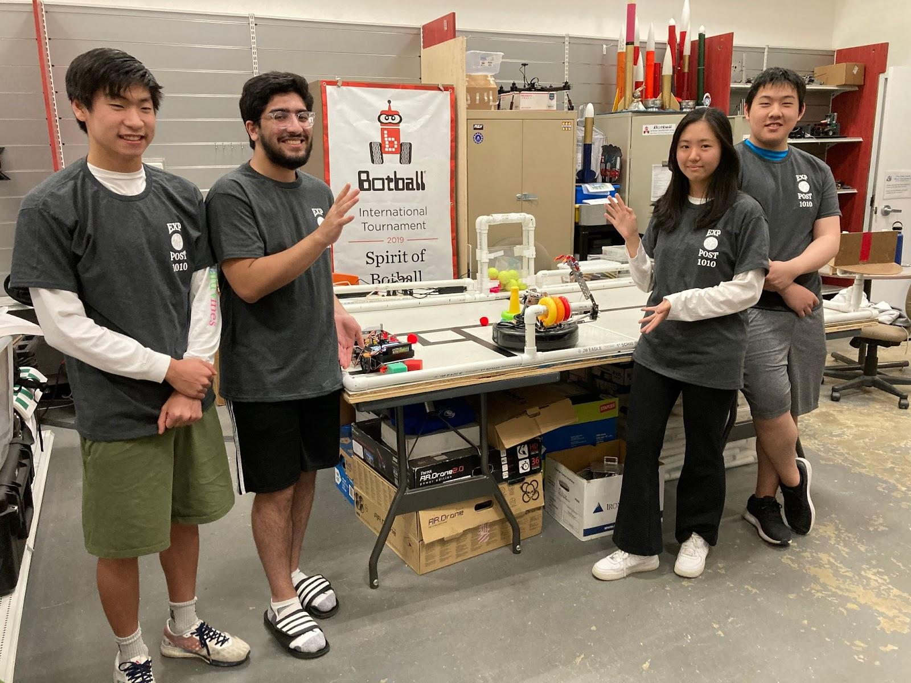
#160

Slide 2
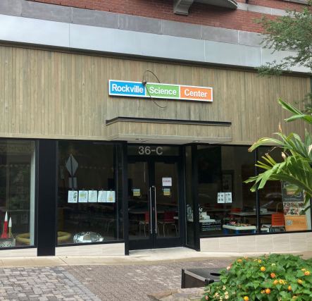
Meetings
Team
Non-school based (extracurricular)
Address
36 Maryland Ave, Rockville, MD 20850
Mon
Tue
Wed
Thu
Fri
Sat
Sun
6-9 pm
—
6-9 pm
—
—
10-1 pm
—
Notes:
dami

Slide 3
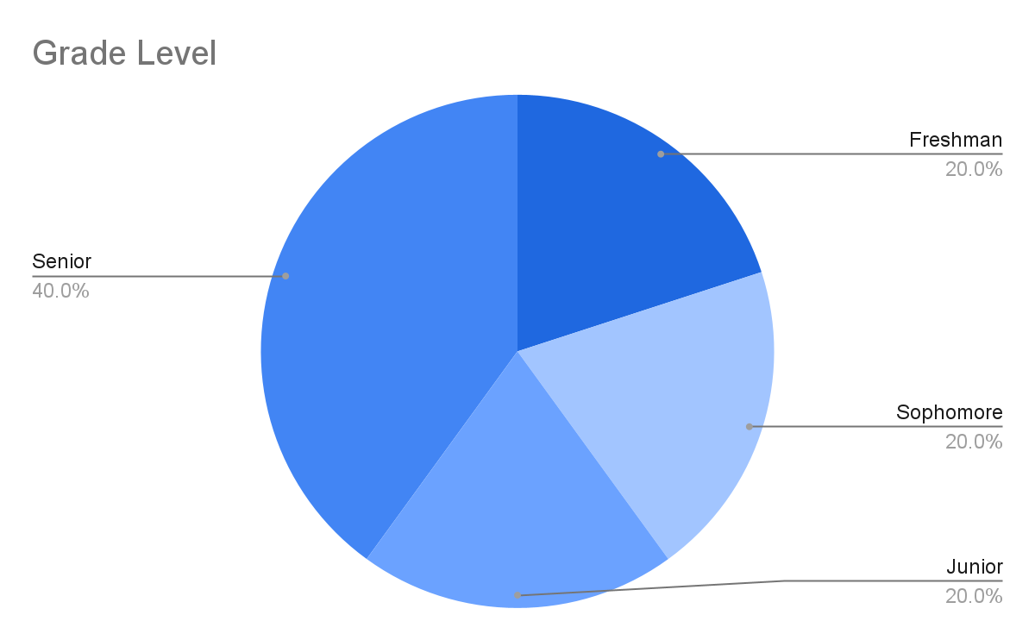
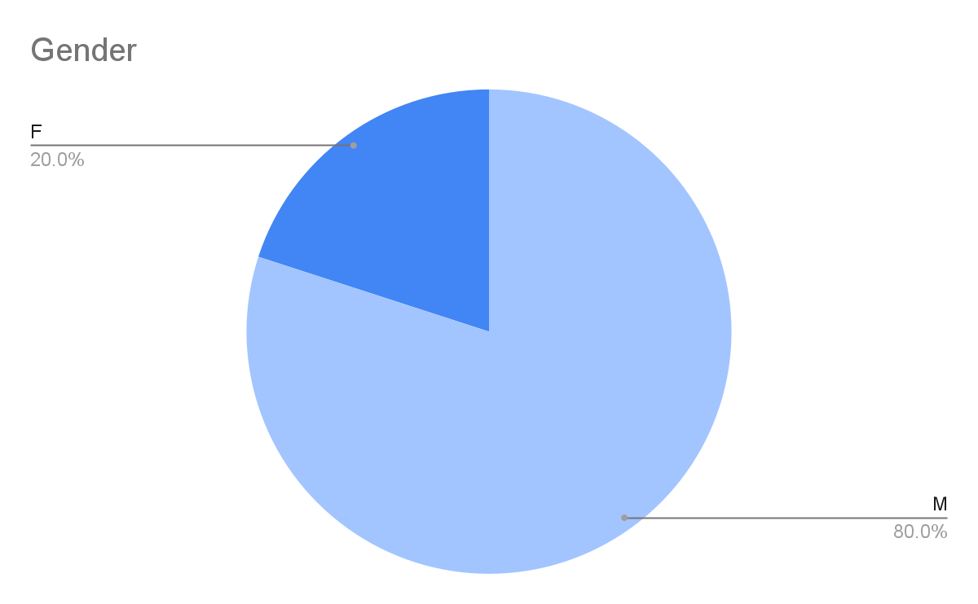
Demographics
Notes:
Here are our demographics

Slide 4
Team Organization
Builders
Build mechanisms and manage robots
Team Captain
Delegates work and strategizes
Coders
Code/test robots
Notes:
Our team is divided into 3 main subgroups

Slide 5
Learning Goals
Develop and implement effective designs
Devise an overall
strategy for the game
Build prototypes
and improve upon them
Cultivate ability
to work as a team
Notes:
These are our long standing goals that are maintained throughout the season because they work well for us to work as a team
Mention: each division (builders and coders) have specific goals to achieve
Team captain and new members work on documents to familiarize w/ botball

Slide 6
Resolving Conflicts
Ex. When we have conflicting designs/strategies
Discussion & Majority Rule
Notes:
When it comes to resolving conflicts, such as when we have conflicting designs, we take a simple majority so that everyone on the team has a say in the process.
But before we do a majority vote, we always discuss the different options/opinions we have to ensure we are able to hear everyone’s reasoning. Communication is a key value of our team.

Slide 7
Project Iteration
1
3
Concept
Discuss and decide
on a base design
Refining
Improve mechanisms, ensure there are no interferences
2
4
Prototype
Build skeleton, attach mechanisms, write basic code
Testing
Optimize code, ensure consistency

Slide 8
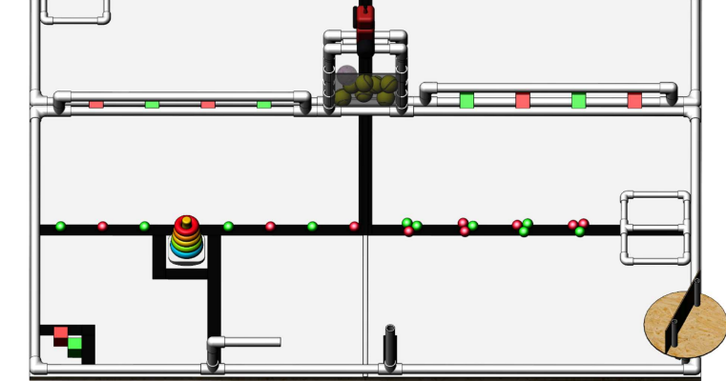
Initial Game Strategy
Roomba Bot
Get 3 rings onto horizontal electrophoresis
Bulldozer Bot
2
Push/scoop poms into the transporter and drag everything to starting box
1

Slide 9
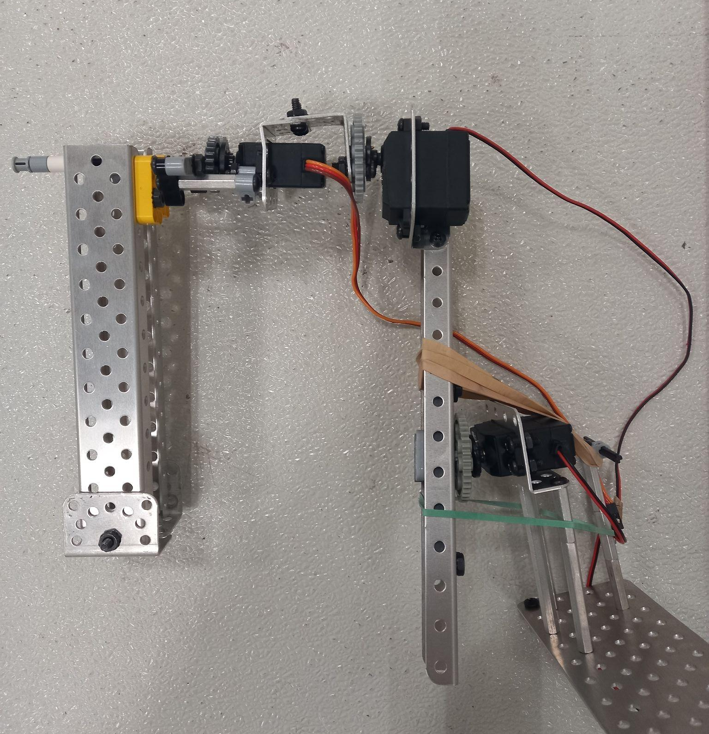
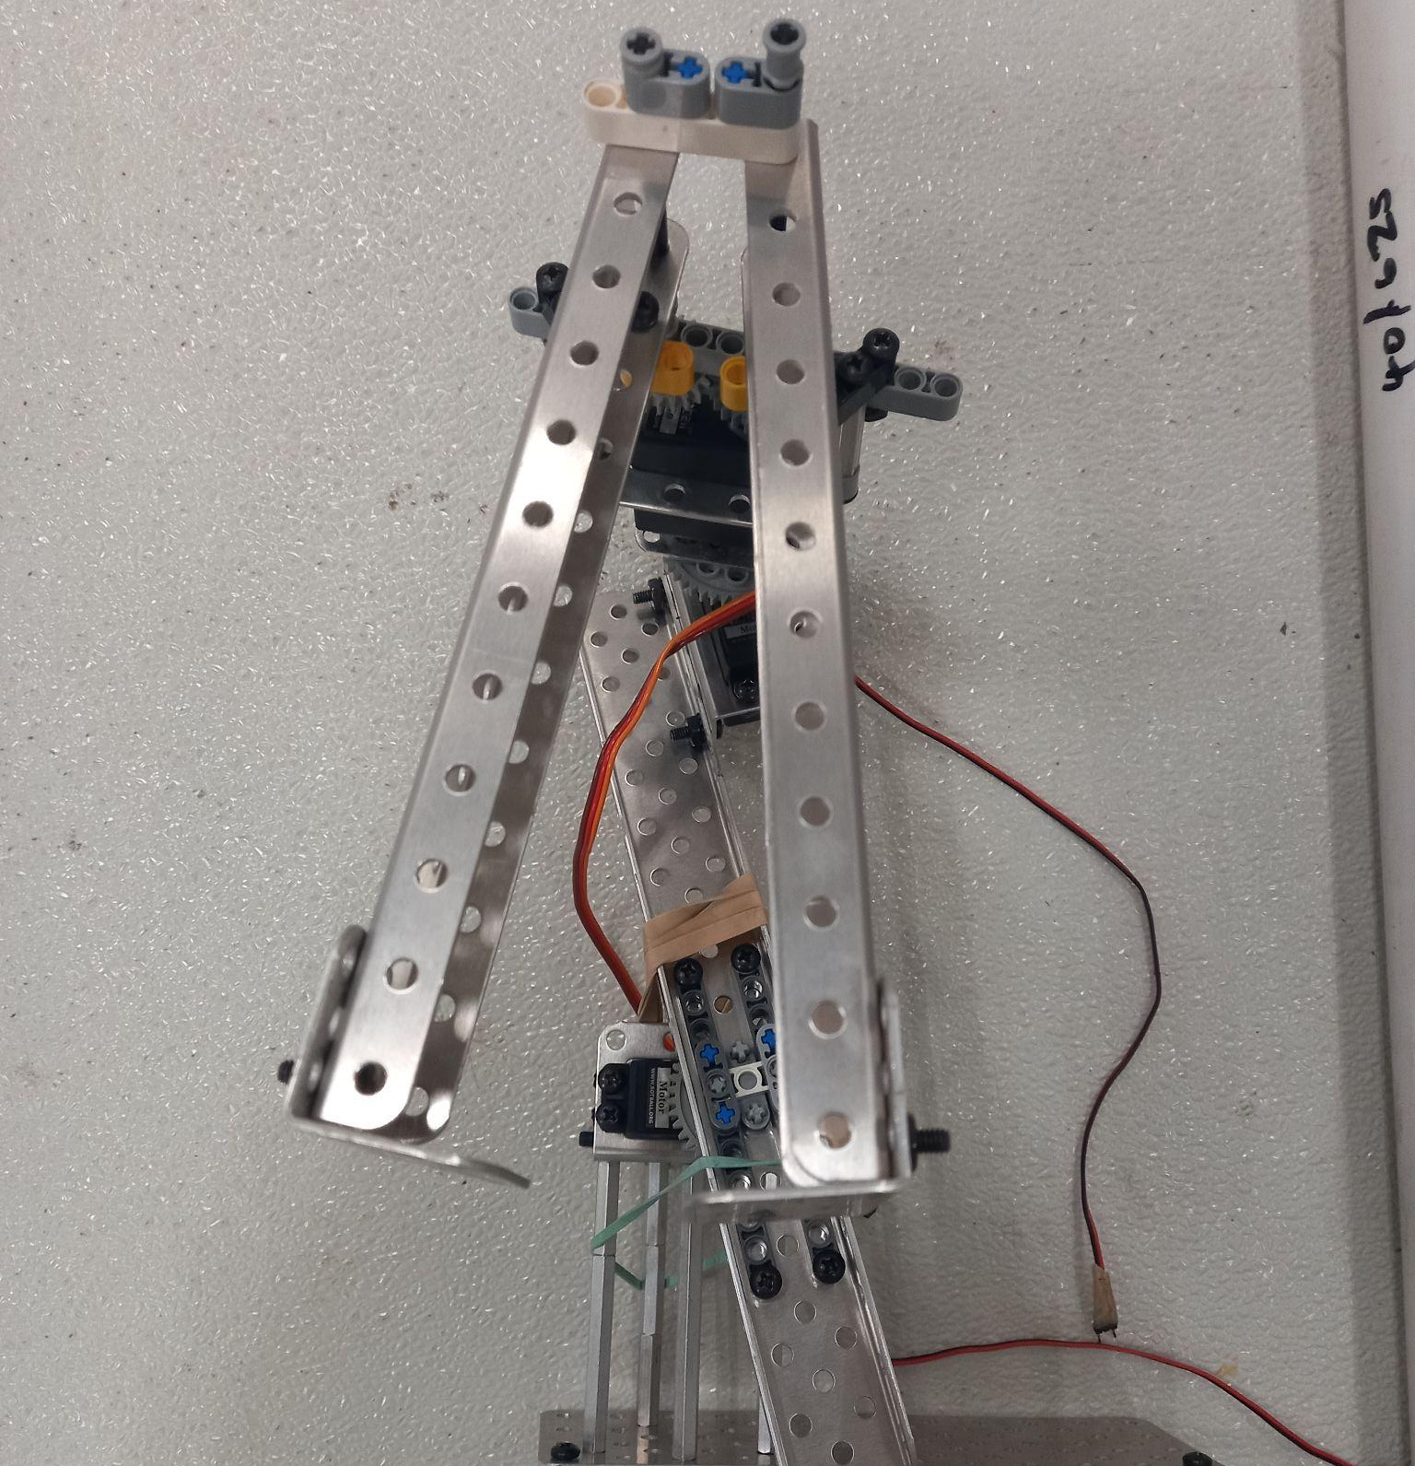
Initial Design
Servo
Motor
Claw
Motor
Notes:
Claw with 2 motors, 1 servo attached to roomba (unstable)
Little to no support
No support for rings (so they fell out easily, could not grab well enough)
Use paper for the bulldozer bot's scoop

Slide 10
Initial Pseudcode
Roomba Bot
Bulldozer Bot
Initialize
Close claws
Enable servos
Wait for light
Open claw
Drive forward
Close claw
Rotate claw
Rotate 90° to the right
Drive forward
Rotate to the right (to get rings on)
Stop
Initialize
Enable servos
Move servo to ground
Wait for light
Drive forward and find black line
Rotate 90° to the right
Line follow
Servo control (raise arm)
Servo control (lower arm)
Rotate 180°
Line follow
Rotate 90° to the left
Drive forward
Stop
Notes:
Bulldozer Bot: Lower arm, Follow black line and Push poms into transporter, Latch onto transporter and move back to designated transporter position
Roomba Bot: Pick up 3 Rings, Rotate claw and Rotate Roomba, Move to Pipe and Rotate Roomba to pole
Explain line follow

Slide 11
Mid GCER Game Strategy
Roomba Bot
Get 3 rings onto horizontal electrophoresis
Bulldozer Bot
2
Get poms into the transporter
Drag transporter to PCR machine
Release tennis balls
Drag everything to starting box
1
Notes:
Strategy stays the same because 3 rings was the max num we could consistently get (we thought it was risky to try more)
We got most of the poms and were satisfied with how the bulldozer bot ran.

Slide 12
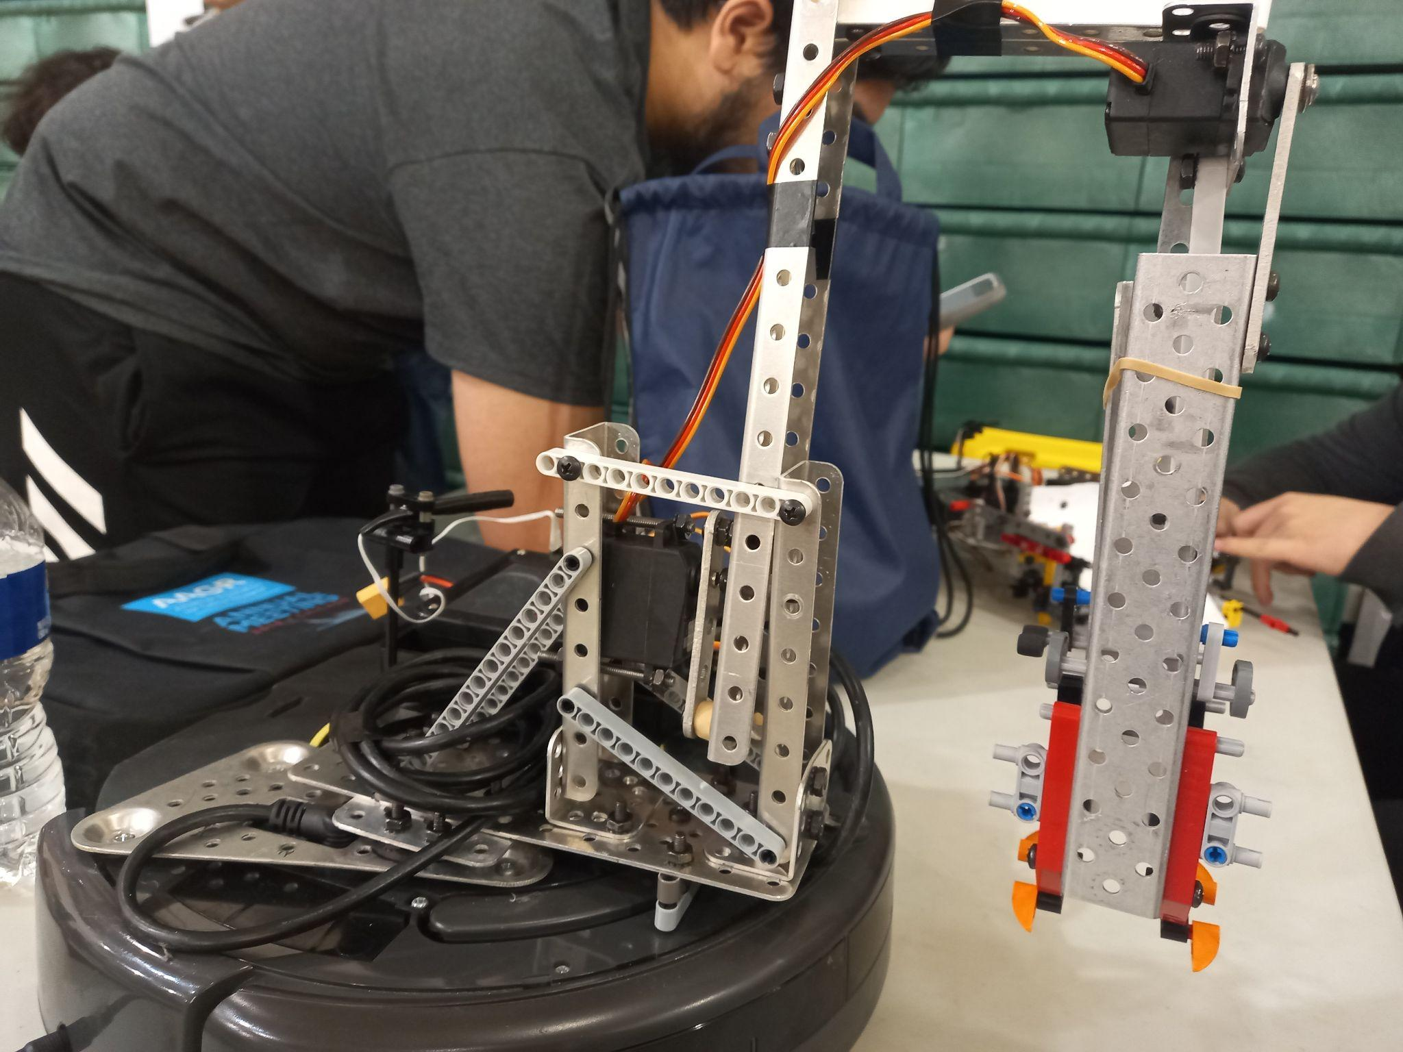
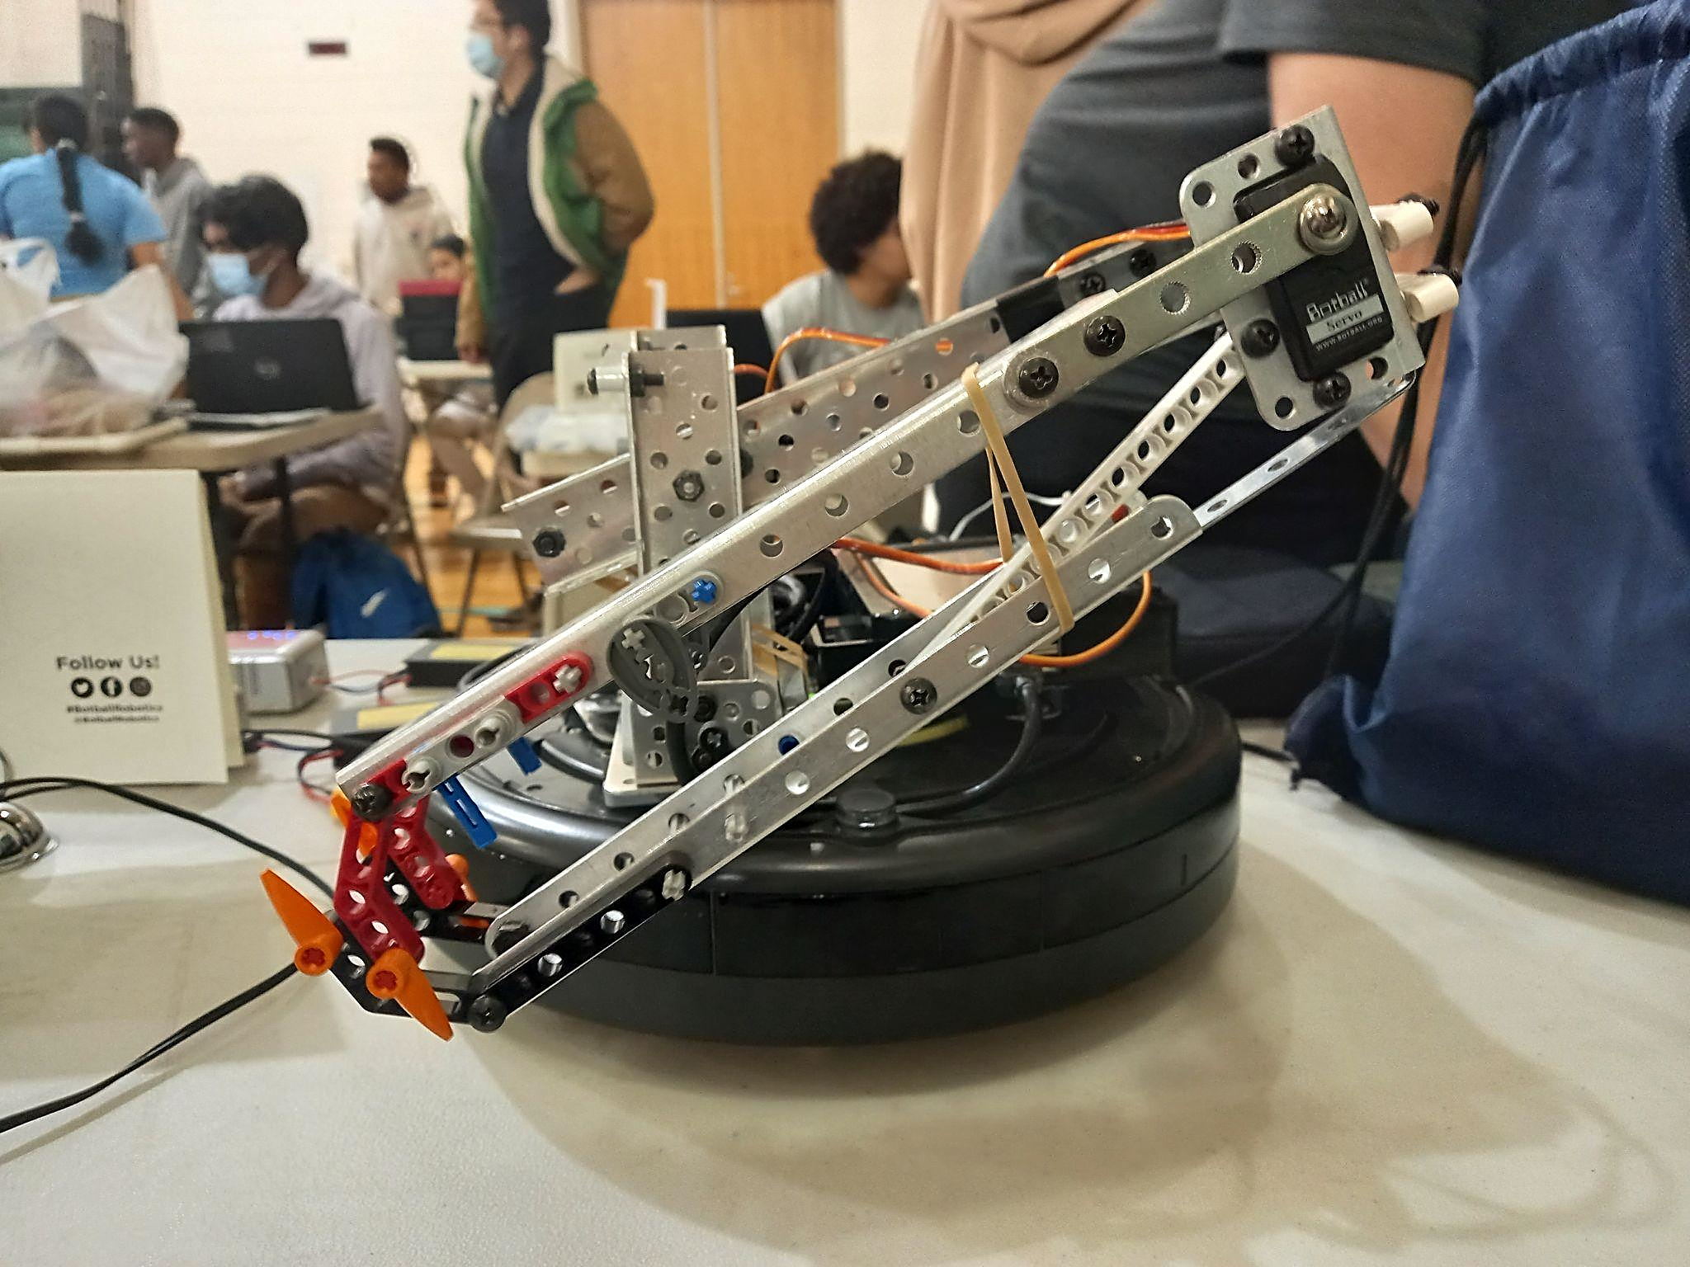
Mid GCER Design
Servo
Servo
Support
Notes:
Reduce servo strain
Bulldozer bot paper attached better (no wrinkles)
Added arm to bulldozer bot to get tennis balls
Changed claw to a more stable design (2 servos)

Slide 13
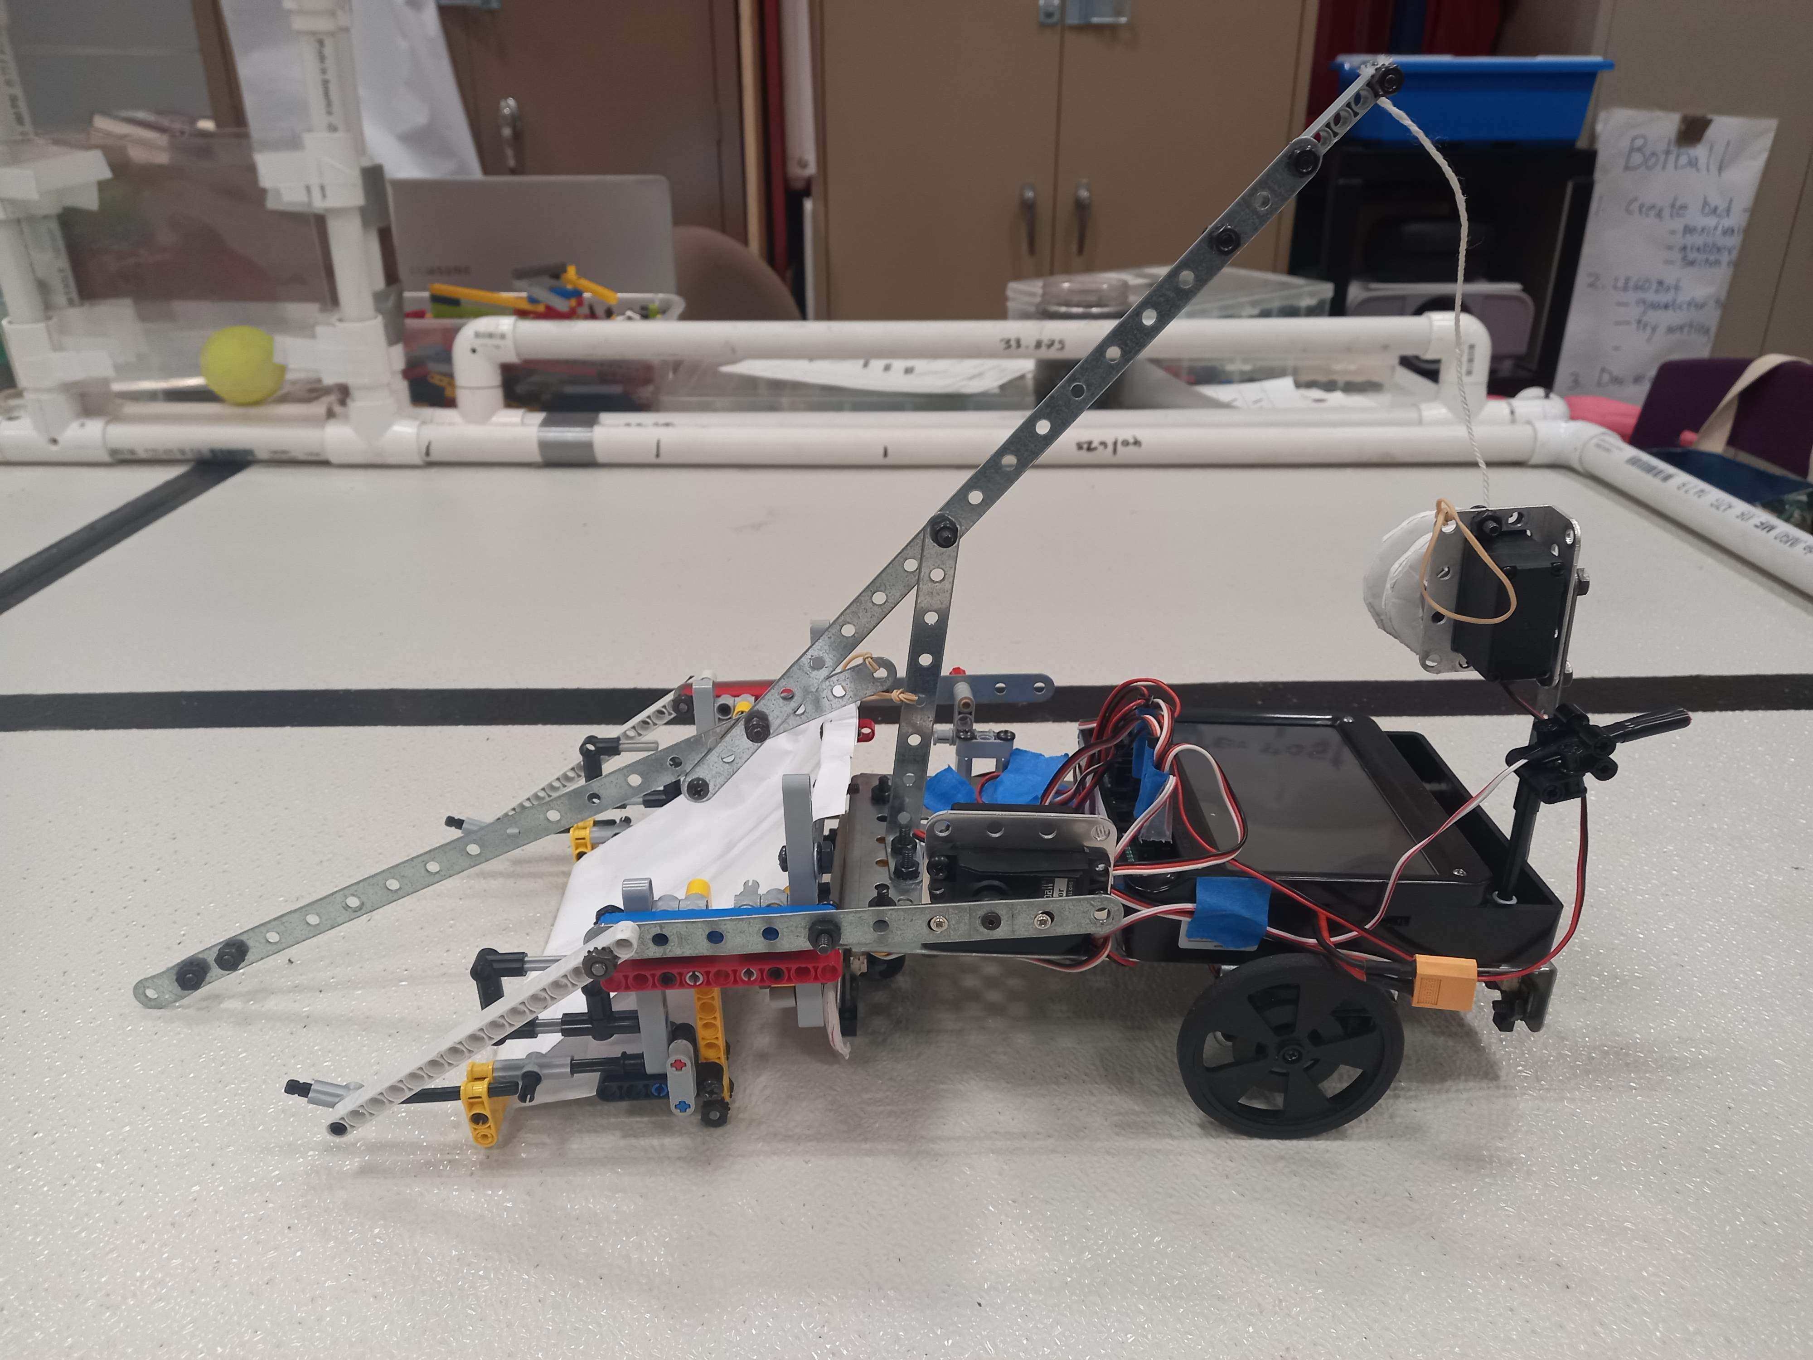
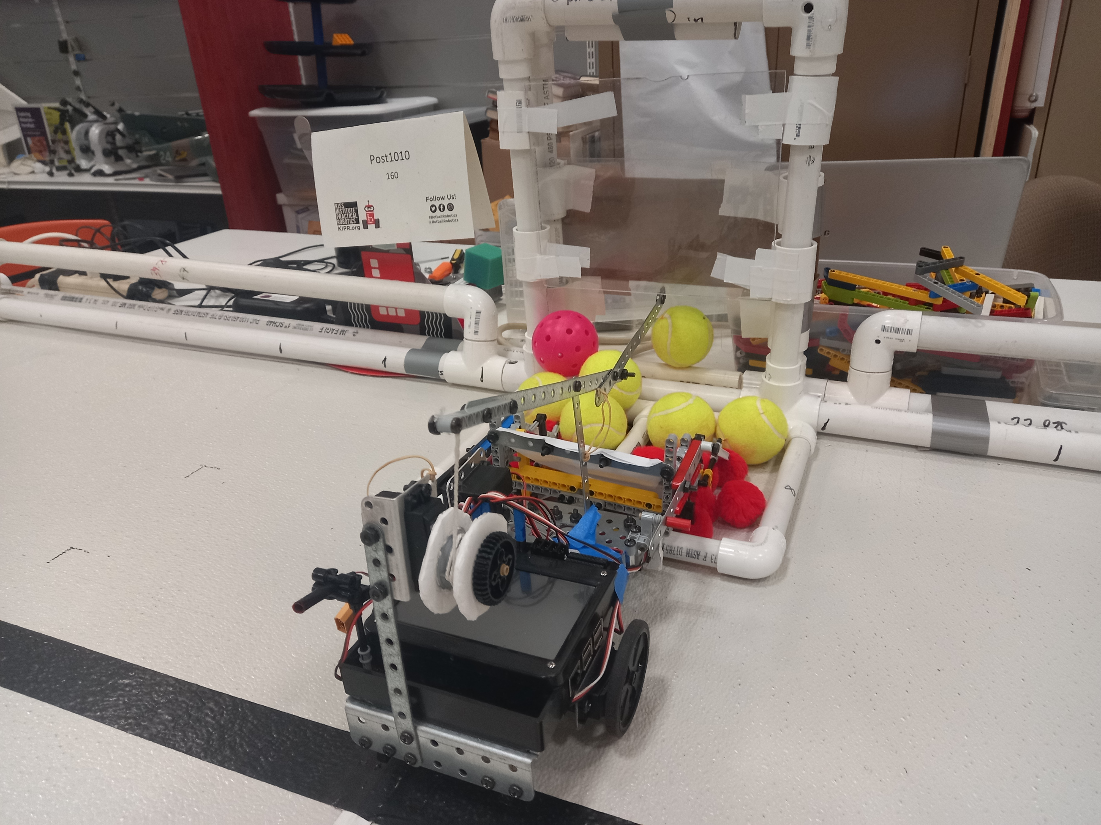
Mid GCER Design
Arm
Motor
Support
Notes:
Added an arm to open PCR machine
Added more supports to the lift so that poms don’t fall out easily
Arm foldable so that robot fits the size parameter (limit)
String mechanism that lowers and elevates the arm

Slide 14
Mid GCER Code
Roomba Bot
def main():
#Roomba Setup
• • •
# Back align with wall
back_align()
# Move claw into operating position
straighten_claw()
claw_open()
# Set Roomba to Claw Position
drive_towards_rings()
# Reduce extraneous momentum
stop(50)
# Tighten claw around rings
claw_tighten()
# Rotate claw and Roomba to remove rings
left_rotate_servo()
# Align Roomba to rotation position
drive_toward_cylinder()
Notes:
Issue: angle had to be really precise, claws held on too hard that the bot would sometimes pick up the ring stand too
Solution: added more supports that would grab the rings well, decreased the power when grabbing
Set claw to starting position
Move forward
Enable servos and grab 3 rings
Move entire claw 90 d counter-clockwise
Turn 90 d to the right
Move forward
Rotate to get rings onto the horizontal electrophoresis
Disable

Slide 15
Mid GCER Code
Bulldozer Bot
def main():
# Align bot on line
go_to_black(100, 100)
move(100, 0, 1400)
# Black line follow
line_follow(20500)
# Going to middle of game board
• • •
# Rotate 90d to the left
move(-25, 25, 3450)
stop(100)
# Releasing tennis balls
# Rotate 90d to the left
move(-50, 50, 1200)
while(KIPR.analog(TOPH_RIGHT) > BLACK):
move(0, 25)
stop(500)
line_follow(8000)
def line_follow (time, sensor=TOPH_LEFT):
end_time = KIPR.seconds() + time
while (KIPR.seconds() < end_time):
if (KIPR.analog(sensor) > BLACK):
if (sensor == TOPH_LEFT):
move(37, 50)
else:
move(50, 37)
else:
if (sensor == TOPH_LEFT):
move(50, 37)
else:
move(37, 50)
Notes:
Issue: There was a bump right at the PCR machine which made it hard for the bot to turn the transporter (it got stuck)
Solution: We increased the speed when rotating
New Issue: A lot of poms fell out
Elevate lift
Move forward
Turn 90 d to the right and line follow
Line follow for a specific time
Back off slightly
Enable servo and lift scoop
Jitter the scoop
Lower scoop and secure the transporter
Drag transporter while moving back and forth to keep poms falling out
Turn 90 d left
Lower lift
Move slightly forward
Elevate lift
14. Wait
15. Lower lift
16. Back off
17. Rotate 90 d left
18. Move forward
19. Rotate 90 d left
20. Move forward (dragging the transporter and into the starting box)
21. Lift scoop
22. Back up
23. Disable

Slide 16
Final GCER Game Strategy
Roomba Bot
Get 3 rings onto horizontal electrophoresis
Knock Botguy down
Bulldozer Bot
2
Get poms into the transporter
Drag transporter to PCR machine
Release tennis balls
Drag everything to starting box
1
Notes:
Strategy stays the same because 3 rings was the max num we could consistently get (we thought it was risky to try more)
We got most of the poms and were satisfied with how the bulldozer bot ran.

Slide 17
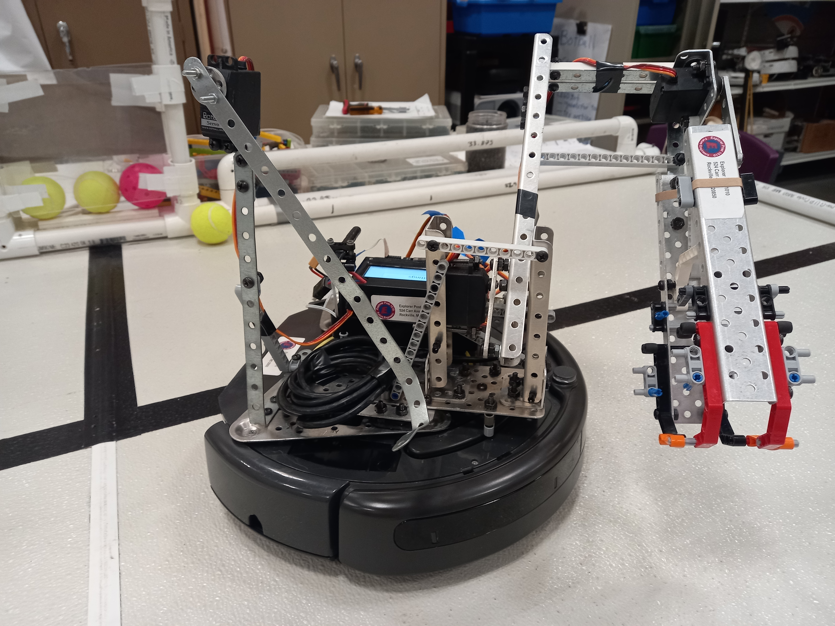
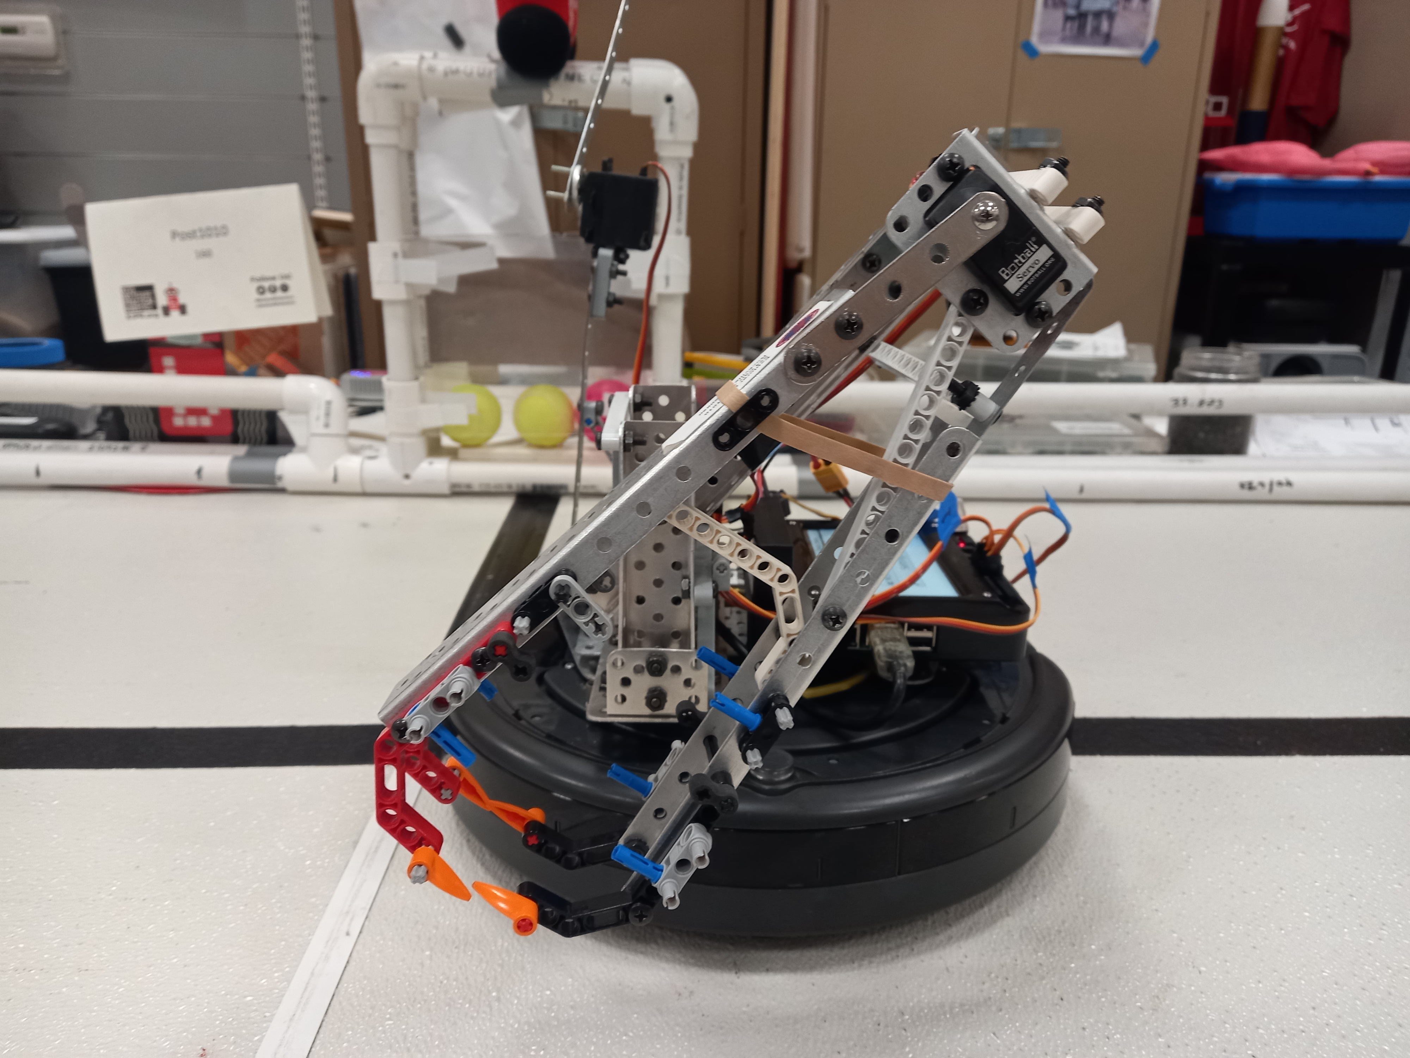
Final GCER Design
Motor
Arm
Notes:
Added an arm to get Botguy

Slide 18
Final GCER Code
Roomba Bot
def drive_backward_to_middlepipe():
drive(-150, -150, 800)
drive(150, -150, 400)
drive(-150, -150, 2800)
drive(-150, 150, 400)
claw_close()
KIPR.msleep(500)
raise_botguy_hook()
drive(-150, -150, 4000)
drive(100, 100, 500)
def main():
• • •
# Release rings
# Wait for other bot for 80 secs
drive_backward_to_middlepipe()
rotate_to_botguy()
Notes:
Had issues with Roomba slipping and angles being slightly off
Gained consistency through back aligning with the pipes that encompassed the game board
Had to wait for Bulldozer bot to move out of the way so had little time to knock down botguy
Set claw to starting position
Back align with the pipe
Move forward
Enable servos and grab 3 rings
Rotate while dragging ring stand
Move entire claw 90 d counter-clockwise (release ring stand which slips out)
Move forward
Rotate
9. Back align with the pipe
10. Slightly move forward
11. Rotate to get rings onto the horizontal electrophoresis
12. Wait for other bot to move out
13. Take an S path
14. Put the arm up
15. Move towards Botguy
16. Rotate to knock Botguy down
17. Disable

Slide 19
Final GCER Code
Bulldozer Bot
def main():
• • •
# Rotate 90d to the right
move(25, -25, 1600)
while(KIPR.analog(TOPH_LEFT) < BLACK):
move(25, -25)
stop(500)
# Back line follow
blf(3000, 30)
def arm_control(position):
KIPR.clear_motor_position_counter(ARM_MOTOR)
while(KIPR.get_motor_position_counter(ARM_MOTOR) > position):
if (position == UP):
KIPR.motor(ARM_MOTOR, 10)
elif (position == DOWN):
KIPR.motor(ARM_MOTOR, -10)
KIPR.off(ARM_MOTOR)
Notes:
We tested many different strategies but it seemed that this one worked the best so we decided to stick with this
Our servo failed and we needed a new wombat but we ran out of time so instead used a motor. Changed the servo code to motor. Used motor step function to calculate angles
Used our sensor when turning 90 degrees to find the line more consistently

Slide 20
Risks
Timing
Clustering
Slip
Timing of the two bots
Friction/clustering of the poms and tennis balls
Roomba slipping, causing angle inconsistency
Notes:
Roomba bot must effectively move rings and ring stand out of the way before the Bulldozer bot comes back to starting box
While transporting the poms to the starting box, friction and clustering of the poms could result in poms falling out of the transporter
Adjusted speed, moved bulldozer to turning
We solved some of the clustering issues by moving the transporter back and forth constantly

Slide 21
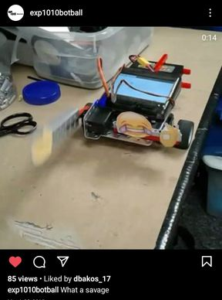
Community Impact
Running our Instagram
account @exp1010botball
Introducing our team to visitors of
the Rockville Science Center
Volunteering during the Science Center
events (Rockville Science Day)
Helping out FLL Teams
Notes:
junwoo

Slide 22
Thank You
Explorer Post 1010

