Slide 1
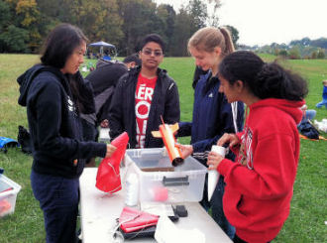
Explorer Post 1010 TARC Team 14212
Samantha Steckel
Mughil Muthupari Aparna Natarajan
Julia Roh

Slide 2
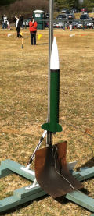
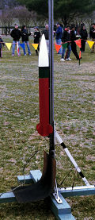
Design and Construction Process
We used OpenRocket to design our rocket.
We used the same simple booster design from last year.
Used dremels, saws, sanders, and manpower to construct our rocket.
We used a round fin design.
When our rocket was damaged by a tree, we had to use our backup rocket

Slide 3
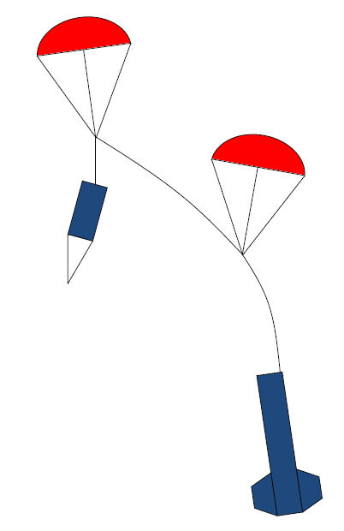
Design and Construction Process
We tried several parachute designs, connecting two chutes at different places.
We tried 12 inch chutes, but then switched to 15 inch chutes
Initially we used an E20-7W single use motor, but didn’t get high enough.
Putting in past experience and the weight, we selected our E28-7T motor.
We had to the learn to assemble the reloadable motor.

Slide 4
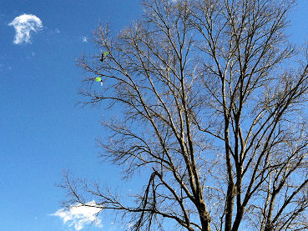
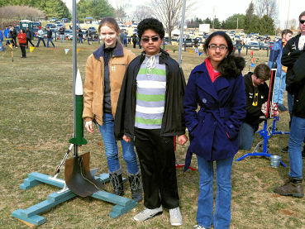
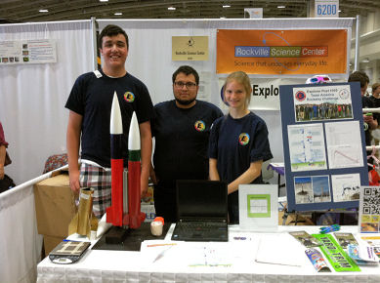
Teamwork
We each put in our own individual input to making the fins and building the body.
We each contributed to the laborious process of sanding.
For the design of the rocket to be cohesive, we all coordinated our ideas and attended all the launches.
Recovery from a tree took some special skills.
Demonstrated rockets at USA Science & Engineering Festival

Slide 5
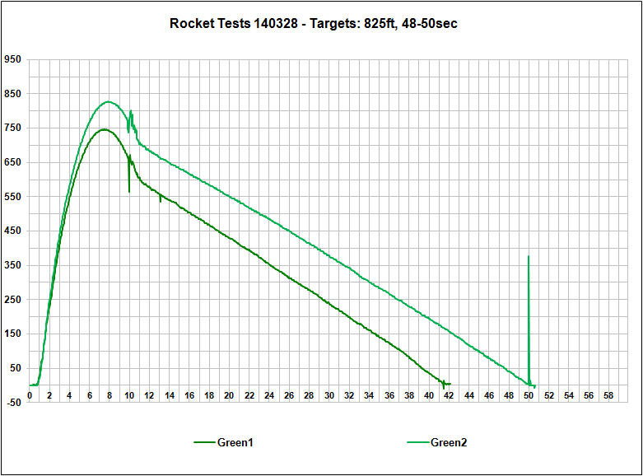
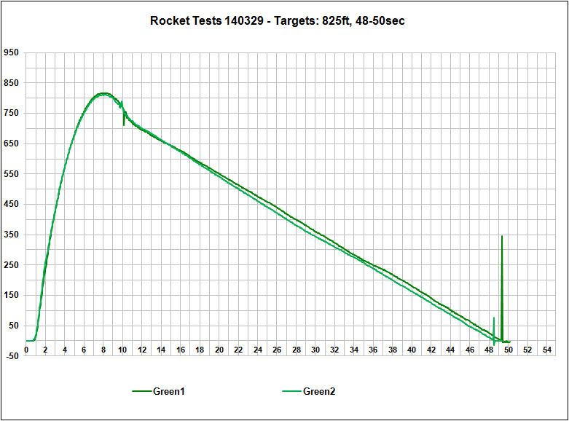
Flight Testing Process
Our flight altitudes were too high, we adjusted the weight of our rocket (about one gram for three feet)
We tested, and repeated the process until scores improved.
We plotted the altimeter data and reviewed the results at meetings the following week.

Slide 6
Lessons Learned
We learned that lot number for engines is very important.
3 launches done with engines from the same lot showed consistent data across them.
Date | Rocket | Engine | Rail | Recovery | Weight | Results | Comments
12/28/13 | Green flight 2 | E28-7T | 7ft 5d | 2-15" Round | 415g | 826ft,
 | Team 14212 |  |  |  |  | 52sec
2/17/14 | Green flight 1 | E28-7T | 7ft 0d | 2-15" Round | 421g | 831ft,
 | Team 14212 |  |  |  |  | 46ec
2/17/14 | Green flight 2 | E28-7T | 7ft 0d | 2-15" Round | 423g | 822ft, | Qualification Score: 21.64
 | Team 14212 |  |  |  |  | 43.34sec
3/15/14 | Green flight 1 | E28-7T | 7ft 6d | 2-15" Round | 419g | 788ft,
 | Team 14212 |  |  |  |  | 47ec
3/15/14 | Green flight 2 | E28-7T | 7ft 6d | 2-15" Round | 417g | 772ft,
 | Team 14212 |  |  |  |  | 34.92sec
3/28/14 | Green flight 1 | E28-7T | 7ft 3d | 2-15" Round | 408g | 745ft,
 | Team 14212 |  |  |  |  | 42ec
3/28/14 | Green flight 2 | E28-7T | 7ft 3d | 2-15" Round | 406g | 826ft,
 | Team 14212 |  |  |  |  | 50sec
3/29/14 | Green flight 1 | E28-7T | 7ft 0d | 2-15" Round | 405g | 816ft, | Qualification Score: 9.0
 | Team 14212 |  |  |  |  | 48.235sec
3/29/14 | Green flight 2 | E28-7T | 7ft 0d | 2-15" Round | 406g | 810ft, | Qualification Score: 17.96
 | Team 14212 |  |  |  |  | 47.26sec
Same lot
Same lot
Same lot

Slide 7
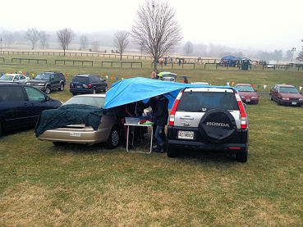
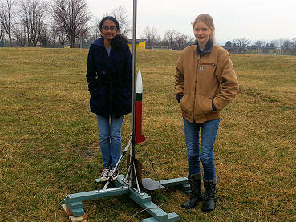
Lessons Learned
We kept a close eye on weather patterns.
There seemed to be less wind when we launched early.

